Slide 1
Medical Laboratory Instrumentation
2010-2011
Third Year
Dr Fadhl Alakwa
www.Fadhl-alakwa.weebly.com
UST-Yemen
Biomedical Department

Slide 2
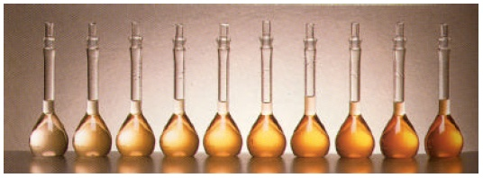
Light Transmission Dependence on Concentration
Beer’s Law

Slide 3
The Beer-Bouguer-Lambert Law

Slide 4
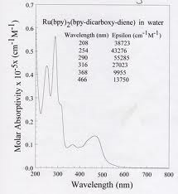
molecular absorptivity distribution curve
ALSO See Figure 3-5 Page 81

Slide 5
STEPS IN DEVELOPING A SPECTROPHOTOMETRIC ANALYTICAL METHOD
Run the sample for spectrum
2. Obtain a monochromatic wavelength for the maximum absorption wavelength.
3. Calculate the concentration of your sample using Beer Lambert Equation: A = KCL

Slide 6
There is some A vs. C where graph is linear.
NEVER extrapolate beyond point known where becomes non-linear.

Slide 7
SPECTROMETRIC ANALYSIS USING STANDARD CURVE
Avoid very high or low absorbencies when drawing a standard curve. The best results are obtained with 0.1 < A < 1. Plot the Absorbance vs. Concentration to get a straight line

Slide 8

Every instrument has a useful range for a particular analyte.
Often, you must determine that range experimentally.
This is done by making a dilution series of the known solution.
These dilutions are used to make a working curve.

Slide 9
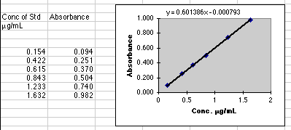
Make a dilution series of a known quantity of analyte and measure the Absorbance. Plot concentrations v. Absorbance.

Slide 10
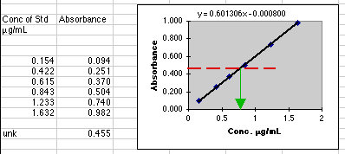
What concentration do you think the unknown sample is?

Slide 11
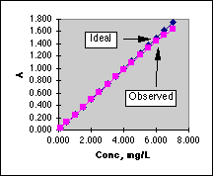
In this graph, values above A=1.0 are not linear. If we use readings above A=1.0, graph isn’t accurate.

Slide 12
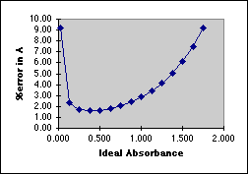
The best range of this spectrophotometer is A=0.1 to A=1.0, because of lower errors. A=0.4 is best.

Slide 13
Relating Absorbance and Transmittance
Absorbance rises linearly with concentration. Absorbance is measured in units.
Transmittance decreases in a non-linear fashion.
Transmittance is measured as a %.
Absorbance = log10
  (100/% transmittance)

Slide 14
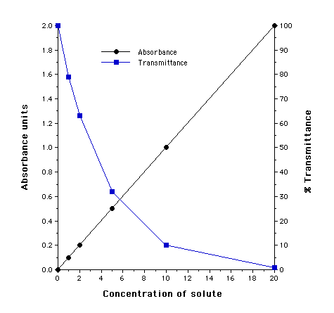

Slide 15
Conventional Spectrophotometer
Schematic of a conventional single-beam spectrophotometer

Slide 16
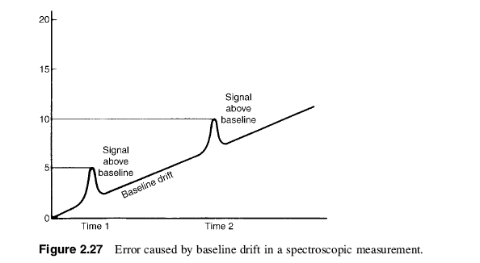
Drift
When single-beam optics are used, any variation in the intensity of the source while measurements are being made may lead to analytical errors.
Slow variation in the average signal (not noise) with time is called drift, displayed in Fig. 2.27.
Drift can cause a direct error in the results obtained. As shown in Fig. 2.27,

Slide 17
Source of drift
There are numerous sources of drift:
The radiation source intensity may change because of line voltage changes, the source warming up after being recently turned on, or the source deteriorating with time.
The monochromator may shift position as a result of vibration or heating and cooling causing expansion and contraction.
The line voltage to the detector may change, or the detector may deteriorate with time and cause a change in response.

Slide 18
the problems associated with drift can be greatly decreased by using a double-beam system
Optical system of a double-beam spectrophotometer

Slide 19
Conventional Spectrophotometer
Optical system of a split-beam spectrophotometer

Slide 20
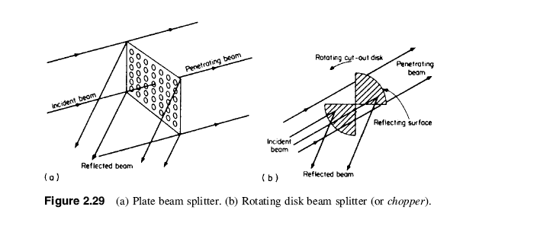
Beam splitter and chopper

Slide 21
Single-Beam and Double-Beam Optics
Using the double-beam system, we can measure the ratio of the reference beam intensity to the sample beam intensity. Because the ratio is used, any variation in the intensity of radiation from the source during measurement does not introduce analytical error.
If there is a drift in the signal, it affects the sample and reference beams equally.
Absorption measurements made using a double-beam system are virtually
independent of drift and therefore more accurate.

Slide 22
Undergraduate Instrumental Analysis
Nuclear Magnetic Resonance Spectroscopy CH3
Infrared Spectroscopy CH4
Visible and Ultraviolet Molecular Spectroscopy CH5
Atomic Absorption Spectrometry CH6
Atomic Emission Spectroscopy CH7
  flame photometer
X-Ray Spectroscopy CH8
Mass Spectrometry CH9 C10

Slide 23
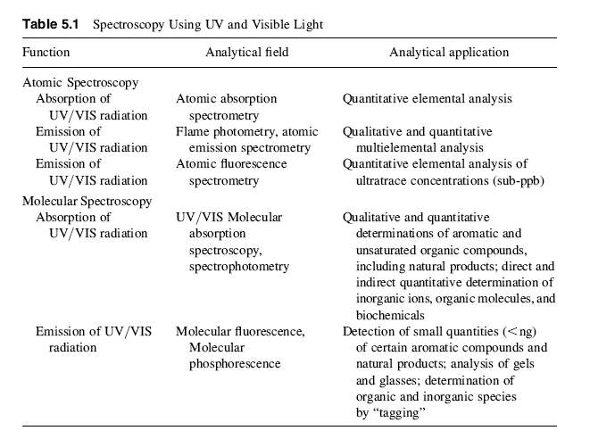
Visible and Ultraviolet Molecular Spectroscopy

Slide 24
UV/VIS Usage
UV/VIS spectrophotometry is a widely used spectroscopic technique. It has found use everywhere in the world for research, clinical analysis, industrial analysis, environmental analysis, and many other applications. Some typical applications of UV absorption spectroscopy include the determination of (1) the concentrations of phenol, nonionic surfactants, sulfate, sulfide, phosphates, fluoride, nitrate, a variety of metal ions, and other chemicals in drinking water in environmental testing; (2) natural products, such as steroids or chlorophyll; (3) dyestuff materials; and (4) vitamins, proteins, DNA, and enzymes in
biochemistry.

Slide 25
UV/VIS Usage
In the medical field, it is used for the determination of enzymes, vitamins, hormones, steroids, alkaloids, and barbiturates.
These measurements are used in the diagnosis of diabetes, kidney damage, and myocardial infarction, among other ailments. In the pharmaceutical industry, it can be used to measure the purity of drugs during manufacture and the purity of the final product. For example, aspirin, ibuprofen, and caffeine, common ingredients in pain relief tablets, all absorb in the UV and can be determined easily by spectrophotometry.

Slide 26
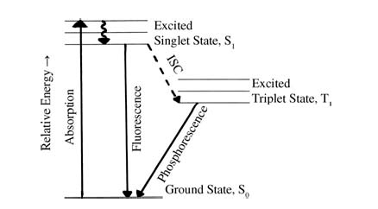
MOLECULAR EMISSION SPECTROMETRY

Slide 27
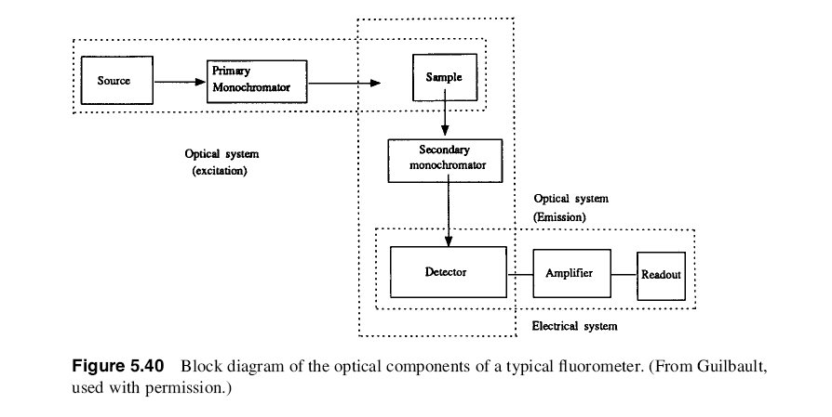
Fluorometer

Slide 28
Fluorometer Application
Fluorometry is used in the analysis of clinical samples, pharmaceuticals, natural products, and environmental samples. There are fluorescence methods for steroids, lipids, proteins, amino acids, enzymes, drugs, inorganic electrolytes, chlorophylls, natural and synthetic pigments, vitamins, and many other types of analytes.

Slide 29
Atomic Absorption Spectrometry
AAS is an elemental analysis technique capable of providing quantitative information on 70 elements in almost any type of sample.
AAS are that no information is obtained on the chemical form of the analyte (no “speciation”) and that often only one element can be etermined at a time.
This last disadvantage makes AAS of very limited use for qualitative analysis.
AAS is used almost exclusively for quantitative analysis of elements, hence the use of the term “spectrometry” in the name of the technique instead of “spectroscopy”.

Slide 30
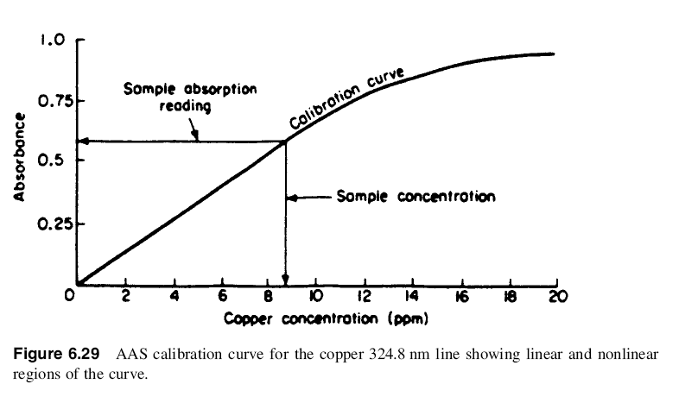

Slide 31
Atomic Emission Spectroscopy
Atomic emission spectroscopy has relied in the past on flames and electrical discharges as excitation sources, but these sources have been overtaken by plasma sources, such as the inductively coupled plasma (ICP) source.
Atomic emission spectroscopy is a multielement technique with the ability to determine metals, metalloids, and some nonmetal elements simultaneously.
The major difference between the various types of atomic emission spectroscopy techniques lies in the source of excitation and the amount of energy imparted to the atoms or ions (i.e., the excitation efficiency of the source).

Slide 32
Photometry: Flame atomic emission spectroscopy
Flame atomic emission spectrometry is particularly useful for the determination of the elements in the first two groups of the periodic table, including sodium, potassium, lithium, calcium, magnesium, strontium, and barium.
The determination of these elements is often called for in medicine, agriculture, and animal science.

Slide 33
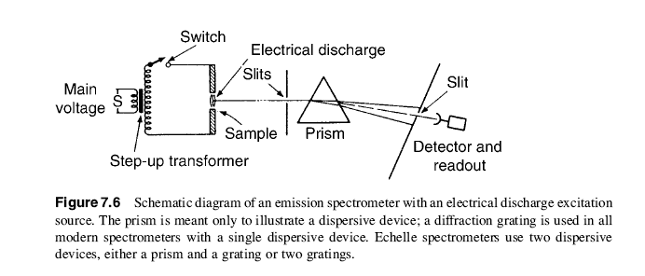
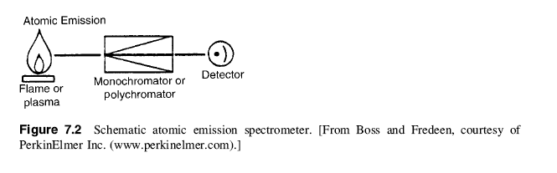

Slide 34
Photometry Application
Flame photometry is used for the quantitative determination of alkaline metals and alkaline-earth metals in blood, serum, and urine in clinical laboratories. It provides much simpler spectra than those found in other types of atomic emission spectrometry, but its sensitivity is much reduced.
sodium, potassium, magnesium and calcium in blood

Slide 35
Many optical instruments share similar design
(1) stable radiation source
(2) transparent sample holder
(3) wavelength selector
(4) radiation detector
(5) signal processor and readout

Slide 36
Light Sources
UV Spectrophotometer
1. Hydrogen Gas Lamp
2. Mercury Lamp
Visible Spectrophotometer
1. Tungsten Lamp
InfraRed (IR) Spectrophotometer
1. Carborundum (SIC)

Slide 37
Cells
UV Spectrophotometer
Quartz (crystalline silica)
Visible Spectrophotometer
Glass
IR Spectrophotometer
NaCl

Slide 38
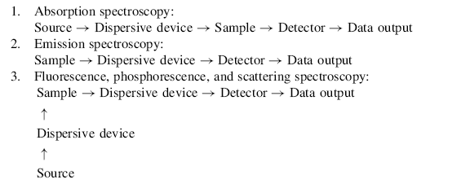
Configuration of the spectroscopy systems

Slide 39
Radiation Source
An ideal radiation source for spectroscopy should have the following characteristics:
1. The source must emit radiation over the entire wavelength range to be studied.
2. The intensity of radiation over the entire wavelength range must be high enough
so that extensive amplification of the signal from the detector can be avoided.
3. The intensity of the source should not vary significantly at different wavelengths.
4. The intensity of the source should not fluctuate over long time intervals.
5. The intensity of the source should not fluctuate over short time intervals. Short time fluctuation in source intensity is called “flicker”.

Slide 40
Most sources will have their intensities change exponentially with changes in voltage, so in all cases a reliable, steady power supply to the radiation source is required. Voltage regulators (also called line conditioners) are available to compensate for variations in incoming voltage.

Slide 41
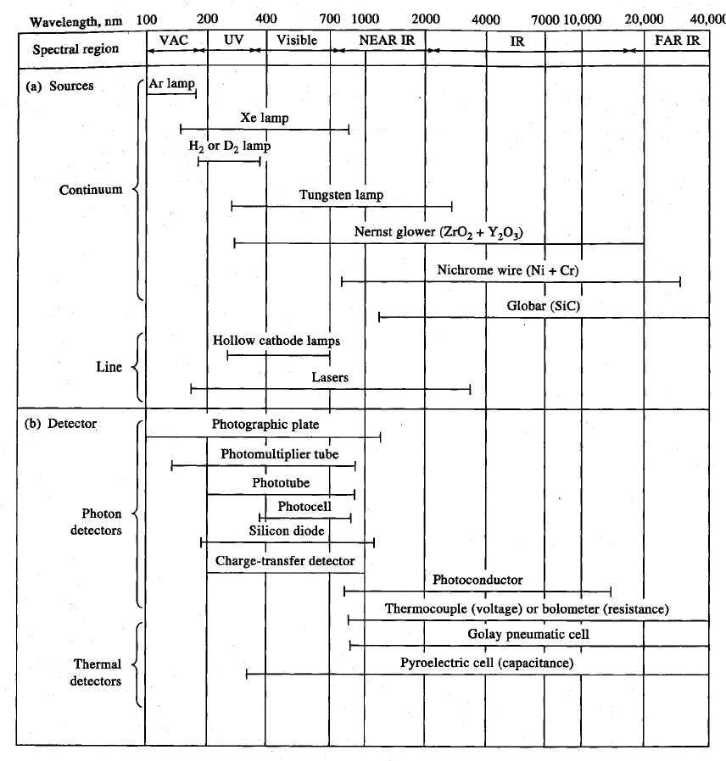
Radiation Source
And Detectors
Fig 7.3

Slide 42
Continuum sources
Continuum sources emit radiation over a wide range of wavelengths and the intensity of emission varies slowly as a function of wavelength.
Typical continuum sources include :
the tungsten filament lamp which produces visible radiation (white light),
the deuteriumlamp for theUVregion,
high pressure mercury or xenon arc lamps for the UV region,
and heated solid ceramics or heated wires for the IR region of the spectrum.
Xenon arc lamps are also used for the visible region.
Continuum sources are used for most molecular absorption and fluorescence spectrometric instruments.

Slide 43
Line sources
Emit only a few discrete wavelengths of light, and the intensity is a strong function of the wavelength.
Typical line sources include:
hollow cathode lamps and
electrodeless discharge lamps, used in the UV and visible regions for AAS and atomic fluorescence spectrometry,
sodium or mercury vapor lamps (similar to the lamps now used in street lamps) for lines in the UV and visible regions, and lasers.
They are used as sources in Raman spectroscopy, molecular and atomic fluorescence spectroscopy.

Slide 44
Wavelength Selection Devices
Filters
  absorption filters Colored glass
  Interference filter
Monochromator
  The entrance slit
  Prisms.
  Diffraction Gratings.

Slide 45
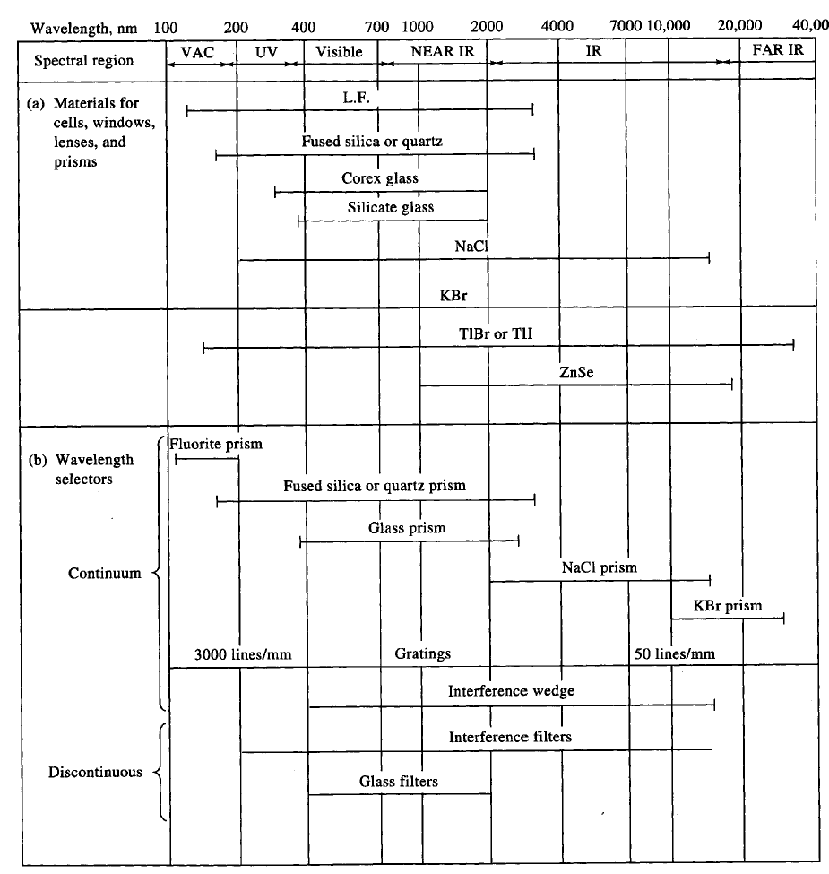
Wavelength selector
Fig 7.2

Slide 46
Colored glass
stable, simple, and cheap,
blue glass transmits blue wavelengths of the visible spectrum but absorbs red and yellow wavelengths.
The range of wavelengths transmitted is broad compared with prisms and gratings which are also devices used to select a narrow wavelength range from a broad band polychromatic source. The transmission range may be 50–300 nm for typical absorption filters.

Slide 47
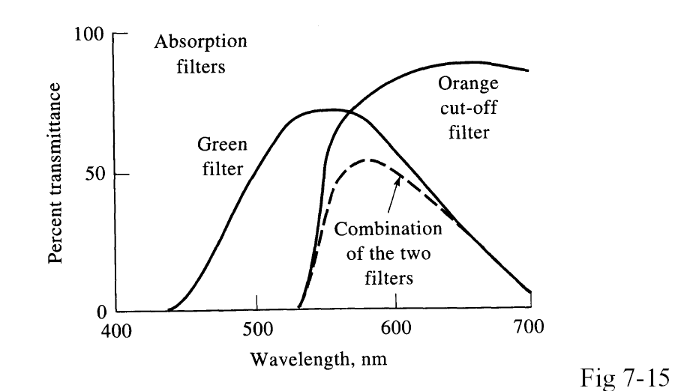

Slide 48
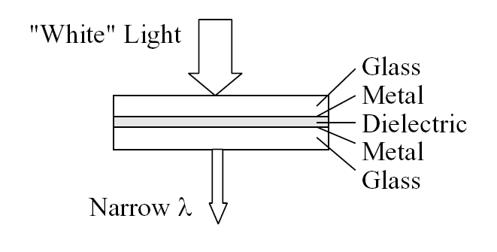
Interference Filter
two thin sheets of metal sandwiched between glass plates, separated by transparent material.
Interference filters can be constructed for transmission of light in the IR, visible, and UV regions of the spectrum.
The wavelength ranges transmitted are much smaller than for absorption filters, generally 1–10 nm, and the amount of light transmitted is generally higher than for absorption filters.

Slide 49
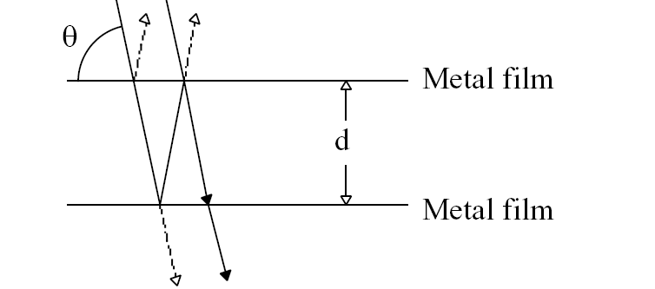
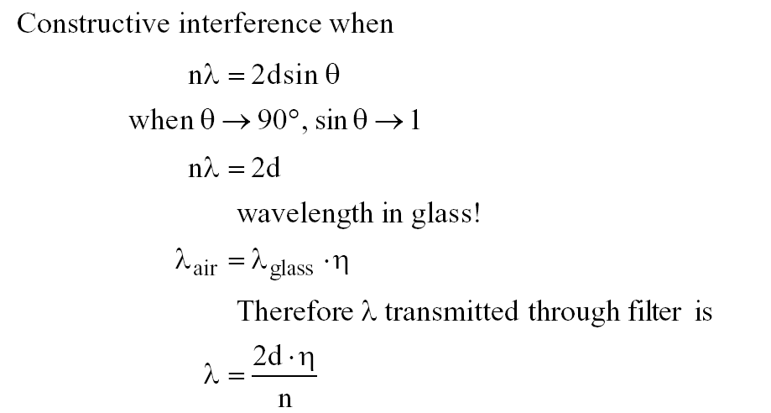
Interference Filter
The filter operates on the principle of constructive interference to transmit selected wavelength ranges. The wavelengths transmitted are controlled by the thickness and refractive index of the center layer of material.
Interference for transmitted wave through 1st layer and reflected from 2nd layer

Slide 50
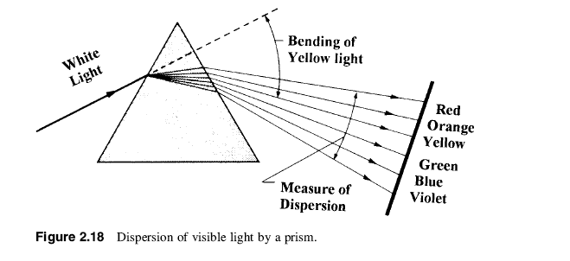
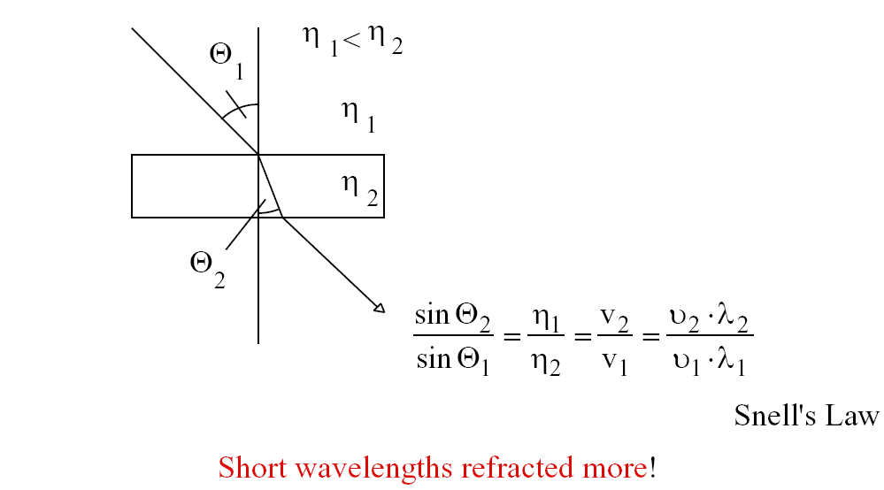
Prisms
Prisms are used to disperse IR, visible, and UV radiation. The most common prisms are constructed of quartz for the UV region, silicate glass for the visible and near-IR region, and NaCl or KBr for the IR region.

Slide 51
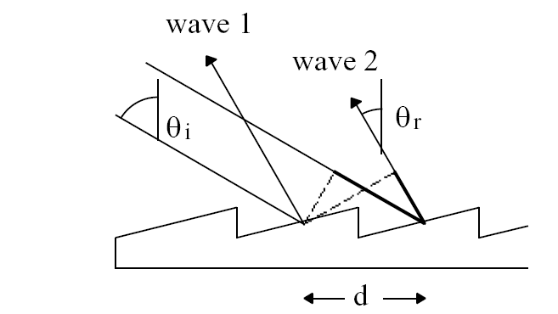

Diffraction Grating (most modern instruments)
UV, visible, and IR radiation can be dispersed by a diffraction grating.
A diffraction grating consists of a series of closely spaced parallel grooves cut (or ruled) into a hard glass, metallic, or ceramic surface.
A grating for use in the UV and visible regions will contain between 500 and 5000 grooves/mm,
while a grating for the IR region will have between 50 and 200 grooves/mm.
d, the distance between grooves
n, the order of diffraction.

Slide 52

Resolution Power
Resolution Required to Separate Two Lines of Different Wavelength.
Ex: in order to observe an absorption band at 599.9 nm without interference from an absorption band at 600.1 nm, we must be able to resolve, or separate, the two bands.
The resolving power R of a monochromator is equal to λ/ dλ, where λ is the average of the wavelengths of the two lines to be resolved and dλ is the difference in wavelength between these lines.

Slide 53

Prism Resolution Power
refractive index of the prism material
t is the thickness of the base of the prism
glass prisms disperse visible light better than quartz prisms.

Slide 54


Resolution of a Grating.
where n is the order and N is the total number of grooves in the grating.
Ex: Suppose that we can obtain a grating with 500 lines/cm. How long a grating would be required to separate the sodium D lines at 589.5 and 589.0 nm in first order?

Slide 55
R=1179=nN
For first order n-1 N=1179 lines
(1179/500) cm long, or 2.358 cm.
Ex2: how many lines per centimeter must be cut on a grating 3.00 cm long to resolve the same sodium D lines?
nN =N =1179
1179 l 3:00 cm= 393 lines/cm

Slide 56
Detectors
There are a number of different types of photon detectors, including the photomultiplier tube, the silicon photodiode, the photovoltaic cell, and a class of multichannel detectors called charge transfer devices.
Charge transfer detectors include photodiode arrays, charge-coupled devices (CCDs), and charge-injection devices (CIDs).
These detectors are used in the UV/VIS and IR regions for both atomic and molecular spectroscopy.

Slide 57
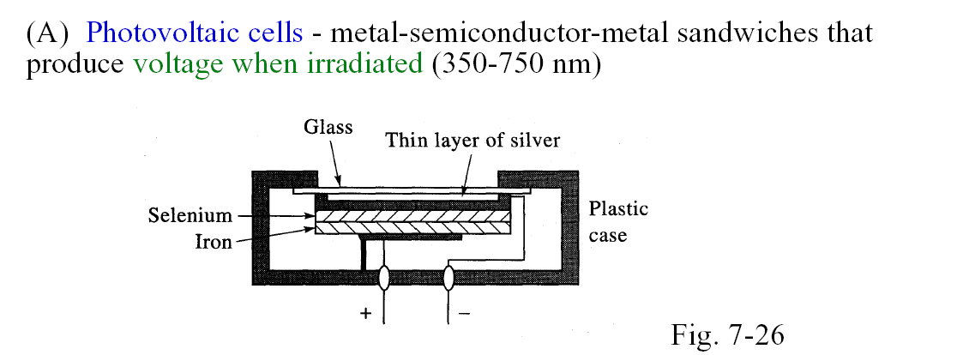
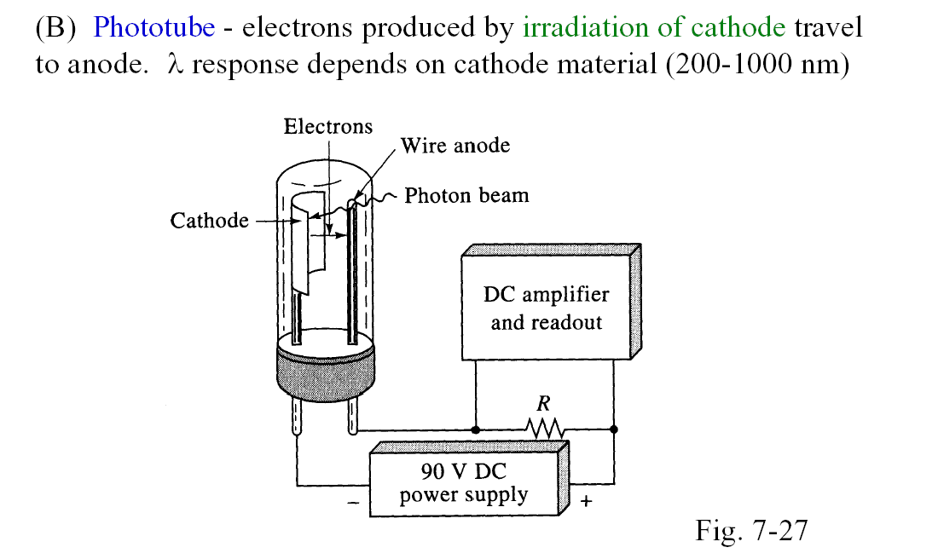

Slide 58
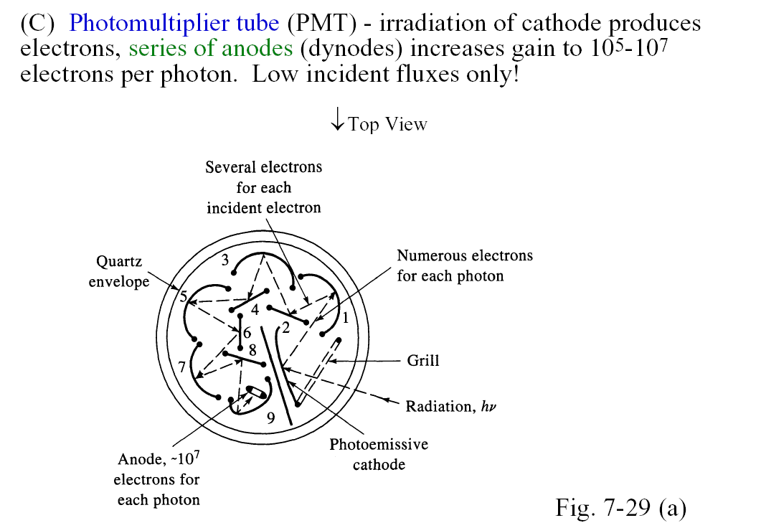
Photomultiplier tube
PMT

Slide 59
Radiation Source
And Detectors
Fig 7.3

Slide 60
Chromatography
Analysis of complex mixtures often requires separation and isolation of components, or classes of components. Examples in noninstrumental analysis include extraction, precipitation, and distillation.
A procedure called chromatography automatically and simply applies the principles of these “fractional” separation procedures. Chromatography can separate very complex mixtures composed of many very similar components.
Electrophoresis is also separation technique but the separation principle is different.

Slide 61
Chromatography
The Russian botanist Mikhail Tswett invented the technique and coined the name chromatography.

