Slide 1
Sources of noise in instrumental analysis
Dr Fadhl Alakwaa
2011-2012 Third Year
Biomedical engineering Department
www.Fadhl-alakwa.weebly.com

Slide 2
Signal &Noise
Merely providing data to other scientists is not enough; the analytical chemist must be able to interpret the data, and communicate the meaning of the results, together with the accuracy and precision (the reliability) of the data, to scientists who will use the data.

Slide 3
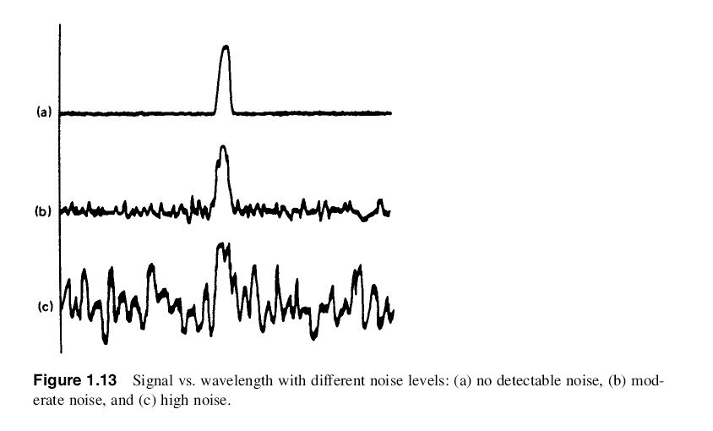
S/N ratio

Slide 4
Every analytical measurement is made up of two components:
signal and noise
Signal: carries information about the analyte
Noise: made up of extraneous information that is unwanted because it degrades the accuracy and precision of an analysis and also places a lower limit on the amount of analyte that can be detected.

Slide 5
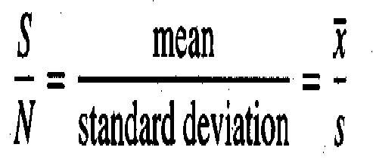
Signal-to-noise ratio

Slide 6
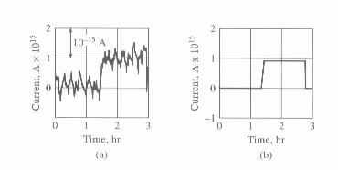
Figure 5-1 Effect of noise on a current measurement: (a) experimental strip-chart recording of a 0.9×10⁻¹⁵ A direct current, (b) mean of the fluctuations. (Adapted from T. Coor, J. Chem. Educ., 1968,45,A594. With permission.)
Actual recording
Average

Slide 7
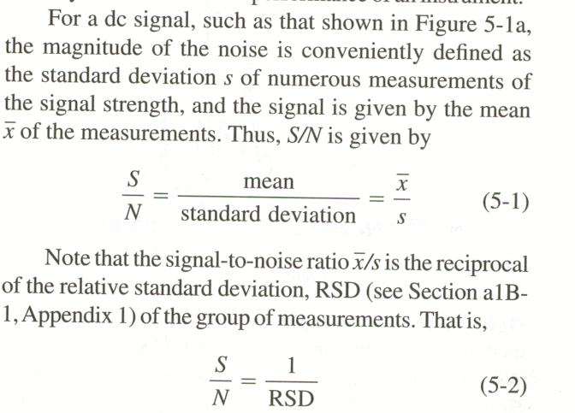

Slide 8
Calculation of signal/noise ratio
The following data were obtained for a voltage
measurement, in V, on a noise system: 1.37, 1.94, 1.35, 1.47, 1.41, 1.63, 1.54, 0.78. Assuming the noise is random, what is the signal to noise ratio?
-
x = 1.436 N = 0.232 S/N= 6.19
If the maximum and the minimum are used for the calculation:
N= (1.94-0.78)/5 = 0.232
N

Slide 9
As a general rule, it becomes impossible to detect a signal when the signal-to-noise ratio becomes less than 3.
Detection limit considerations

Slide 10
Signal/noise calculation
Noise types
Noise reduction
Multiple measurements and S/N

Slide 11
Noise Types
Noise from a given source may or may not be random. The sign and magnitude of the instantaneous voltage deviation from the mean value are unpredictable for random noise.
random noise
nonrandom noise,

Slide 12
Noise can also be classified as fundamental or
non-fundamental.
Fundamental noise arises from the particle nature of light and matter and can never be totally eliminated.
Nonfundamental noise, often called excess noise, is due to imperfect components and instrumentation; theoretically, it can be eliminated completely.
Random noise can be fundamental or nonfundamental
noise, but nonrandom noise is never fundamental noise.
The noise observed in a signal at any instant is due to the summation of the fluctuations caused by a large number of random and nonrandom noise sources

Slide 13
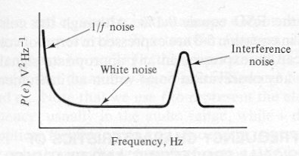
White Noise
For white or Gaussian noise, the magnitude of the noise power P(e) is independent of frequency. White noise is random noise and is usually fundamental noise, although it can arise because of nonfundamental causes.
Figure. Noise power spectrum (NPS)

Slide 14
Statistics: be care the next term

Slide 15
Sources of noise in instrumental analysis:
1. Chemical noise:
undetected variations in temperature, pressure, humidity, and other factors.
2. Instrumental noise:
complex composite cannot be fully characterized
five different kinds of noises:
Thermal noise, Johnson noise
Shot noise, 1/f noise
flicker noise
environmental noise
white noise

Slide 16
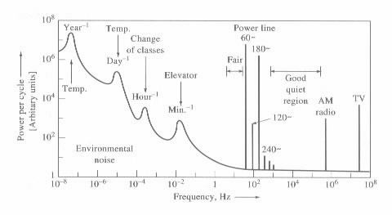
Figure 5-3 Some sources of environmental noise in a university laboratory. Note the frequency dependence and regions where various types of interference occur.
Environmental noise

Slide 17
Environmental noise
environmental noise is a frequency-dependent, Nonfundamental noise.
the amplitude, frequency, and phase are predictable.
The most common interference noise in the United States is 60-Hz noise from ac power lines;
Some interference noise, often called impulse noise,
is correlated noise, that is random in time. Examples
are noise spikes generated by turning instruments on
and off, spikes on the ac power line, and radio-frequency noise from spark gaps in lasers.

Slide 18
signal/noise calculation
Noise types
noise reduction
multiple measurements and S/N

Slide 19
Signal/noise Ratio Enhancement
Two general methods are available for improving the signal-to-noise ratio of an instrumental method, namely hardware and software.

Slide 20
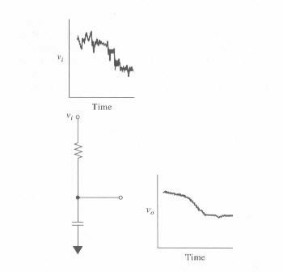
Some Hardware Devices for Noise Reduction
GROUNDING AND SHIELDING
DIFFERENCE AND INSTRUMENT AMPLIFIERS
ANALOG FILTERING
MODULATION
ANALOG FILTERING
Figure 5-5 Use of a low-pass filter with a large time constant to remove noise from a slowly changing dc voltage.

Slide 21
MODULATION
Direct amplification of a low-frequency or dc signal
particularly troublesome because of amplifier drift and
flicker noise. Often, this l/f noise is several times larger than the types of noise that predominate at higher frequencies.
For this reason, low-frequency or dc signals from transducers are often converted to a higher frequency, where 1/f noise is less troublesome.
After amplification, the modulated signal can be freed from 1/f noise by filtering with a high pass filter; demodulation and low pass filtering will result in a suitable signal for output.

Slide 22
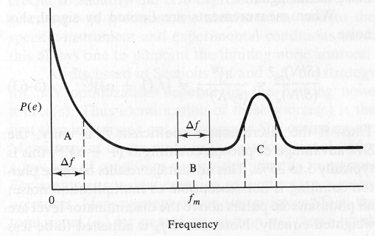
S/N Advantages
FIGURE 5-8 Advantage of modulation. Modulation is used to encode the signal information at the modulation frequency f _{m}. The background noise observed is less at frequency f _{m} (region B) than at dc frequencies (region A) for the same noise equivalent bandpass (Δf). The rms noise is proportional to the square root of the area under the NPS defined by Δf. To discriminate against 1/f noise, the signal processor is adjusted to respond only to the signal encoded at f _{m} and the noise in the bandwidth centered around f _{m} . It is important to choose f _{m} to be high enough that the 1/f noise has fallen off and to be at a frequency where interference noise is negligible (f _{m} should not be in region C).

Slide 23
Software methods
ensemble averaging

Slide 24
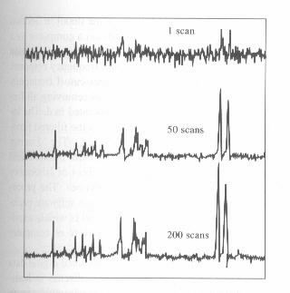
Figure 5-10 Effect of signal averaging. Note that the vertical scale is smaller as the number of scans increases. The signal-to-noise ratio is proportional to . Random fluctuations in the noise tend to cancel as the number of scans increases. but the signal accumulates; thus, S/N increases.

Slide 25
The signal-to-noise ratio S/N for the signal average is given by
Thus, the signal-to-noise ratio increases by the square root of the number of times the data points are collected and averaged.
To realize the advantage of ensemble averaging and still extract all of the information available in an analyte wave form, it is necessary to measure points at a frequency that is at least twice as great as the highest frequency component of the wave form. Much greater sampling frequencies, however, provide no additional information but include more noise.

Slide 26
Signal/noise calculation
Noise types
Noise reduction
Multiple measurements and S/N

Slide 27
Improve the signal/noise ratio by more measurements
The following data were obtained for a voltage
measurement, in V, on a noise system: 1.37, 1.94, 1.35, 1.47, 1.41, 1.63, 1.54, 0.78. Assuming the noise is random, what is the signal to noise ratio? How many measurements would have to be averaged
to achieve a S/N of 20?

