Slide 1
Introduction to medical imaging
Dr Fadhl Alakwaa
Biomedical Engineering program
fadlwork@gmail.com
2010-2011

Slide 2
The thing you must have when you graduat?

Slide 3
Things you must have when you graduate?
Self confident
Critical thinking
Problem solving
Team work
Communication skills
Fast learning

Slide 4
COURSE INFORMATION
Course Description: توصيف المقرر
This course covers biomedical imaging modalities: {Ultrasound + X-ray + CT +MRI + PET+ SPECT}
Purpose: الغاية (الهدف) من هذا المقرر
The purpose of this course is to expand the student’s knowledge with new biomedical imaging modalities, advantage, disadvantage, troubleshooting and the future modalities generation.
www.fadhl-alakwa.weebly.com

Slide 5
GRADING SYSTEM
Term Exam: 50 points
Midterm Exam: 15 Points
Lab: 15 Points
Class Project: 15 Points
Other (Homework assignments, quizzes, class participation etc.): 5 points

Slide 6
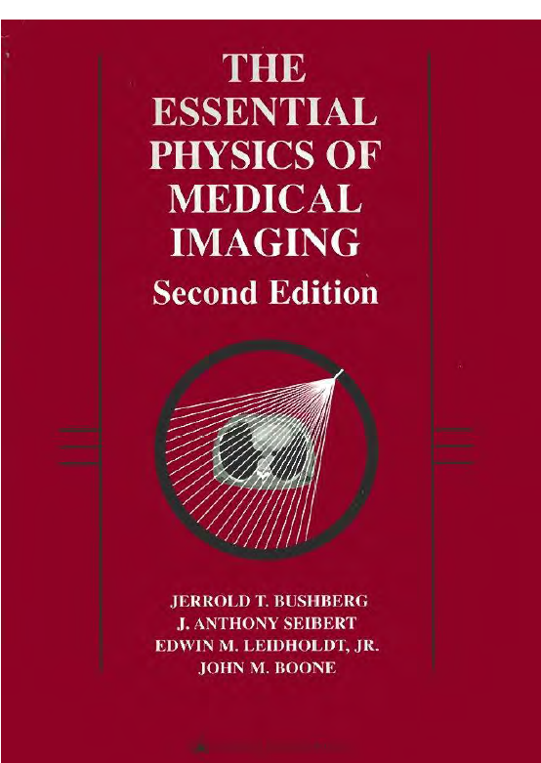
Text Book الكتاب الأساسي للمقرر
The Essential Physics of Medical Imaging (2nd Edition), Jerrold T. Bushberg, 2001.

Slide 7
Supplement (s) المراجع الإضافية والداعمة
MEDICAL IMAGING PHYSICS Fourth Edition, William R. Hendee, 2002.
The physics of medical imaging, Steve Webb, 1988.
Introduction to Biomedical Imaging, Andrew Webb – John Wiley & Sons, Inc, 2003.
MEDICAL IMAGING Principles, Detectors, and Electronics, Krzysztof Iniewski, 2009.
An Introduction to the Principles of Medical Imaging, Chris Guy, 2005.
Fundamentals of Medical Imaging Second Edition Paul Suetens 2002.
Essential Nuclear Medicine Physics Rachel A. Powsner 2006.
Biomedical Imaging KAREN M. MUDRY 2003.
Intermediate Physics for Medicine and Biology, Russell K. Hobbie, 2001.
Encyclopedia of Medical Devices and Instrumentation, 6 Volume Set - Second Edition by: John G. Webster
The Biomedical Engineering Handbook, 3rd Edition (3 Volume Set)by: Joseph D. Bronzino
Medical Instrumentation Application and Design, 4th Edition by: John G. Webster
Handbook of Modern Sensors: Physics, Designs, and Applications, Fourth Edition by: Jacob Fraden
Biomedical Instrumentation: Technology and Applications By R. Khandpur

Slide 8
Medical Imaging
The overall objective of medical imaging is to acquire useful information about physiological processes or organs of the body by using external or internal sources of energy.

Slide 9
Imaging Modalities
Radiography
Fluoroscopy
Mammography
Computed Tomography (CT)
Nuclear Medicine Imaging
Single Photon Emission Computed Tomography (SPECT)
Positron Emission Tomography (PET)
Magnetic Resonance Imaging (MRI)
Ultrasound Imaging
Doppler Ultrasound Imaging
X-RAY
Notes:
The different modes of making images are referred
to as modalities. Each modality has its own applications in medicine.

Slide 10
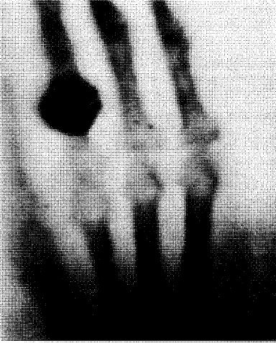
Radiography
Radiography was the first medical imaging technology, made possible when the physicist Wilhelm Roentgen discovered x-rays on November 8, 1895. Roentgen also made the first radiographic images of human anatomy.
FIGURE 1-1. The beginning of diagnostic radiology, represented by this famous radiographic image made on December 22,1895 of the wife of the discoverer of x-rays, Wilhelm Conrad Roentgen.

Slide 11
Radiography
Radiography was the first medical imaging technology, made possible when the physicist Wilhelm Roentgen discovered x-rays on November 8, 1895. Roentgen also made the first radiographic images of human anatomy.
diagnosis of broken bones, lung cancer, cardiovascular disorders.

Slide 12
Fluoroscopy
Fluoroscopy refers to the continuous acquisition of a sequence of x-ray images over time, essentially a real-time x-ray movie of the patient.
Fluoroscopy is used for positioning catheters in arteries, for visualizing contrast agents in the gastrointestinal (GI) tract, and for other medical applications such as invasive therapeutic procedures where real-time image feedback is necessary.

Slide 13
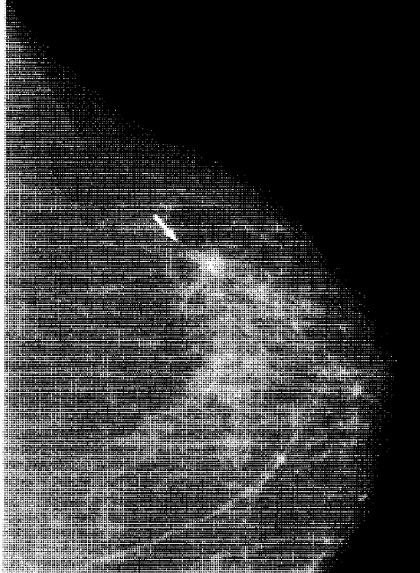
Mammography
Mammography is a specialized x-ray projection imaging technique useful for detecting breast anomalies such as masses and calcifications.
Much lower x-ray energies are used in mammography than any other radiographic applications.

Slide 14
Computed Tomography (CT)
CT became clinically available in the early 1970s and is the first medical imaging modality made possible by the computer.
CT images are produced by passing x-rays through the body, at a large number of angles, by rotating the x-ray tube around the body. One or more linear detector arrays, opposite the x-ray source, collect the transmission projection data.
tomography refers to a picture (-graph) of a slice (tomo-).
Modern CT scanners can acquire 5-mm-thick tomographic images along a 30-cm length of the patient (i.e., 60 images) in 10 seconds,

Slide 15
Nuclear Medicine Imaging
Nuclear medicine is the branch of radiology in which a chemical or compound containing a radioactive isotope is given to the patient orally, by injection, or by inhalation.
Once the compound has distributed itself according to the physiologic status of the patient, a radiation detector is used to make projection images from the x and/or gamma rays emitted during radioactive decay of the agent.
Nuclear medicine produces emission images (as opposed to transmission images), because the radioisotopes emit their energy from inside the patient.
Nuclear medicine imaging is a form of functional imaging.

Slide 16
Single Photon Emission Computed Tomography (SPECT)
In SPECT, a nuclear camera records x- or gamma-ray emissions from the patient from a series of different angles around the patient. These projection data are used to reconstruct a series of tomographic emission images.
SPECT allows physicians to better understand the precise distriburion of the radioactive agent, and to make a better assessment of the function of specific organs or tissues within the body

Slide 17
Positron Emission Tomography (PET)
Although more expensive than SPECT, PET has clinical advantages in certain diagnostic areas. The PET detector system is more sensitive to the presence of radioisotopes than SPECT cameras, and thus can detect very subtle pathologies.
Positrons are positively charged electrons, and are emitted by some radioactive isotopes such as fluorine 18 and oxygen 15. These radioisotopes are incorporated into metabolically relevant compounds [such as 18F-fluorodeoxyglucose (FOG)), which localize in the body after administration. The decay of the isotope produces a positron, which rapidly undergoes a very unique interaction: the positron (e+)combines with an electron (e-) from the surrounding tissue, and the mass of both the e+ and the e- is converted by annihilation into pure energy, following Einstein's famous equation E = mc2.

Slide 18
Magnetic Resonance Imaging (MRI)
MRI scanners use magnetic fields that are about 10,000 to 60,000 times stronger than the earth's magnetic field.
Most MRI utilizes the nuclear magnetic resonance properties of the proton-i.e., the nucleus of the hydrogen atom, which is very abundant in biologic tissues (each cubic millimeter of tissue contains about 1018 protons).
The proton has a magnetic moment, and when placed in a 1.5-tesla (T) magnetic field, the proton will preferentially absorb radio wave energy at the resonance frequency of 63 megahertz (MHz).

Slide 19
MRI
In MRI, the patient is placed in the magnetic field, and a pulse of radio waves is generated by antennas ("coils") positioned around the patient. The protons in the patient absorb the radio waves, and subsequently reemit this radio wave energy after a period of time that depends on the very localized magnetic properties of the surrounding tissue.
The radio waves emitted by the protons in the patient are detected by the antennas that surround the patient. By slightly changing the strength of the magnetic field as a function of position in the patient (using magnetic field gradients), the proton resonance frequency will vary as a function of position, since frequency is proportional to magnetic field strength.
MR angiography IS useful for monitoring blood flow through arteries.

Slide 20
Ultrasound Imaging
A short-duration pulse of sound is generated by an ultrasound transducer that is in direct physical contact with the tissues being imaged. The sound waves travel into the tissue, and are reflected by internal structures in the body, creating echoes. The reflected sound waves then reach the transducer, which records the returning sound beam. This mode of operation of an ultrasound device is called pulse echo imaging. The sound beam is swept over a range of angles (a sector) and the echoes from each line are recorded and used to compute an ultrasonic image in the shape of a sector.
Because ultrasound is less harmful than ionizing radiation to a growing fetus, ultrasound imaging is preferred in obstetric patients.

Slide 21
Ultrasound Imaging
An interface between tissue and air is highly echoic, and thus very little sound can penetrate from tissue into an air-filled cavity. Therefore, ultrasound imaging has less utility in the thorax where the air in the lungs presents a wall that the sound beam cannot penetrate.
Similarly, an interface between tissue and bone is also highly echoic, thus making brain imaging, for example, impractical in most cases.

Slide 22
Doppler Ultrasound Imaging
Both the velocity and direction of blood flow can be measured, and color Doppler display usually shows blood flow in one direction as red and in the other direction as blue.
change in frequency (the Doppler shift) is used to measure the motion of blood or of the heart.

Slide 23
Differences

Slide 24
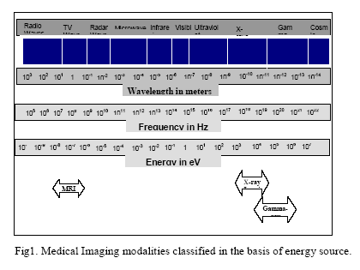
Differences

Slide 25
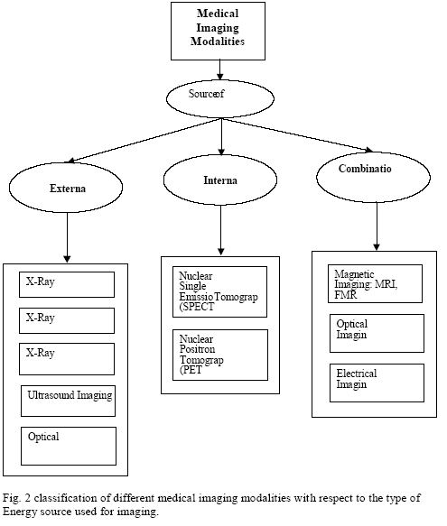
Differences

Slide 26
What you want to know about each modalities?
(1) a short history of the imaging modality,
(2) the theory of the physics of the signal and its interaction with tissue,
(3) the image formation or reconstruction process,
(4) a discussion of the image quality,
(5) the different types of equipment in use today {block diagram + implementation},
(6) examples of the clinical use of the modality,
(7) a brief description of the biologic effects and safety issues, and
(8) some future expectations.

Slide 27
MEDICAL IMAGING: FROM PHYSIOLOGY TO INFORMATION
1. Understanding Image medium:
tissue density is a static property that causes attenuation of an external radiation beam in X-ray imaging modality. Blood flow, perfusion and cardiac motion are examples of dynamic physiological properties that may alter the image of a biological entity.

Slide 28
MEDICAL IMAGING: FROM PHYSIOLOGY TO INFORMATION
2 Physics of Imaging: The next important consideration is the principle of imaging to be used for obtaining the data. For example, X-ray imaging modality uses transmission of X-rays through the body as the basis of imaging. On the other hand, in the nuclear medicine modality, Single Photon Emission Computed Tomography (SPECT) uses emission of gamma rays resulting from the interaction of radiopharmaceutical substance with the target tissue.

Slide 29
MEDICAL IMAGING: FROM PHYSIOLOGY TO INFORMATION
3. Imaging instrumentation: The instrumentation used in collecting the data is one of the most important factors defining the image quality in terms of signal-to ratio,resolution and ability to show diagnostic information.
Source specifications of the instrumentation directly affect imaging capabilities. In addition, detector responses such as non-linearity, low efficiency and long decay time may cause artifacts in the image.

Slide 30
MEDICAL IMAGING: FROM PHYSIOLOGY TO INFORMATION
4. Data Acquisition Methods for Image formation: The data acquisition methods used in imaging play an important role in image formation. Optimized with the imaging instrumentation, the data collection methods become a decisive factor in determining the best temporal and spatial resolution.

Slide 31
MEDICAL IMAGING: FROM PHYSIOLOGY TO INFORMATION
5. Image Processing and Analysis: Image processing and analysis methods are aimed at the enhancement of diagnostic information to improve manual or computer-assisted interpretation of medical images.

Slide 32
Image properties
Contrast
Spatial resolution

Slide 33
Contrast

Slide 34
Contrast
X-ray contrast is produced by differences in tissue composition, which affect the local x-ray absorption coefficient.
Contrast in MRI is related primarily to the proton density and to relaxation phenomena (i.e., how fast a group of protons gives up its absorbed energy).
Contrast in ultrasound imaging is largely determined by the acoustic properties of the tissues being imaged.

Slide 35
Spatial resolution
resolve fine detail in the patient.
RESOVE= separate into constituent parts
the ability to see small detail, and an imaging system has higher spatial resolution if it can demonstrate the presence of smaller objects in the image.
The limiting spatial resolution is the size of the smallest object that an imaging system can resolve.
In ultrasound imaging, the wavelength of sound is the fundamental limit of spatial resolution. At 3.5 MHz, the wavelength of sound in soft tissue is about 0.50 mm. At 10 MHz, the wavelength is 0.15 mm.
Notes:
Each imaging modality generates contrast based on different physical parameters in the patient.

Slide 36
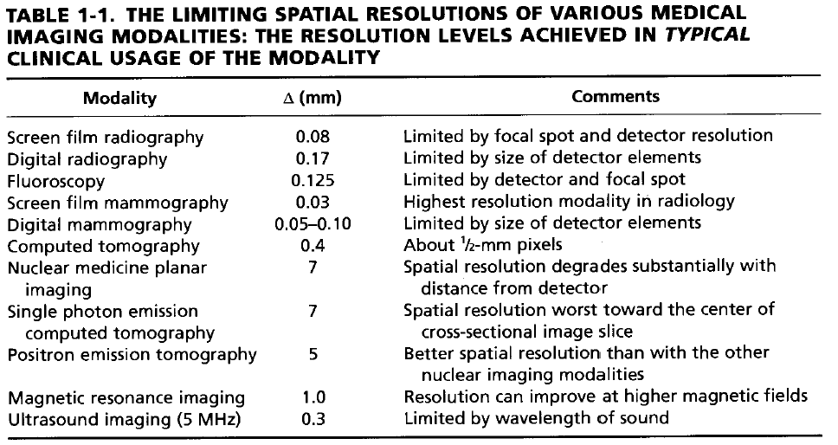
Spatial resolution

Slide 37
Safety
MR and ultrasound, which do not produce any ionising radiation, could perform diagnostic roles that were traditionally the preserve of X-ray radiology.

Slide 38
How does the referring doctor decide to request an MRI rather than an X-ray, CT or ultrasound image?
In general, the investigation chosen is the simplest, cheapest and safest able to answer the specific question posed.
Notes:
Introduction to the principal of medical imaging

Slide 39
X-ray
Because of the high contrast between bone and soft tissue, the X-ray is particularly useful in the investigation of the skeletal system.
An X-ray image of the chest, for example, reveals a remarkable amount of information about the state of health of the lungs, heart and the soft tissues in the mediastinum (the area behind the breast bone).

Slide 40
X-ray
In contrast, soft tissue organs such as the spinal cord, kidneys, bladder, gut and blood vessels are very poorly resolved by X-ray. Imaging of these areas necessitates the administration of an artificial contrast medium to help delineate the organ in question.

Slide 41
CT
In general, CT images are only obtained after a problem has been identified with a single projection X-ray or ultrasound image; however, there are clinical situations (a head injury, for example) in which the clinician will request a CT image as the first investigation.
CT is particularly useful when imaging soft tissue organs such as the brain, lungs, mediastinum, abdomen and, with newer ultra-fast acquisitions, the heart.

Slide 42
Gamma imaging: SPECT Single Photon Emission Computed Tomography
Like X-ray images, gamma investigations are limited by the dose-related effects of ionising radiation and their spatial resolution, even with tomographic enhancement, means that they are poorly suited for the imaging of anatomical structure. However, the technique has found an important niche in the imaging of function, that is to say, how well a particular organ is working.

Slide 43
Gamma imaging
In practice, function equates to the amount of labelled tracer taken up by a particular organ or the amount of labelled blood-flow to a particular region. The radionuclide is usually injected into a vein and activity measured after a variable delay depending on the investigation being performed. A quantitative difference in ‘function’ provides the contrast between neighbouring tissues, allowing a crude image to be obtained.

Slide 44
Gamma imaging
In kidney scans, an intravenous injection of 99mTc labelled diethylenetriaminepentaacetic acid (DTPA) helps quantify the ability of each kidney to extract and excrete the tracer.

Slide 45
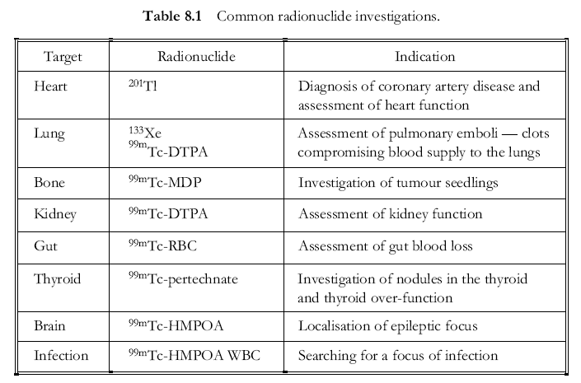
An Introduction to the Principles of Medical Imaging, Chris Guy, 2005.

Slide 46
PET Positron Emission Tomography
In contrast, PET, first proposed in the 1950’s, has taken much longer to be accepted as a clinical tool. The problem is related in part to the cost of the scanner and its ancillary services the cyclotron and radiopharmacy — and in part to the absence of a defined clinical niche. Thus, while PET has a number of theoretical advantages over SPECT such as its higher spatial resolution and its use of a number of biologically interesting radionuclides, in practice, it remains a research tool, found in a handful of national specialist centres, used in the investigation of tumours or heart and brain function.

Slide 47
MRI
it has already found a particular place in the imaging of the brain and spinal cord.
One reason is its ability to detect subtle changes in cerebral and spinal cord anatomy that were not resolvable with CT (a slipped disc pressing on a spinal nerve or a small brain tumour, for example).
Notes:
Cerebral دماغي

Slide 48
MRI
This advantage of MRI over CT is due in part to the superior spatial resolution of the technique and in part to the fact that MR images are insensitive to bone — in CT, the proximity of bony vertebrae to the spinal cord make this region difficult to image as a result of partial volume effects.
Furthermore, patients with pacemakers, artificial joints or surgical clips cannot be scanned and there are technical problems in scanning unconscious patients that require monitoring or artificial ventilation.

Slide 49
Ultrasound
Ultrasound is an effective and safe investigative tool. It offers only limited spatial resolution but can answer a number of clinical questions without the use of ionising radiation and, unlike MRI, the equipment required is portable, compact and relatively inexpensive.
It has found a particular place in the imaging of pregnancy, but it is also used to image the liver, spleen,
kidneys, pancreas, thyroid and prostate glands, and is also used as a screening tool in interventional radiology .
Ultrasound plays an important role in the investigation of the heart and blood vessels

Slide 50
Ultrasound
However, there are a number of specific clinical situations in which ultrasound cannot be used. Structures surrounded by bone, such as the brain and spinal cord, do not give clinically useful images, and the attenuation of the ultrasound signal at air/tissue boundaries means that the technique is not suitable for imaging structures in the lung or abdominal organs obscured by gas in the overlying bowel.

