Slide 1
Medical Laboratory Instrumentation 2010-2011 Third Year
Dr Fadhl Alakwa
www.Fadhl-alakwa.weebly.com
UST-Yemen
Biomedical Department

Slide 2
Cell Counter
Manual
Hemocytometer
Instrumental
Wallace coulter (beer law)
Electric impedance or aperture impedance
Flow cytometer

Slide 3
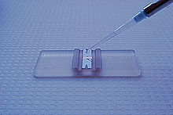
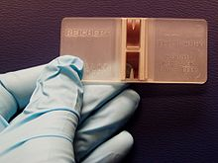
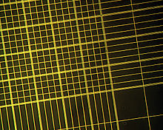
Hemocytometer

Slide 4
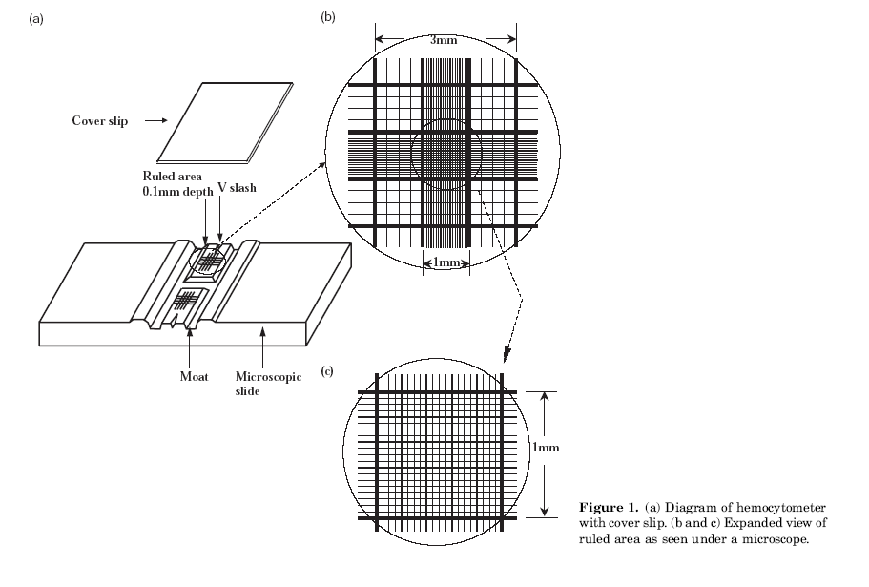
Hemocytometer

Slide 5
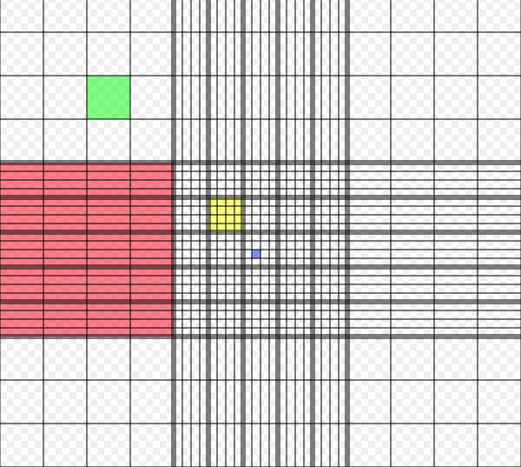
Hemocytometer
Haemocytometer grid: red square = 1.0000 mm², 100.00 nl green square = 0.0625 mm², 6.250 nl yellow square = 0.040 mm², 4.00 nl blue square = 0.0025 mm², 0.25 nl
at a depth of 0.1 mm
Notes:
http://en.wikipedia.org/wiki/Hemocytometer

Slide 6
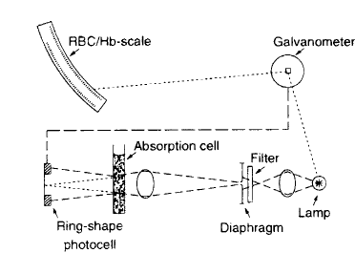
Wallace coulter

Slide 7
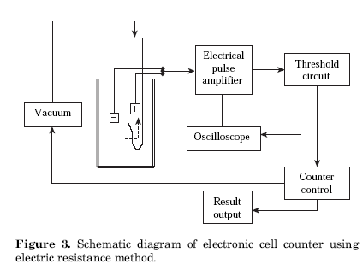
Electric impedance

Slide 8
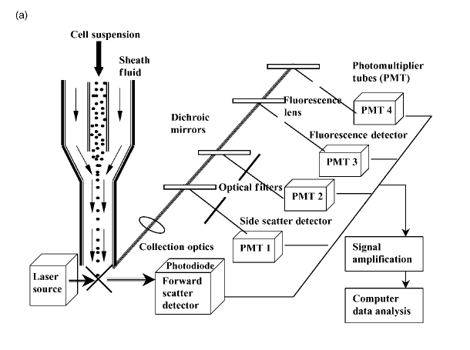
Flow cytometer

Slide 9
Chromatography
Analysis of complex mixtures often requires separation and isolation of components, or classes of components. Examples in noninstrumental analysis include extraction, precipitation, and distillation.
A procedure called chromatography automatically and simply applies the principles of these “fractional” separation procedures. Chromatography can separate very complex mixtures composed of many very similar components.
Electrophoresis is also separation technique but the separation principle is different.

Slide 10
Chromatography
The Russian botanist Mikhail Tswett invented the technique and coined the name chromatography.

