Slide 1

CARDIAC PACING AND DEFIBRILLATION
Dr Fadhl Al-Akwaa
fadlwork@gmail.com
www.Fadhl-alakwa.weebly.com

Slide 2
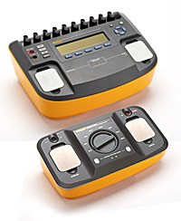
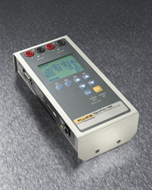
SigmaPace™ 1000
Impulse 7000DP

Slide 3
AGENDA
Heart Anatomy
How to generate ECG EKG?

Slide 4
Heart Anatomy
The heart is a pump that normally beats approximately 72 times every minute.
This adds up to an impressive 38 million beats every year.
The walls of the heart are made of muscle tissue. When they contract, the blood is ejected from the heart into the arteries of the body.

Slide 5
The electrical signal that initiates each normal heartbeat arises from a small structure located at the top of the right atrium called the sinus node or sinoatrial node.
Atria
Sinoatrial (SA) Node
Ventricles
Atrioventricular (AV) Node

Slide 6
Electrical activity from the atria is transferred to the ventricles via a second electrical structure of the heart called the atrioventricular node or AV node, located deep in the center of the heart.
Atria
Sinoatrial (SA) Node
Ventricles
Atrioventricular (AV) Node

Slide 7
Bradycardia and Tachycardia
slow heart rhythms, also known as bradycardia (from the Greek brady=slow Cardia=heart).
heart to beat rapidly, in a condition known as tachycardia (from the Greek, tachy=fast).

Slide 8
Diseased Heart Tissue May:
Prevent impulse generation in the SA node
Inhibit impulse conduction
SA node
AV node
Notes:
Impulses in a patient with diseased heart tissue may be:
Intermittent
Irregular
Not generated at all
At an inappropriate rate for the patient’s metabolic demand.
Block can occur at any point–within the SA node, AV node, His bundle or distal conduction system.

Slide 9
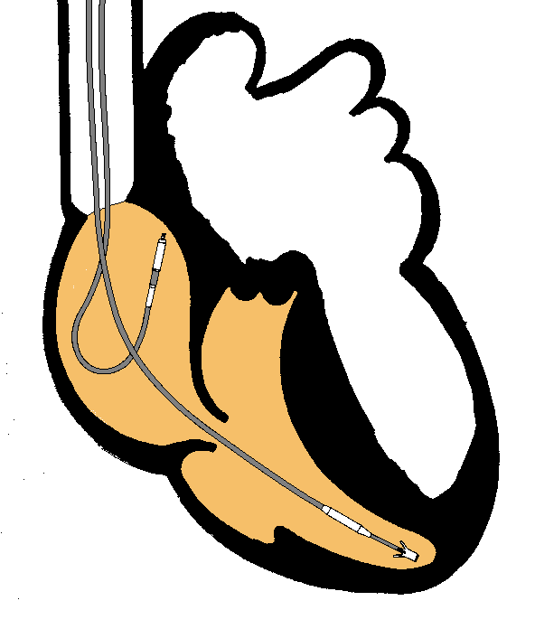
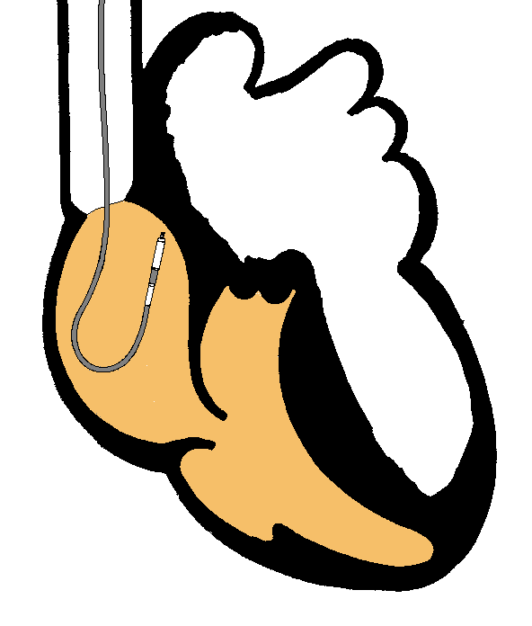
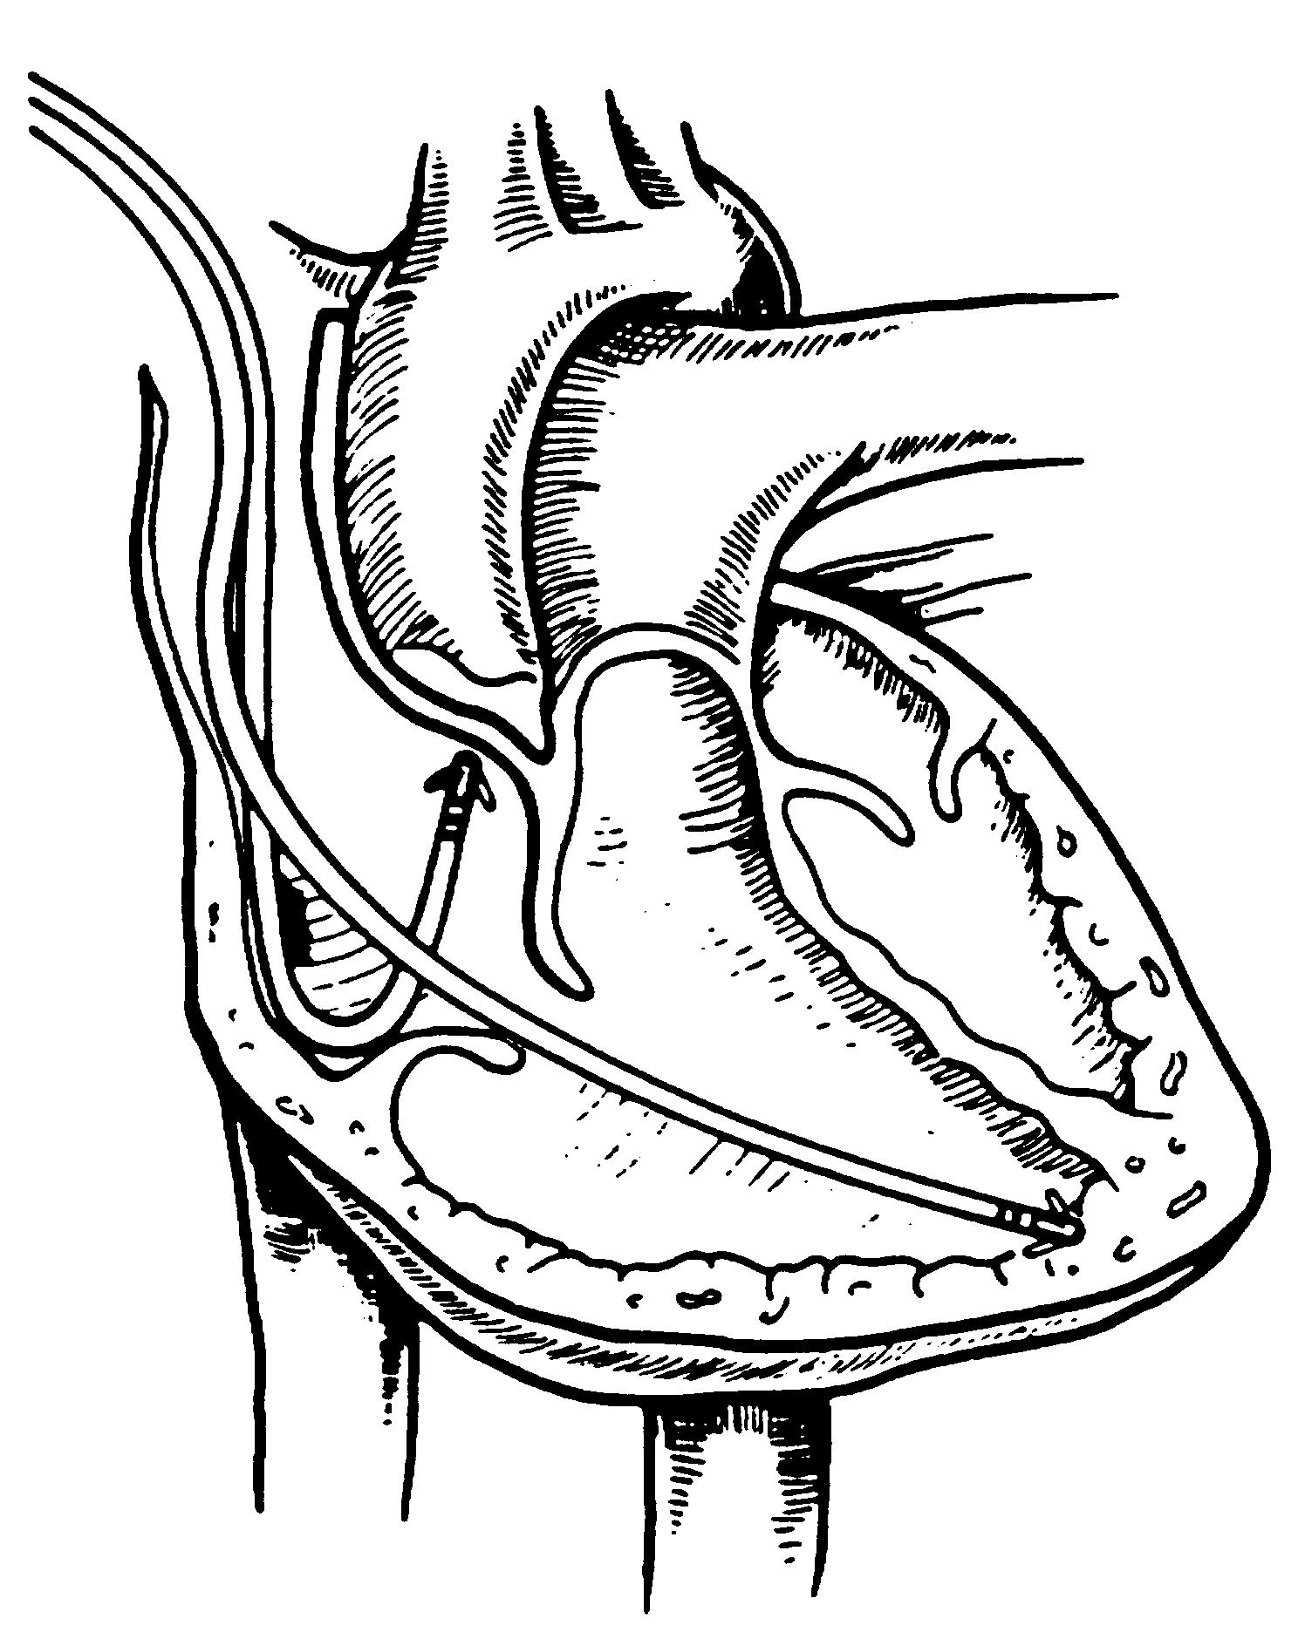
Single and Dual-Chamber pacemaker

Slide 10
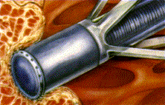
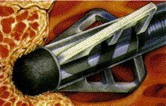
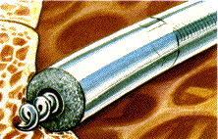
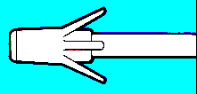
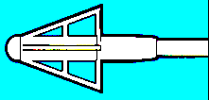
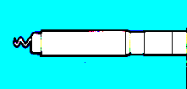
Fixation mechanisms of the Electrode
Active fixation
Tines
Passive fixation
Wingtips
Active fixation
Screw

Slide 11
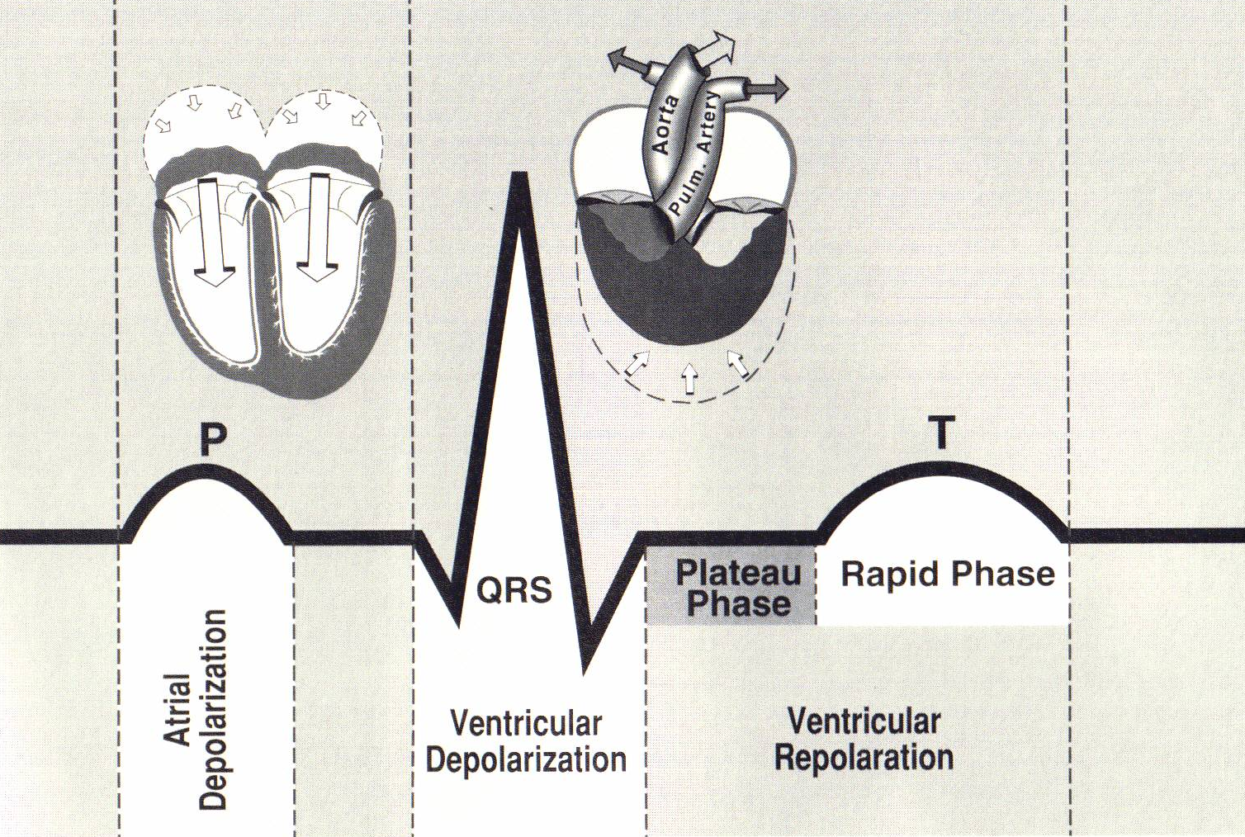
Normal Sinus Rhythm
P-wave for atria, QRS for ventricles

Slide 12
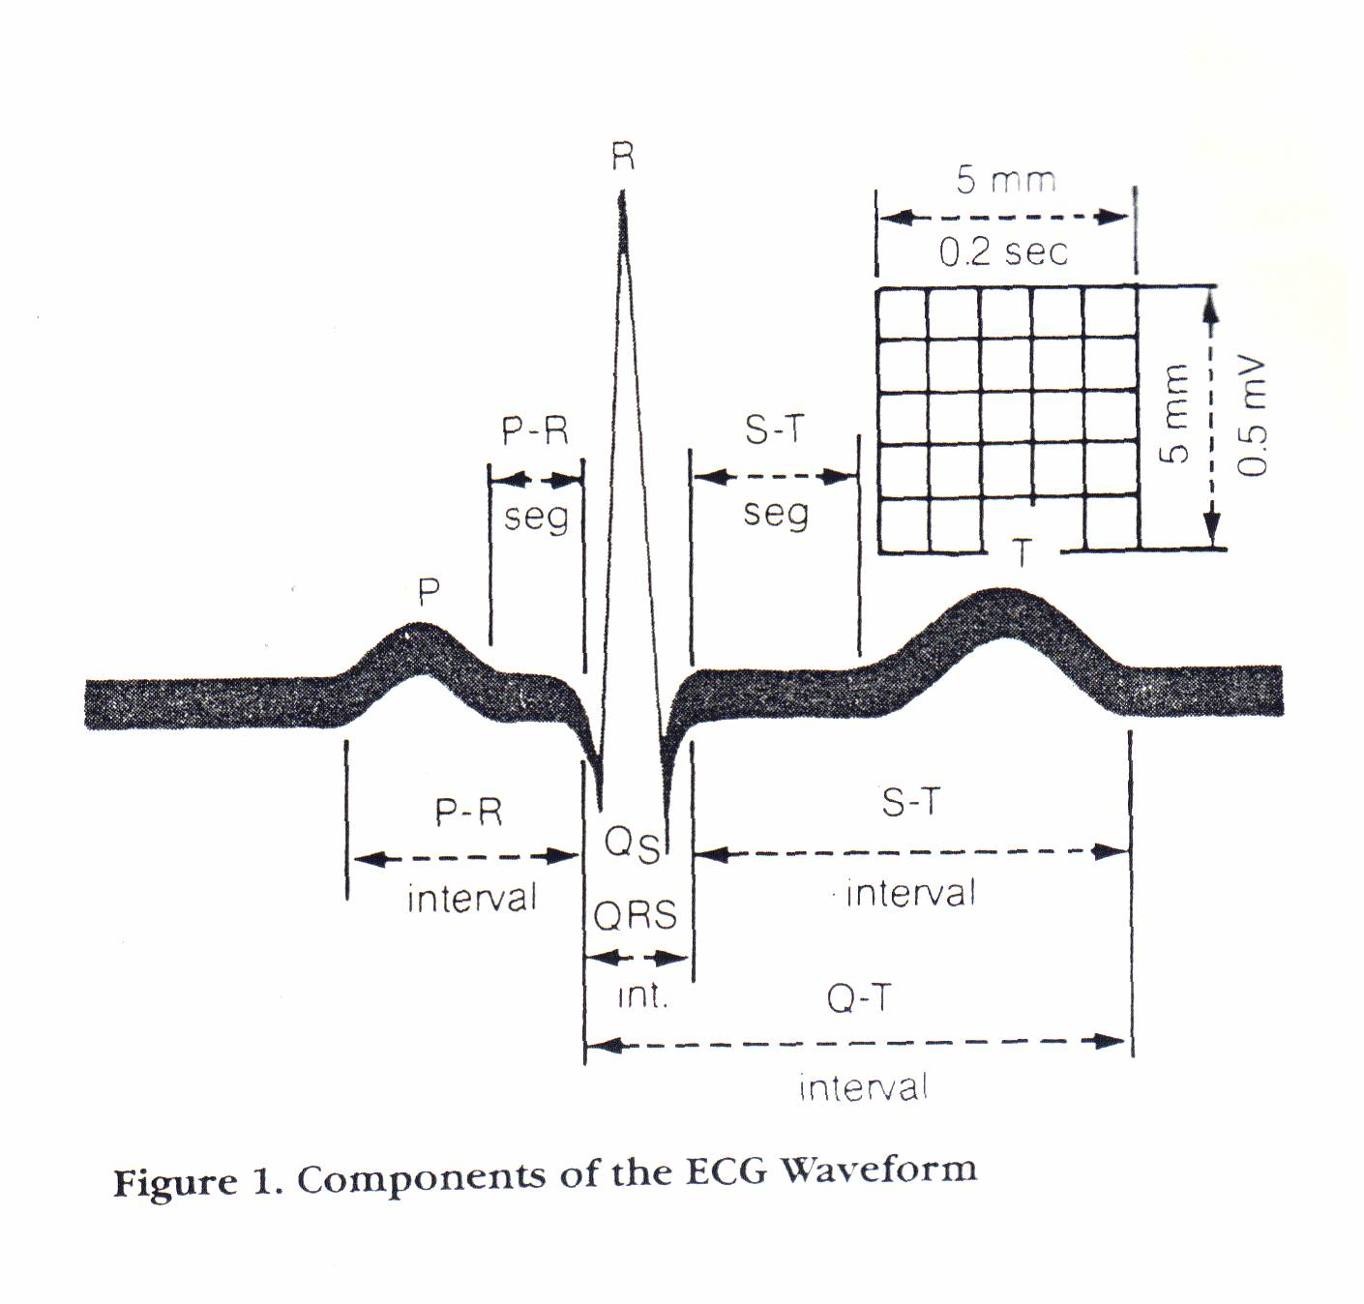
Normal Sinus Rhythm

Slide 13
Sinus / Atrial dysrhythmia
EXAMPLES
  SINUS TACHYCARDIA
  SINUS BRADYCARDIA
  ATRIAL FIBRILLATION
  ATRIAL FLUTTER

Slide 14
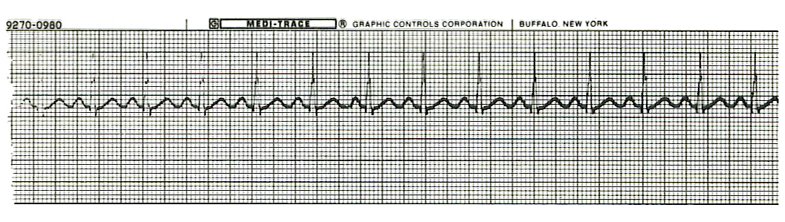

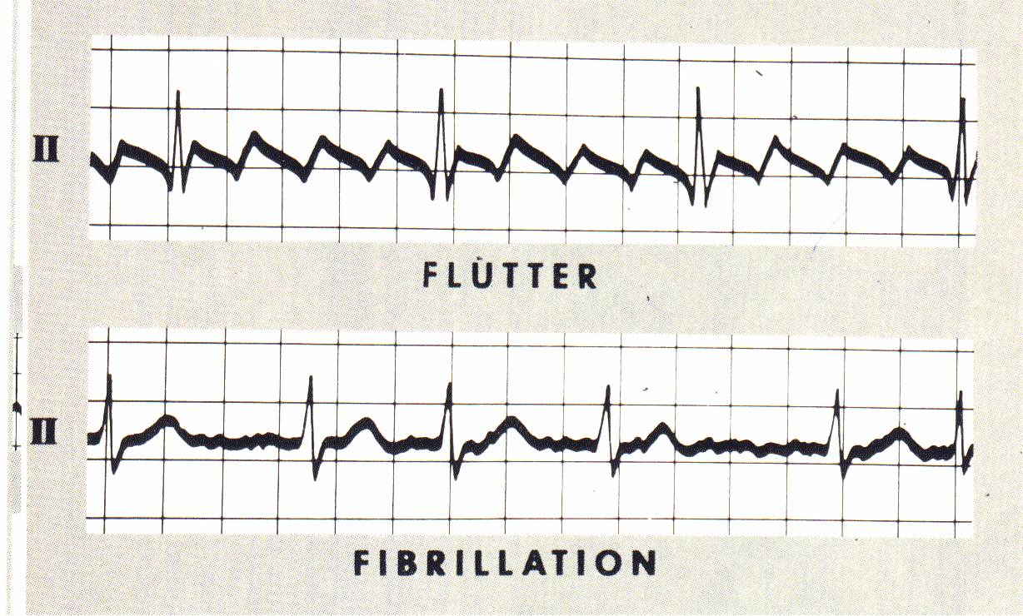

Slide 15
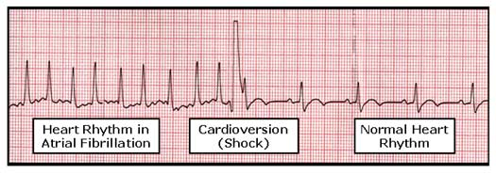

Slide 16
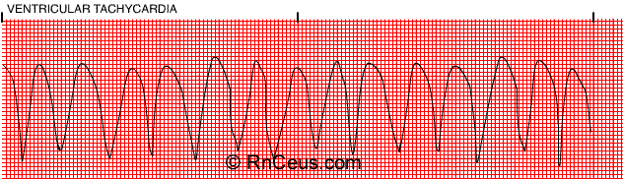

Ventricular Arrhythmias
VENTRICULAR TACHYCARDIA
VENTRICULAR FIBRILLATION
NO CARDIAC OUTPUT

Slide 17
Refractory Periods
Refractory period =
a programmable interval occurring after the delivery of a pacing impulse or after a sensed intrinsic complex, during which the pacemaker can sense signals but chooses to ignore them

Slide 18
Atrial Refractory Period
AV delay
PVARP= Post Ventricular Atrial Refractory Period
  ◆ TARP = Total Atrial Refractory Period
      = AV delay + PVARP

Slide 19
Atrial Refractory Period
1. Pacing pulse delivered to the atrium
2. AV delay ([AV Time Out])
3. Pacing pulse delivered to ventricle
4. Refractory period ([R Time Out])
5. Completely alert period ([A Time Out])
6. Go to 1.
AV delay
PVARP
TARP

Slide 20
Pacing Stimulus and sensing Parameters
Pacing Stimulus Parameters
• Pacing pulse width: duration of the pacing pulse, can be implemented in the same way as timeouts
• Pacing pulse amplitude: initial voltage of the pacing pulse; requires the hardware to enable the firmware to adjust the pacing voltage to the desired level
Sensing Parameters
• Atrial sensing sensitivity: threshold voltage level (in millivolts) that the atrial electrogramsignal must reach for the sense amplifier to report the occurrence of intrinsic atrial activity as an atrial sense event
• Ventricular sensing sensitivity: same as above, but for the ventricle

Slide 21
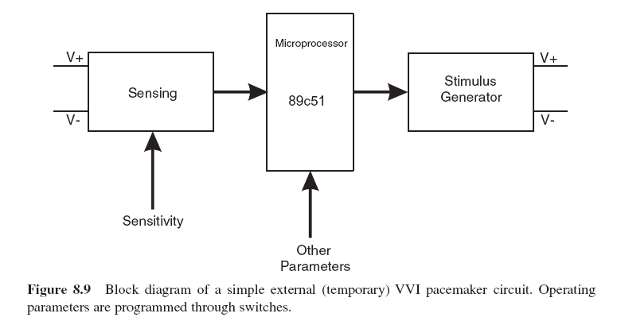
Pacemaker Block Diagram (page 381)
DESIGN AND DEVELOPMENT OF MEDICAL ELECTRONIC INSTRUMENTATION
A Practical Perspective of the Design, Construction, and Test of Medical Devices
DAVID PRUTCHI and MICHAEL NORRIS

Slide 22
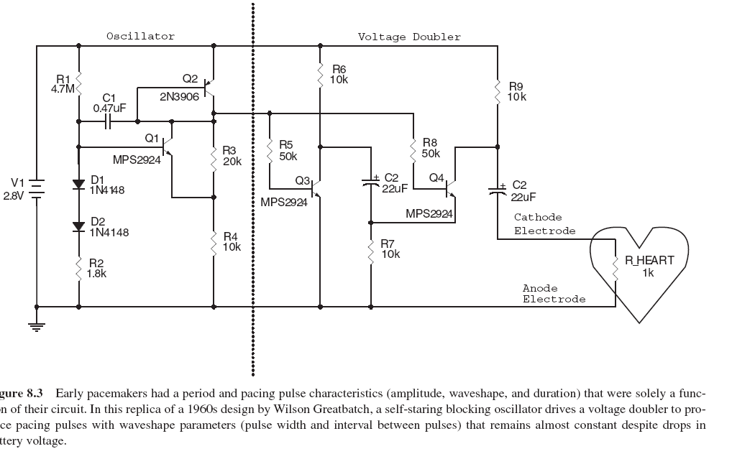
Page 374

Slide 23
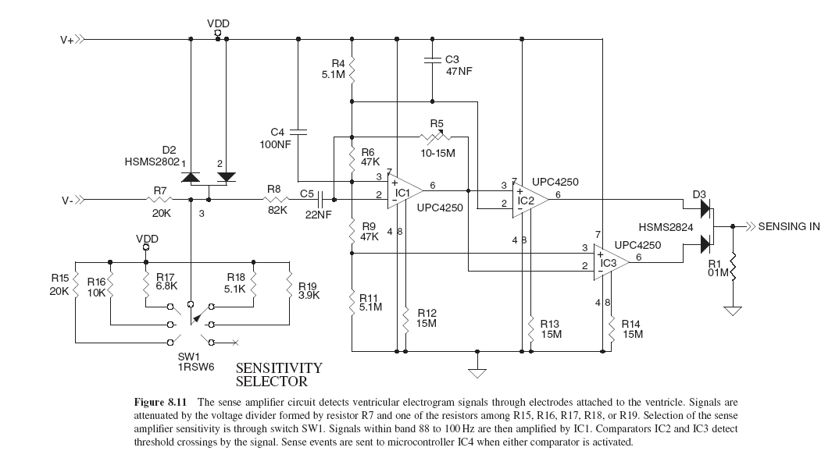

Slide 24
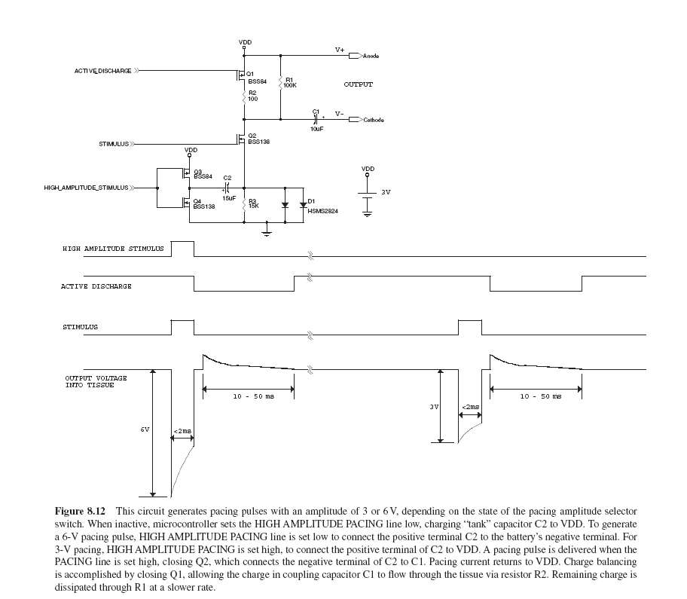

Slide 25
C or Assembly
The microcontroller runs algorithms that implement the state machine as well as stimulus routines. Firmware for pacemakers is usually coded in assembly language due to reliability concerns as well as real-time and power consumption issues.
For clarity in this example, however, programming was done in C. Despite this, power consumption and real-time performance are reasonable, and use of a high-level language could be used to develop code for an implantable device.

Slide 26
Stimulation Threshold
The smallest amount of electrical energy that is required to depolarize the heart adequately outside the refractory period.

Slide 27
Stimulation Threshold
Inversely proportional to current density (amount of current per mm²)
Electrode surface as small as possible
Compromise with the sensing of intracardiac signals, for which a larger surface is required
Surface of the electrode: around 6 to 8 mm²

Slide 28
Output Pulse
Stimulation Threshold
Leading Edge
Trailing Edge
Pulse Amplitude
Pulse Width
The energy is proportional to the pulse amplitude and the pulse width (=surface under the curve)

Slide 29
Stimulation Threshold
L’IMPULSION DE STIMULATION
0.5 V
to
10 V
Pulse Width

Slide 30
Stimulation Threshold
L’IMPULSION DE STIMULATION
0.5 V
to
10 V
0.1 to 1.5 ms

Slide 31
Stimulation Threshold
L’IMPULSION DE STIMULATION
0.5 V
to
10 V
Energy
0.1 to 1.5 ms

Slide 32
Strength - Duration Curve
Pulse Amplitude (V)
2.5
2.25
2
1.75
1.5
1.25
1
0.75
0.5
0.25
0
0.1 0.2 0.3 0.4 0.5 0.6 0.7 0.8 0.9 1 1.1 1.2 1.3 1.4 1.5 1.6 1.7 1.8
Pulse Width (ms)

Slide 33
Strength - Duration Curve
Pulse Amplitude (V)
2.5
2.25
2
1.75
1.5
1.25
1
0.75
0.5
0.25
0
5
4.5
4
3.5
3
2.5
2
1.5
1
0.5
0
Capture
Non-Capture
0.1 0.2 0.3 0.4 0.5 0.6 0.7 0.8 0.9 1 1.1 1.2 1.3 1.4 1.5 1.6 1.7 1.8
Pulse Width (ms)

Slide 34
Strength - Duration Curve
Pulse Amplitude (V)
2.5
2.25
2
1.75
1.5
1.25
1
0.75
0.5
0.25
0
5
4.5
4
3.5
3
2.5
2
1.5
1
0.5
0
Threshold at 0.5 ms = 0.7 V
0.1 0.2 0.3 0.4 0.5 0.6 0.7 0.8 0.9 1 1.1 1.2 1.3 1.4 1.5 1.6 1.7 1.8
Pulse Width (ms)

Slide 35
Energy and Longevity
²
V
E = x PW
R
Example : F 5 V, 500 Ω , 0.5 ms
5
²
E = x 0.5 = 25 µJ
500

Slide 36
Energy and Longevity
Example : F 5 V, 500 Ω , 0.5 ms
F2.5 V, 500 Ω , 0.5 ms
5
²
E = x 0.5 = 25 µJ
500
2.5
²
( Increased longevity! )
E = x 0.5 = 6.25 μJ
500

Slide 37
Pacemaker codes and modes

Slide 38
Pacemaker Code
I
II
III
IV
V
Chamber
Chamber
Response
Programmable
Antitachy
Paced
Sensed
to Sensing
Functions/Rate
Function(s)
Modulation
V: Ventricle
V: Ventricle
T: Triggered
P: Simple
programmable
P: Pace
A: Atrium
A: Atrium
I: Inhibited
M: Multi-
programmable
S: Shock
D: Dual (A+V)
D: Dual (A+V)
D: Dual (T+I)
C: Communicating
D: Dual (P+S)
O: None
O: None
O: None
R: Rate modulating
O: None
S: Single
(A or V)
S: Single
(A or V)
O: None
Notes:
The first letter refers to the chamber(s) being paced
The second letter refers to the chamber(s) being sensed
The third letter refers to the pacemaker’s response to a sensed event:
T = Triggered D = Dual (inhibited and triggered*)
I = Inhibited O = No response
*In a single chamber mode, “triggered” means that when an intrinsic event is sensed, a pace is triggered immediately thereafter. In a dual chamber mode, “triggered” means that a sensed atrial event will initiate (trigger) an A-V delay.
The fourth letter denotes the pacemaker’s programmability and whether it is capable of rate response:
P = Simple Programmable (rate and/or output)
M = Multiprogrammable (rate, output, sensitivity, etc.)
C = Communicating (pacemaker can send/receive information to/from the programmer)
R = Rate Modulation
O = None
Note that this sequence is hierarchical. In other words, it is assumed that if a pacemaker has rate modulation capabilities, “R”, that it also can communicate, “C”.
The fifth letter represents the pacemaker’s antitachycardia functions:
P = Pace D = Dual (pace and shock available)
S = Shock O = None
You may want to test the audience by having them describe different pacing modes. More modes and ECG strips are found in Module 2.

Slide 39
Common Pacemakers
VVI
  Ventricular Pacing : Ventricular sensing; intrinsic QRS Inhibits pacer discharge
VVIR
  As above + has biosensor to provide Rate-responsiveness
DDD
  Paces + Senses both atrium + ventricle, intrinsic cardiac activity inhibits pacer d/c, no activity: trigger d/c
DDDR
  As above but adds rate responsiveness to allow for exercise
Notes:
Biosensors --- most are vibrations sensors that increase HR in proportion to activity sensed, but can also have pH, venous temp, resp rate, QT interval, stroke volume, O2 sat, RA pressure sensors less commonly.
Dual chamber pacing allows for atrial contribution to CO (up to 30% of CO)

Slide 40
NASPE/ BPEG Generic (NBG) Pacemaker Code
I. Chamber II. Chamber III. Response to IV. Programmability V. Antitachy
Paced Sensed Sensing Rate Modulation arrhythmia funct.
O= none O= none O= none O= none O= none
A=atrium A= atrium T= triggered P= simple P= pacing
V= ventricle V= ventricle I= inhibited M= multi S= shock
D= dual D= dual D= dual C= communication D= dual
(A+V) (A+V) (T+I) R= Rate Modulation
Manufacturers’ Designation only:
S= single S= single
(A or V) (A or V)

Slide 41
Causes of bradycardia requiring pacing and recommended pacemaker modes
Diagnosis Incidence (%) Recommended Pacemaker Mode
Optimal Alternative Inappropriate
Sinus node disease 25 AAIR AAI VVI; VDD
AV block 42 VDDR DDD AAI; DDI
Sinus node disease
+ AV block 10 DDDR DDD AAI; VVI
Chronic A fib
with AV block 13 VVIR VVI AAI; DDD; VDD
Carotid Sinus S. 10 DDD AAI VVI; VDD
Neurocardiogenic + hysteresis + hysteresis
Syncope

Slide 42
Choice of a Stimulation Mode
Bradycardia
Atrial fib
Normal P waves
Normal A-V
A-V Block
RR ^{é}
RR ^{è}
RR ^{é}
RR ^{è}
RR ^{é}
RR
VVI
VVIR
AAI
DDI
AAIR
DDIR
DDD
DDDR

Slide 43
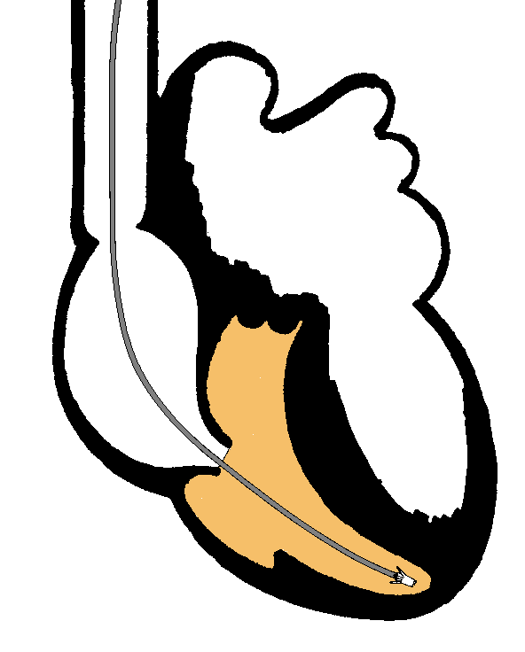
Single Chamber Pacing
VVI (R)

Slide 44
Single Chamber Pacing
AAI (R)

Slide 45
Pacemaker Malfunction

Slide 46
4 broad categories
Failure to Output
Failure to Capture
Inappropriate sensing: under or over
Inappropriate pacemaker rate

Slide 47
Failure to Output
absence of pacemaker spikes despite indication to pace
dead battery
fracture of pacemaker lead
disconnection of lead from pulse generator unit
Oversensing
Cross-talk: atrial output sensed by vent lead
Notes:
Cross-talk = oversensing of pacemaker generated electrical activity E.g. vent lead senses atrial pacing spike → misinterprets as vent contraction → inhibits pacer d/c → skipped beat → dizziness / syncope

Slide 48
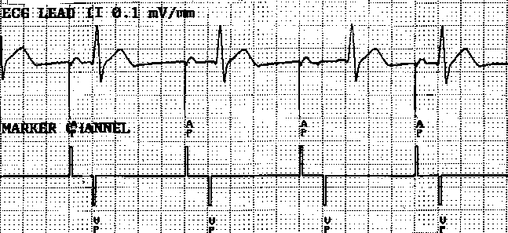
No Output
Pacemaker artifacts do not appear on the ECG; rate is less than the lower rate
Pacing output delivered; no evidence of pacing spike is seen
Notes:
CorePace Module 4: Troubleshooting
When the pacemaker problem is no output, the marker channel shows pacing markers—AP or VP—although no artifact appears on the ECG.
No output is defined as the failure to pace. Impulses are generated from the IPG, but is not transferred to the lead.

Slide 49
Failure to capture
spikes not followed by a stimulus-induced complex
change in endocardium: ischemia, infarction, hyperkalemia, class III antiarrhythmics (amiodarone, bertylium)

Slide 50
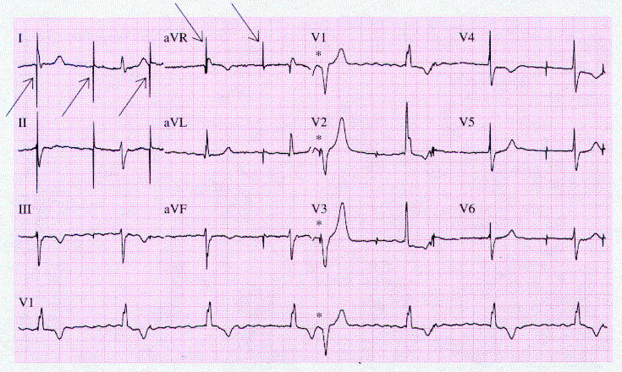
Failure to sense or capture in VVI
Notes:
Figure 21-11 A 12-lead ECG with a lead-V1 rhythm strip from an 84-year-old man who returned to a pacemaker clinic with dizziness 11 years after implantation of a VVI pacemaker. Arrows show pacing artifacts continuing regularly (68/min) not sensing for the patient's intrinsic beats and not producing paced beats. The asterisks indicate the single incidence of ventricular capture by the pacemaker

Slide 51
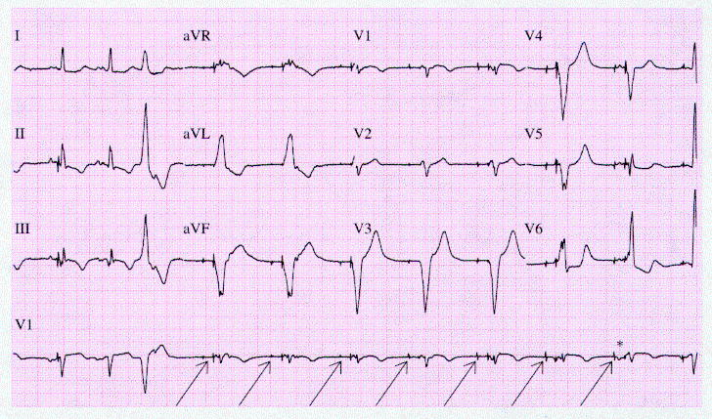
A: failure to capture atria in DDD
Notes:
Figure 21-12 A 12-lead ECG with a lead-V1 rhythm strip from a 73-year-old man seen in a pacemaker clinic 6 months after implantation of a DDD pacemaker. During the pause after the VPB, minimum-rate pacing occurs (the first six arrows), but with failure of atrial capture. An asterisk and the last arrow indicate the single incidence of atrial capture by the pacemaker.

Slide 52
Inappropriate sensing: Undersensing
Pacemaker incorrectly misses an intrinsic deoplarization  paces despite intrinsic activity
Appearance of pacemaker spikes occurring earlier than the programmed rate: “overpacing”
may or may not be followed by paced complex: depends on timing with respect to refractory period
AMI, progressive fibrosis, lead displacement, fracture, poor contact with endocardium

Slide 53
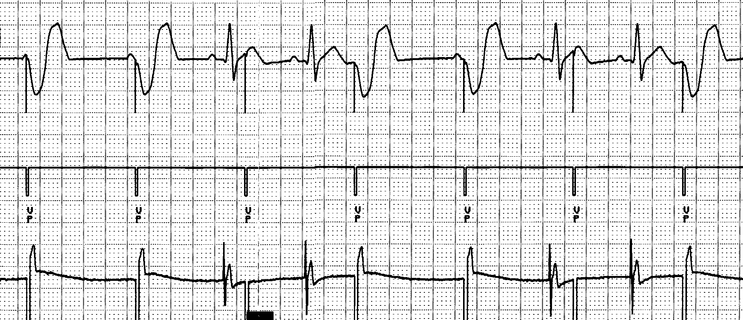
Undersensing
Pacemaker does not “see” the intrinsic beat, and therefore does not respond appropriately
Scheduled pace delivered
Intrinsic beat not sensed
VVI / 60

Slide 54
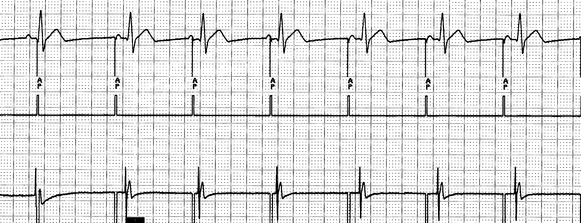
Undersensing
An intrinsic depolarization that is present, yet not seen or sensed by the pacemaker
P-wave
not sensed
Atrial Undersensing
Notes:
CorePace Module 4: Troubleshooting
An intrinsic depolarization occurs in the atrium, but this depolarization is not sensed by the pacemaker. Therefore, the pacemaker sends an inappropriate pacing pulse to that chamber. Undersensing can be thought of as “overpacing.”
In this example, an AAI pacemaker is programmed to inhibit the atrial pacing pulse when a P-wave is sensed. Because the P-wave was not sensed, the pacemaker delivered an atrial pulse. If a pacemaker is undersensing, you will not see appropriate atrial sense markers on the marker channel.

Slide 55
Inappropriate sensing: Oversensing
Detection of electrical activity not of cardiac origin  inhibition of pacing activity
“underpacing”
pectoralis major: myopotentials oversensed
Electrocautery
MRI: alters pacemaker circuitry and results in fixed-rate or asynchronous pacing
Cellular phone: pacemaker inhibition, asynchronous pacing

Slide 56
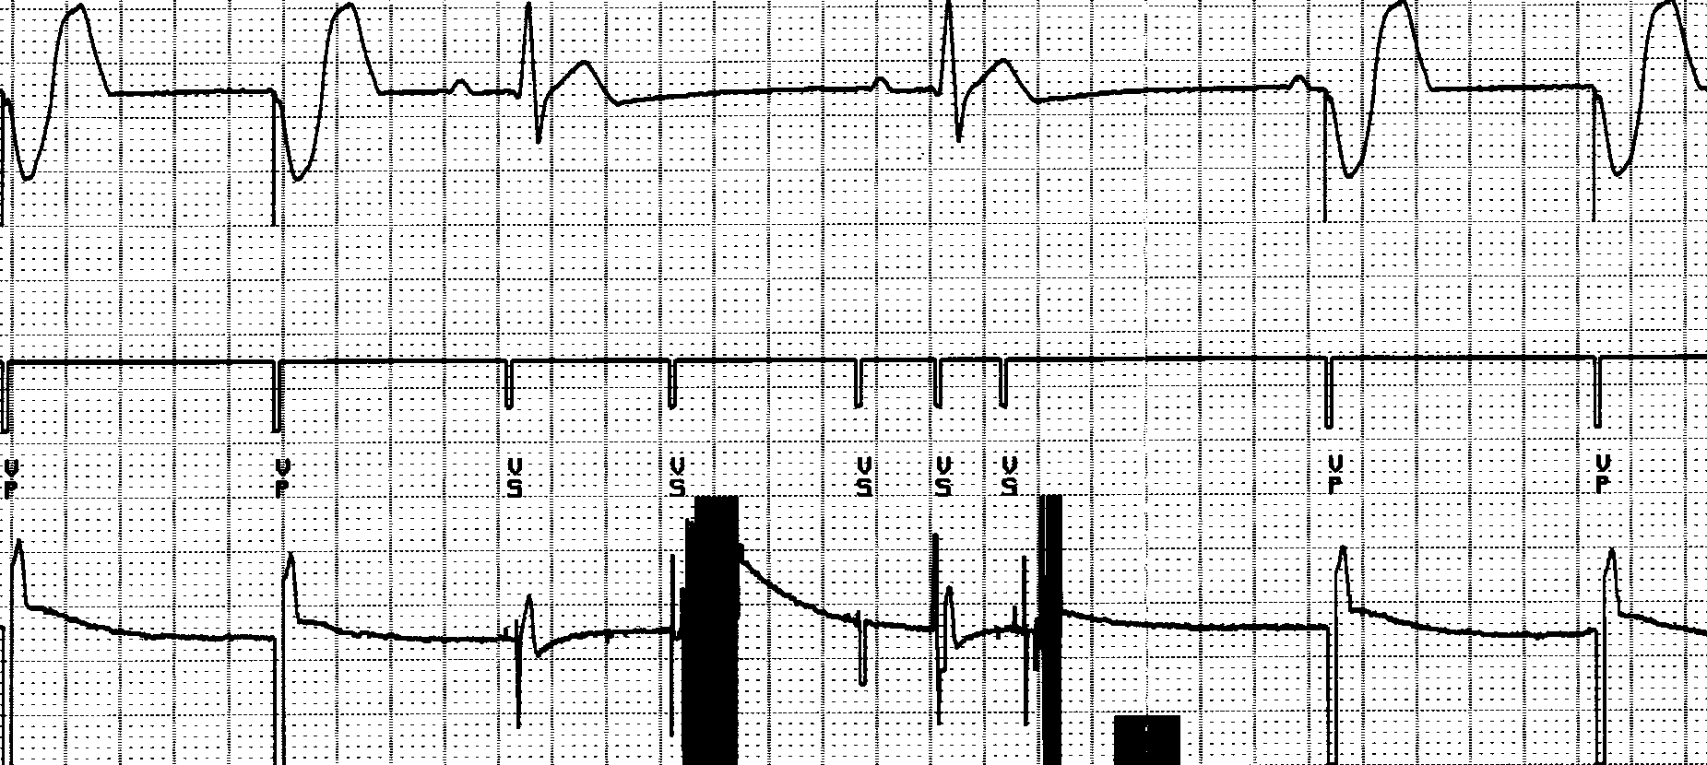
Oversensing
...though no activity is present
Marker channel shows intrinsic activity...
An electrical signal other than the intended P or R wave is detected
VVI / 60
Notes:
Oversensing will exhibit pauses in single chamber systems. In dual chamber systems, atrial oversensing may cause fast ventricular pacing without P waves preceding the paced ventricular events.

Slide 57
Inappropriate Pacemaker Rate
Rare reentrant tachycardia seen w/ dual chamber pacers
Premature atrial or vent contraction → sensed by atrial lead → triggers vent contraction → retrograde VA conduction → sensed by atrial lead → triggers vent contraction → etc etc etc
Tx: Magnet application: fixed rate, terminates tachyarrthymia,
reprogram to decrease atrial sensing

Slide 58
Causes of Pacemaker Malfunction
Circuitry or power source of pulse generator
Pacemaker leads
Interface between pacing electrode and myocardium
Environmental factors interfering with normal function

Slide 59
Pulse Generator
Loose connections
  Similar to lead fracture
  Intermittent failure to sense or pace
Migration
  Dissects along pectoral fascial plane
  Failure to pace
Twiddlers syndrome
  Manipulation → lead dislodgement

Slide 60
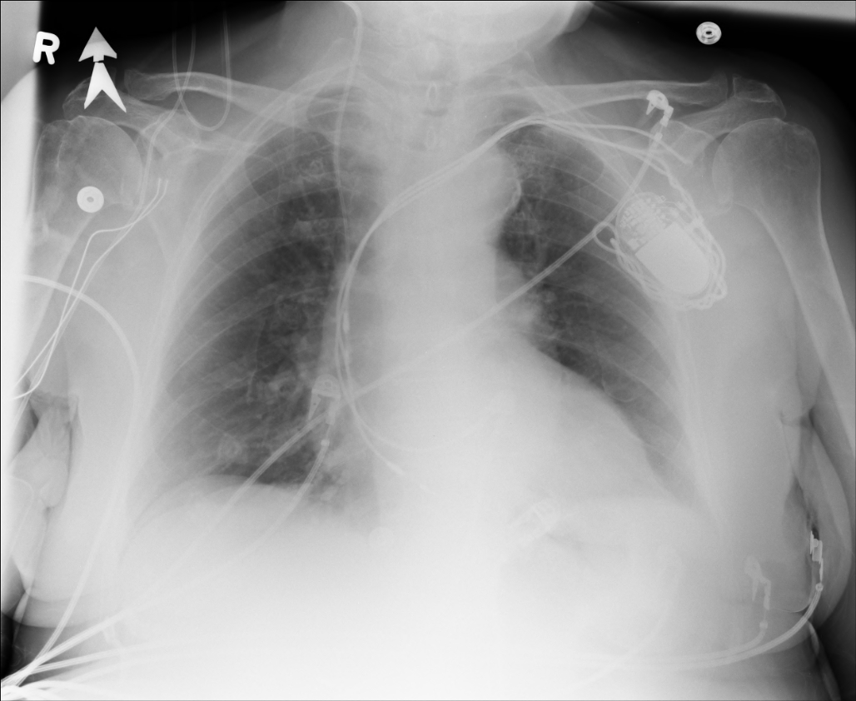
Twiddler’s Syndrome

Slide 61
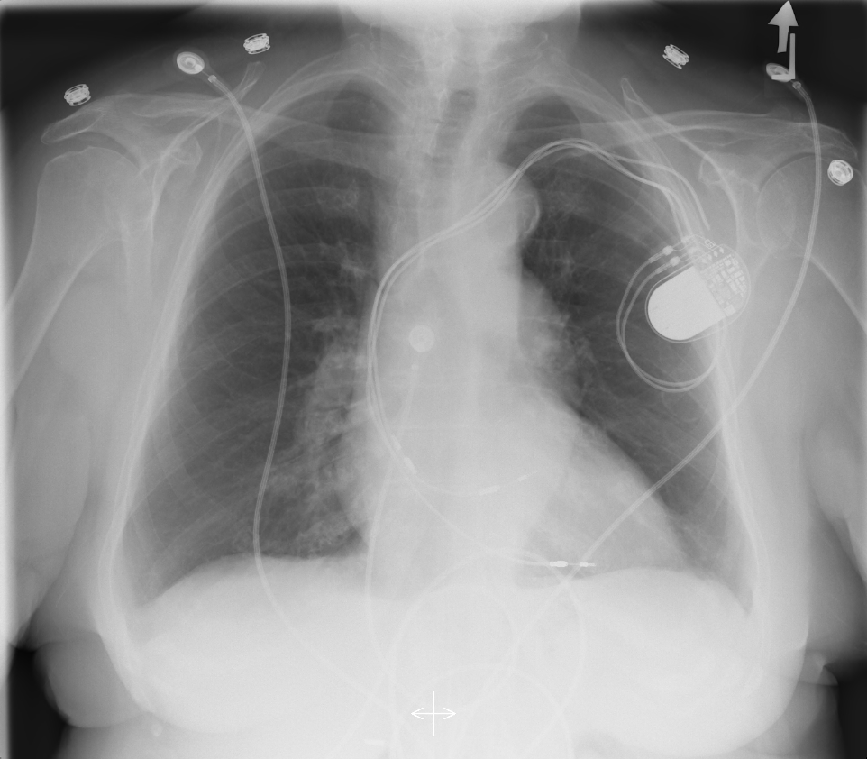
Twiddler’s Syndrome

Slide 62
Leads
Dislodgement or fracture (anytime)
  Incidence 2-3%
  Failure to sense or pace
  Dx w/ CXR, lead impedance
Insulation breaks
  Current leaks → failure to capture
  Dx w/ measuring lead impedance (low)
Notes:
Fractures occur at sharp turns (pulse generator, entry into vein, in ventricle, most commonly occurring at the clavicle/first rib location
Measure lead impedance w/ pacemaker programmer
Insulation break like leaky garden hose

Slide 63
Cardiac Perforation
Early or late
Usually well tolerated
  Asymptomatic → inc’d pacing threshold, hiccups
  Dx: P/E (hiccups, pericardial friction rub), CXR, Echo

Slide 64
Environmental Factors Interfering with Sensing
    MRI
    Electrocautery
    Arc welding
    Lithotripsy
    Cell phones
    Microwaves
    Mypotentials from muscle

Slide 65
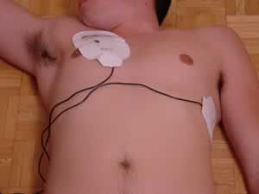
Pacemakers
intrinsic Pacemaker “Permanent“
  Implantable pacemaker
External Pacemaker “temporary”
  Transvenous Pacemaker “Invasive”
  Transcutaneou Pacemaker “Non Invasive”
  Transthoracic عبر الصدر
Notes:
الوريد
عبر الجلد

Slide 66
Terminology
Dual-Chamber
Transcutaneou عبر الجلد
Transvenous الوريد
Resuscitation إحياء
Asynchronous non-demand
Demand
Electrocardiography (ECG, or EKG)
sensing circuit
pacing circuit
Notes:
CARDIAC PACING AND DEFIBRILLATION

Slide 67
Transcutaneous Pacemaker Tests
Output Pulse Measurement
Demand Mode Test
Asynchronous Mode Test
Amplitude Sensitivity Test
Noise Immunity Test
Paced Refractory Period Test (PRP)
Sensed Refractory Period Test (SRP)

Slide 68
Transvenous Pacemaker Tests
Output Pulse Measurement Quantitative
AV Interval (Delay Time) Quantitative
Demand Mode Test Qualitative
Asynchronous Mode Test Qualitative
Amplitude Sensitivity Test Qualitative
Atrial Channel Quantitative
Ventricular Channel Quantitative
Noise Immunity Test Qualitative
Refractory Period Test (Atrial Channel)
  Paced Refractory Period (PRP)
  Sensed Refractory Period (SRP)
  Refractory Period Test (Ventricular Channel)
  DC Leakage Current Quantitative
    Static Tests (Pacemaker Power OFF):
    Dynamic Tests (Pacemaker Power ON):
  Current Drain Test Quantitative
  Long Term Test
  Interactive Pacer ECG Simulation

Slide 69
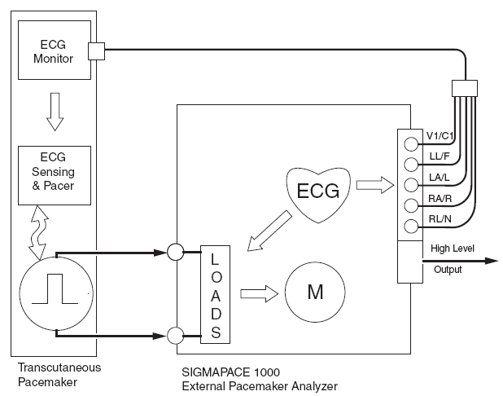
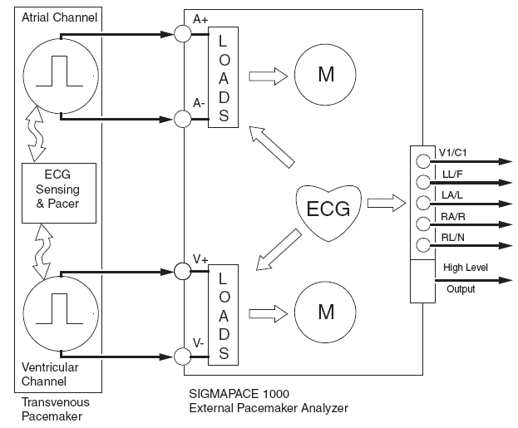
Transvenous and Transcutaneous
Pacemaker Testing
Transvenous
Transcutaneous

Slide 70
Transvenous and Transcutaneous
Pacemaker Testing
Pulse Amplitude (milliamperes)
Pulse Rate (pulses per minute)
Pulse Width (milliseconds)
Pulse Energy (joules)
Pulse Amplitude = milliamperes
• Pulse Rate = pulses per minute
• Pulse Width = milliseconds
• AV Delay = milliseconds
• Voltage = volts
• Energy = joules

