Slide 1

University of Science &Technology
Biomedical Engineering Department
Level : 4th
Blood gas ANALYZER
Student work : Work done :
Abdullah Saleh Bin_Madhi Dr. Fadhl Alakwaa
Faiz Ramadan Obad
Mohammed Zyad Fetna
Hamza Najm Aldeen
ahmed mohammad abokhleel

Slide 2
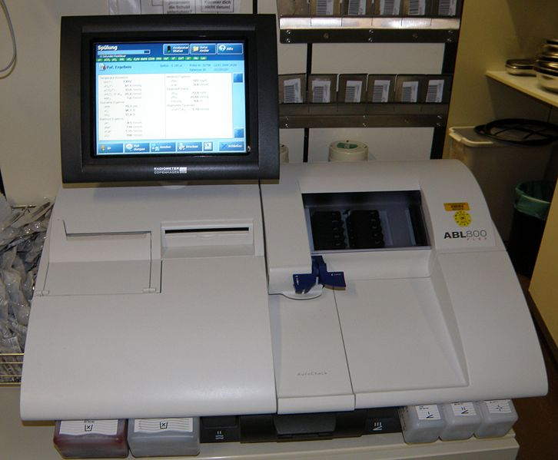

Slide 3
Agenda
1- Theory of operation.
2- block diagram.
3- implementation.
4- Survey.

Slide 4
Definition
Blood gas analysis, also called arterial blood gas (ABG) analysis, is a test which measures the amounts of oxygen and carbon dioxide in the blood, as well as the acidity (pH) of the blood.

Slide 5
IMPORTANT
An ABG analysis evaluates how effectively the lungs are delivering oxygen to the blood and how efficiently they are eliminating carbon dioxide from it. The test also indicates how well the lungs and kidneys are interacting to maintain normal blood pH (acid-base balance).

Slide 6
Parameter Blood Gases
pH:This is alogarithmic expression of hydrogen ion concentration the acidity or alkalinity of the blood.
The normal human arterial pH is 7.4. Any pH below this is acid, and any pH above it is alkaline. There is a narrow range of pH values (7.35 to 7.45) that the human body.

Slide 7

Cont.
The interfacial potential difference, E, of an electrode can be calculated using the Nernst equation [3]:
E=Eº $\frac{RT}{nF}(\frac{Co}{CR})$
where Eo is the standard potential of the electrode, R is the molar gas constant, T is the absolute temperature, n is the number of electrons transferred in the reaction, F is Faraday’s constant, and CO and CR are the concentration of the oxidized and reduced forms of the species, respectively [3].

Slide 8
Cont.
2) PCO₂: This value is measured directly by the CO₂electrode. An increased PCO₂ Is often the result of acute, chronic or impending respiratory failure, whereas a decreased PCO₂ is the result of hyperventilation stimulated by a metabolic acidosis or hysteria and severe anxiety reactions. The normal arterial PCO₂ is 40 mmHg.

Slide 9
Cont.
3) PO₂: The partial pressure of oxygen in the blood is measured directly by electrode.
The normal acceptable range is roughly between 85 and 100. An increased PO₂ is usually the result of excessive oxygen administration that needs to be adjusted downwards on such results. A decreased PO₂ is often the result of any number of respiratory or cardiopulmonary problems.

Slide 10
Theory of operation
PO₂ Electrode
The PO₂ electrode basically consists of two terminals (1).The cathode, which usually made of platinum (negatively charged) and (2) the anode, which usually made of silver– sliver chloride (positively charged). How does this unit measure PO₂ in the blood sample? As shown in Fig.5, the electricity source (battery or wall electricity) supplies the platinum cathode with energy (voltage of 700 mV).

Slide 11
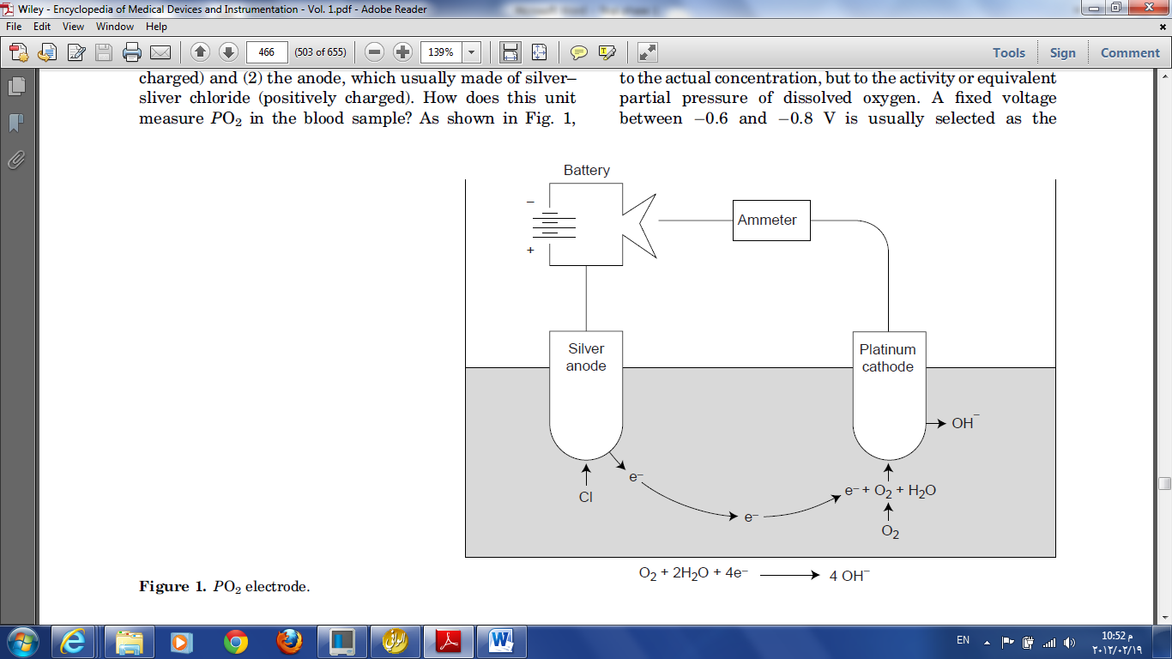
The cathode, which usually made of platinum (negatively charged) and (2) the anode, which usually made of silver– sliver chloride (positively charged).
Source : Akay, M., WILEY ENCYCLOPEDIA OF BIOMEDICAL ENGINEERING. 2006, Washington: simultaneously in Canada.

Slide 12
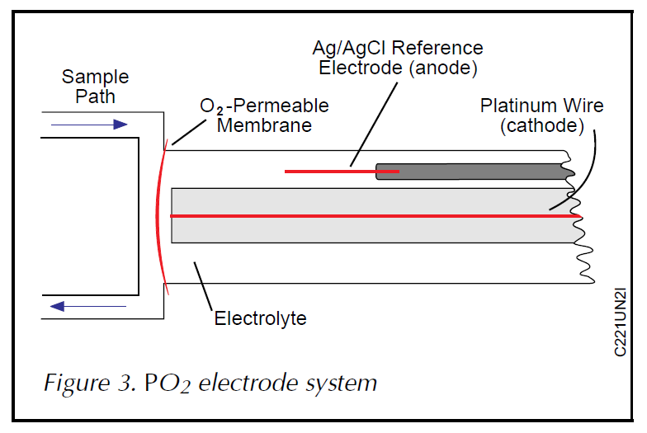
The PO₂ electrode system uses principles similar to those for pH measurement.
Source : ECRI, Blood Gas/pH Analyzers, H.P.C. System, Editor. 2001. p. 1-4.

Slide 13
Cont.
This voltage attracts oxygen molecules to the cathode surface, where they react with water. This reaction consumes four electrons for every oxygen molecule reacts with water and produces four hydroxyl ions. The consumed four electrons, in turn, are replaced rapidly in the electrolyte solution as silver and chloride react at the anode.

Slide 14
Cont.
. This continuous reaction leads to continuous flow of electrons from the anode to the cathode (electrical current). This electrical current is measured by using an ammeter (electrical current flow meter). The current generated is indirect proportion to the amount of dissolved oxygen in the blood sample, which in direct proportion to PO₂ in that sample.

Slide 15
pH Electrode
The pH electrode uses voltage to measure pH, rather than actual current as in PO₂ electrode. It compares a voltage created through the blood sample (with unknown pH) to known reference voltage (in a solution with known pH). To make this possible, the pH electrode basically needs four electrode terminals (Fig. 4),

Slide 16
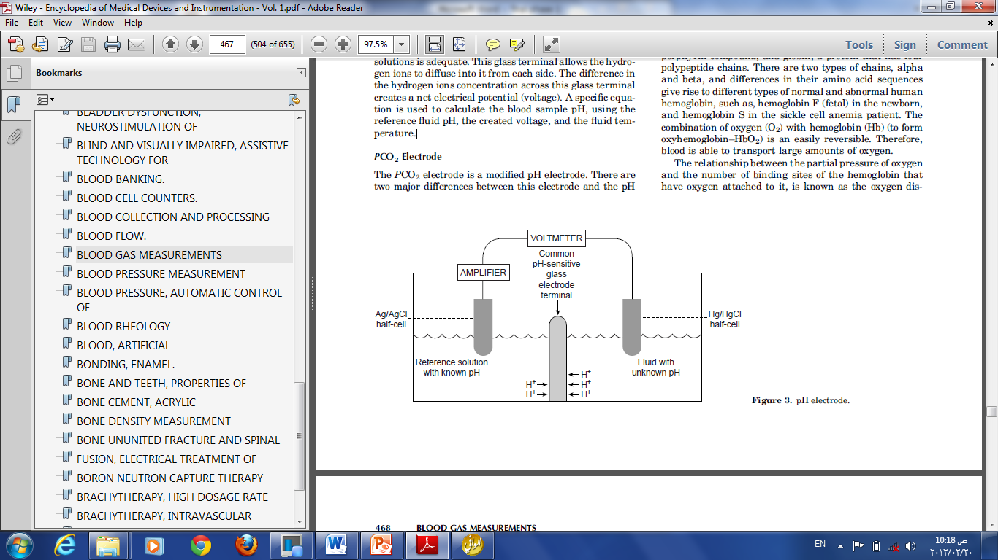
Figure A specific equation is used to calculate the blood sample pH, using the reference fluid pH, the created voltage, and the fluid temperature.
Source : Akay, M., WILEY ENCYCLOPEDIA OF BIOMEDICAL ENGINEERING. 2006, Washington: simultaneously in Canada.

Slide 17
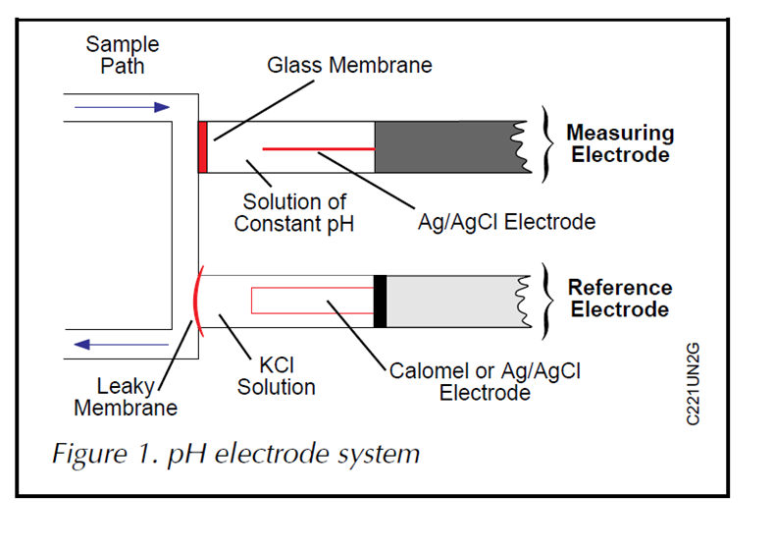
The pH measurement is performed using two separate electrodes: a pH-measuring electrode and a reference electrode.
Source : ECRI, Blood Gas/pH Analyzers, H.P.C. System, Editor. 2001. p. 1-4.

Slide 18
Cont.
rather than two terminals (as in the PO₂electrode). Practically, one common pH-sensitive glass electrode terminal between the two solutions is adequate. This glass terminal allows the hydrogen ions to diffuse into it from each side. The difference in the hydrogen ions concentration across this glass terminal creates a net electrical potential (voltage). A specific equation is used to calculate the blood sample pH, using the reference fluid pH, the created voltage, and the fluid temperature.

Slide 19
PCO₂ Electrode
The PCO₂ electrode is a modified pH electrode. There are two major differences between this electrode and the pH electrode. The first difference is that in this electrode, the blood sample comes in contact with a CO₂ permeable membrane (such as Teflon, Silicone rubber), rather than a pH-sensitive glass (in the pH electrode), as shown in (Fig.6). The CO₂ from the blood sample diffuses via the CO₂ permeable (silicone) membrane into a bicarbonate solution.

Slide 20
Cont.
The amount of the hydrogen ions produced by the
hydrolysis process in the bicarbonate solution is
proportional to the amount of the CO₂ diffused
through the silicone membrane. The difference in the
hydrogen ions concentration across the pH-sensitive
glass terminal creates a voltage. The measured
voltage (by voltmeter) can be converted to PCO₂
units. The other difference is that the CO₂ electrode
has two similar electrode terminals (silver–silver
chloride). However, the pH electrode has two
different electrode terminals (silver–silver chloride
and mercury–mercurous chloride)

Slide 21
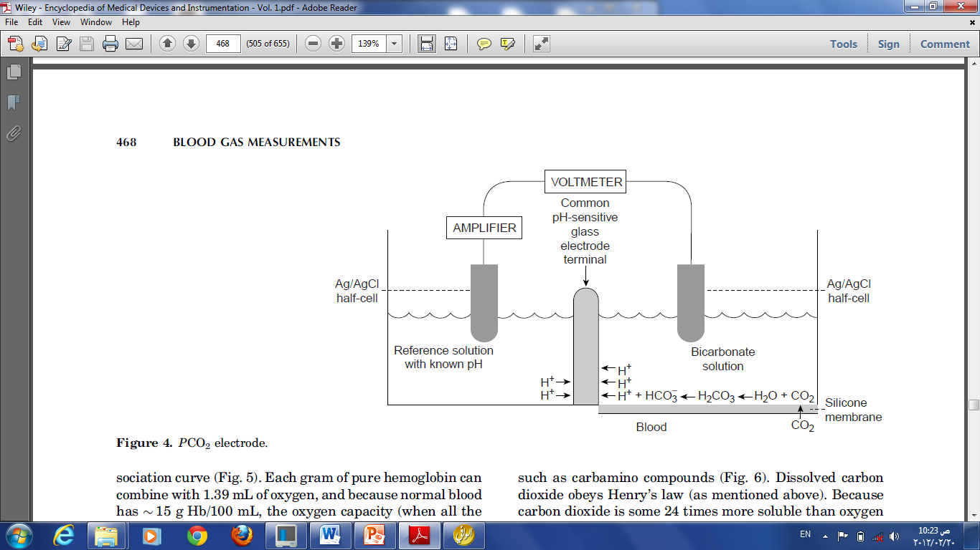
The PCO₂ electrode is a modified pH electrode. There are two major differences between this electrode and the pH electrode.
Source : Akay, M., WILEY ENCYCLOPEDIA OF BIOMEDICAL ENGINEERING. 2006, Washington: simultaneously in Canada.

Slide 22
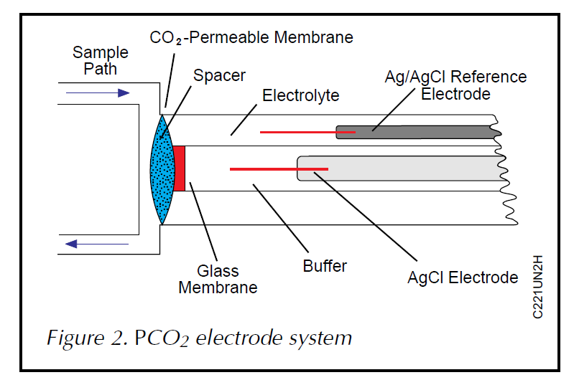
The PCO₂ electrode system uses principles similar to those for pH measurement.
Source : ECRI, Blood Gas/pH Analyzers, H.P.C. System, Editor. 2001. p. 1-4.

Slide 23
Block diagram
Most blood gas analyzers have multiple sensors that are driven through an amplifier and a multiplexer to an analog-to-digital converter (ADC). The data is processed in the microcontroller, which is connected to a PC or other instruments through RS-232, USB, or Ethernet. A digital-toanalog converter (DAC) is often used to calibrate the sensor amplifiers to maximize the sensitivity of the electrodes.

Slide 24
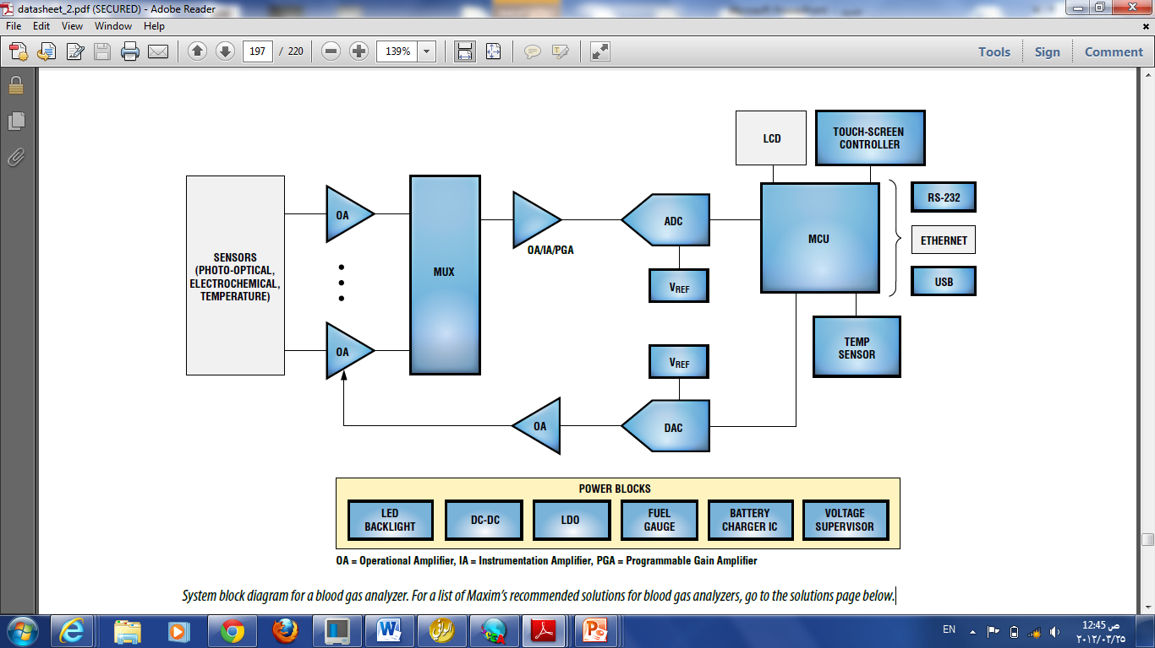
Source: www.maxim-ic.com/medical

Slide 25
Implementation
The amplifier circuit of Figure illustrates how this may be done. Due to the high electrical resistance of the indicator electrode’s glass membrane, the meter must have a correspondingly high input impedance.
Most pH meters currently sold contain built-in microprocessors that simplify pH measurement by performing and storing calibrations, doing diagnostics, and implementing temperature compensation.

Slide 26
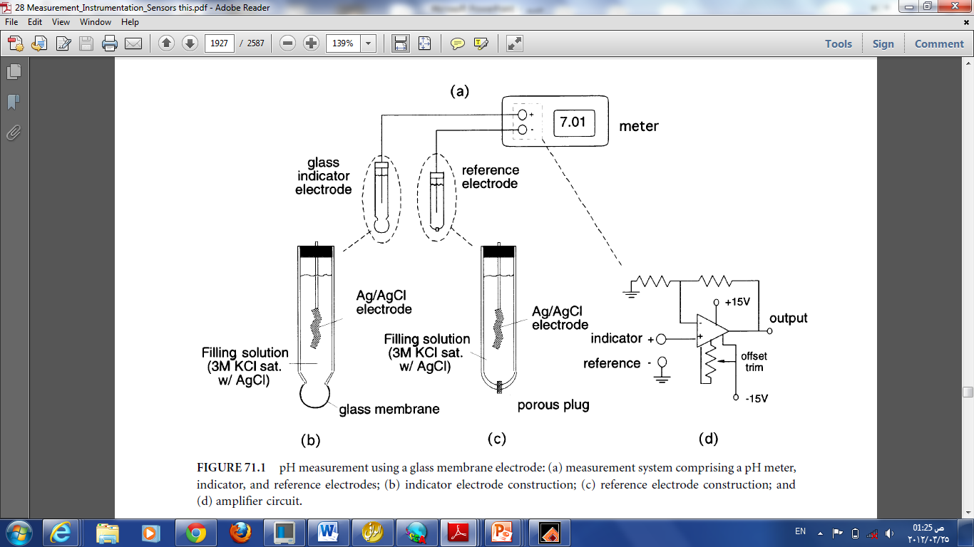
Source : Aller, M., Measurement Instrumentation Sensors1999: CRC Press LLC.

Slide 27
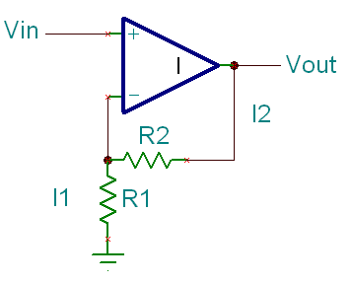
Opamp Amplifier
Approx. Vin
I2 approx = I1
I₁ = V_{IN}/R₁
I₂ = (V_{OUT} - V_{IN})/R₂ => V_{OUT} = V_{IN} + I₂R₂
V_{OUT} = I₁R₁ + I₂R₂ = (R₁+R₂)I₁ = (R₁+R₂)V_{IN}/R₁
Therefore V_{OUT} = (1 + R₂/R₁)V_{IN}

Slide 28
FIGURE Current/Voltage converter used for an oxygen sensor.
source: John D. Enderle, S. M. B., Joseph D. Bronzino (2005). INTRODUCTION TO BIOMEDICAL ENGINEERING, Elsevier Inc.

Slide 29
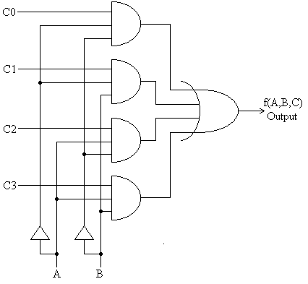
multiplexer
A multiplexer performs the function of selecting the input on any one of 'n' input lines and feeding this input to one output line.

Slide 30
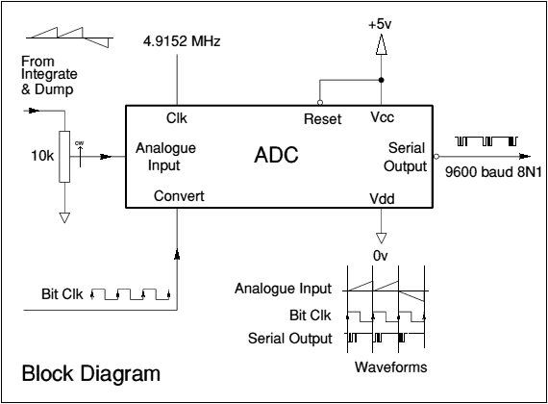
Figure convert the signal from analog to digital
Source http://www.jrmiller.demon.co.uk/products/p3adc.html

Slide 31
MODEL | AVL FAILED TO RESPOND * Compact 3 | BAYER Rapidlab 248 | NOVA Stat Profile M | VIA MEDICAL ABG
WHERE MARKETED | Worldwide | Worldwide | Worldwide | Japan, USA
FDA CLEARANCE | Yes | Yes | Yes | Yes
TESTS AVAILABLE Measured (range) BP, mm Hg pH PCO2, mmHg PO2, mmHg | 300-800 6.000-8.000 4-200 0-740 | 400-825 6.500-8.000 5-250 0-749 | 450-800 6.5-8.0 3-200 0-800 | No 6.80-7.70 10-150 20-699
AMBIENT TEMPERATURE RANGE, °C | 15-32 | 15-32 | 16-30 | 18-30
SAMPLE VOLUME, mL Normal Micro | 55 25 (step mode) | 90 35 | 190 85 | 0 NA

Slide 32
WAVELENGTH OXIMETER | NO | NO | Yes | No
VISIBLE SAMPLE CHAMBER | Yes | Yes | Yes | No
ANALYSIS TIME, sec | 20 | 60 | 108 | 70
USER-ENTERED DATA | Patient temp, FiO2, RQ, Hb (adult or fetal), tHb | Patient temp, FiO2 patient/operator ID, tHb | Patient ID and temp, FiO2, accession number | Patient ID, name, Temp
ELECTRODE MAINTENANCE | Zero-maintenance or optional premem- braned electrode housing replacement | None | Some maintenance- free, some pre- membraned snap-on caps | Disposable
DISPLAY | LCD | LCD | CRT | Vacuum fluorescent

Slide 33
PRINTOUT | Thermal printer, optional ticket printer | Roll printer | Thermal printer, optional ticket printer | Thermal
CALIBRATION | Automatic, programmable and point calibration | Automatic, programmable | Automatic (point every 2-6 hr; point with every Sample. | Initial point; automatic point every 10 min after initial
STANDBY MODE | Yes | Yes | Not specified | Yes
DATA MANAGEMENT | Onboard QC, stores last 3 patient re- sults, error logbook | Optional | Onboard QC, Windows NT, data manager option | Yes
INTERFACE | RS232 (3) | RS232 | RS232 | RS232
BAR-CODE READER | Yes | Not specified | Optional | No
PASSWORD PROTECTION | Yes | Not specified | Yes | No

Slide 34
POWER REQUIREMENTS, VAC, Hz | 100-240, 50/60 | 100/120/220/240, 50/60 | 90-264, 50/60 | 110/120/220/240, 50/60
POWER CONSUMPTION | 65 VA, max 110 | Not specified | 200 W | Not specified
H x W x D, cm | 34 x 34 x 31.5 | 38.1 x 38.1 x 33 | 46 x 56 x 48 | 21.6 x 24.1 x 22.9
WEIGHT, kg | 13 | 9.1 | 31 | 7.3
LIST PRICE | $16,995 | $19,500 | $25,750-52,750 varies by test menu | Not specified
Warranty | 1 year, including electrodes | 1 year | 1 year | 1 year
Source : ECRI, Blood Gas/pH Analyzers, H.P.C. System, Editor. 2001. p. 1-4.

Slide 35
references
[1] John D. Enderle, S. M. B., Joseph D. Bronzino (2005). INTRODUCTION TO BIOMEDICAL ENGINEERING, Elsevier Inc.
[2] Akay, M. (2006). WILEY ENCYCLOPEDIA OF BIOMEDICAL ENGINEERING. Washington, simultaneously in Canada.
[3] ECRI, Blood Gas/pH Analyzers, H.P.C. System, Editor. 2001. p. 1-4.
[4] Khandpur, R. S. (2003). Handbook of Biomedical Instrumentation New Delhi, Tata McGraw-Hill.
[5] Bronzino, J.D., The Biomedical Engineering HandBook. Second ed. 2000.

Slide 36
following
http//www.AVL.com/support
http://www.labtestsonline.org/understanding/analytes/blood_gases/test.html
http://www.nlm.nih.gov/medlineplus/ency/article/003855.htm
www.ecri.org

