Slide 1
Ventilator VT Plus HF Gas flow analyzer
Dr Fadhl Al-Akwaa
fadlwork@gmail.com
www.Fadhl-alakwa.weebly.com

Slide 2
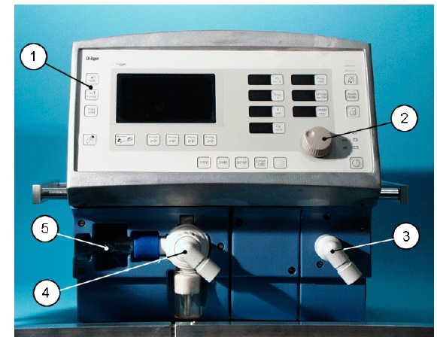

Slide 3
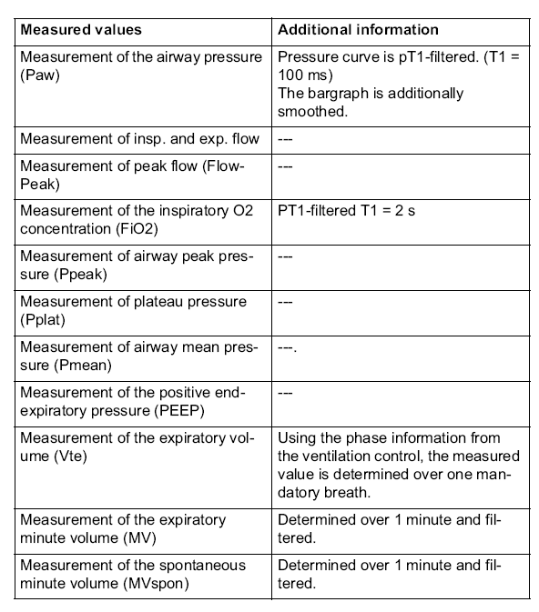

Slide 4
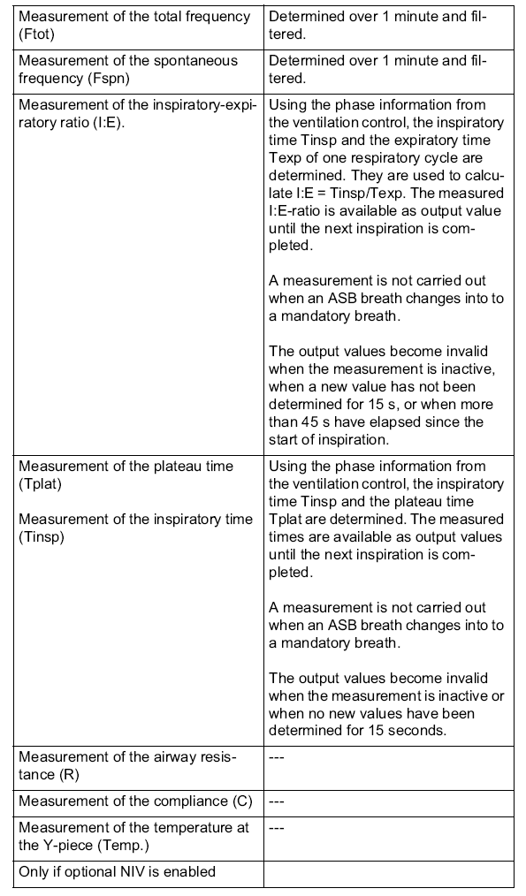

Slide 5
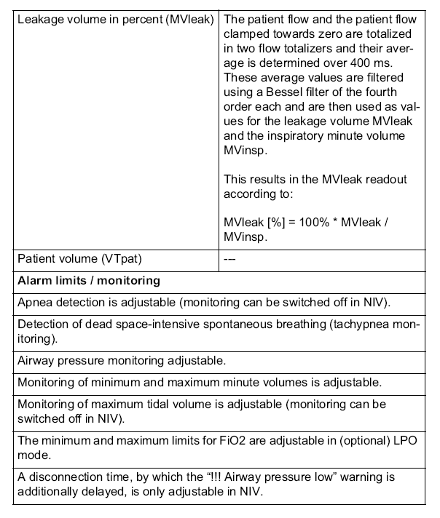

Slide 6
AGENDA
Medical Terminology
How Ventilators Work
Modes of Ventilation
Block diagram
Ventilator performance test

Slide 7
Terminology
Expiration = Exhalation= breathing out
Inspiration =inhalation= breathing in
tidal volume (TV) =The amount of air flowing into and out of the lungs with each breath.
In a typical adult this amounts to about 500 mL(0.5 L) during quiet breathing.
The minute volume (MV) is the volume of air per breath (tidal volume) multiplied by the respiratory rate (R), i.e., MV = (TV) R (L/M)

Slide 8
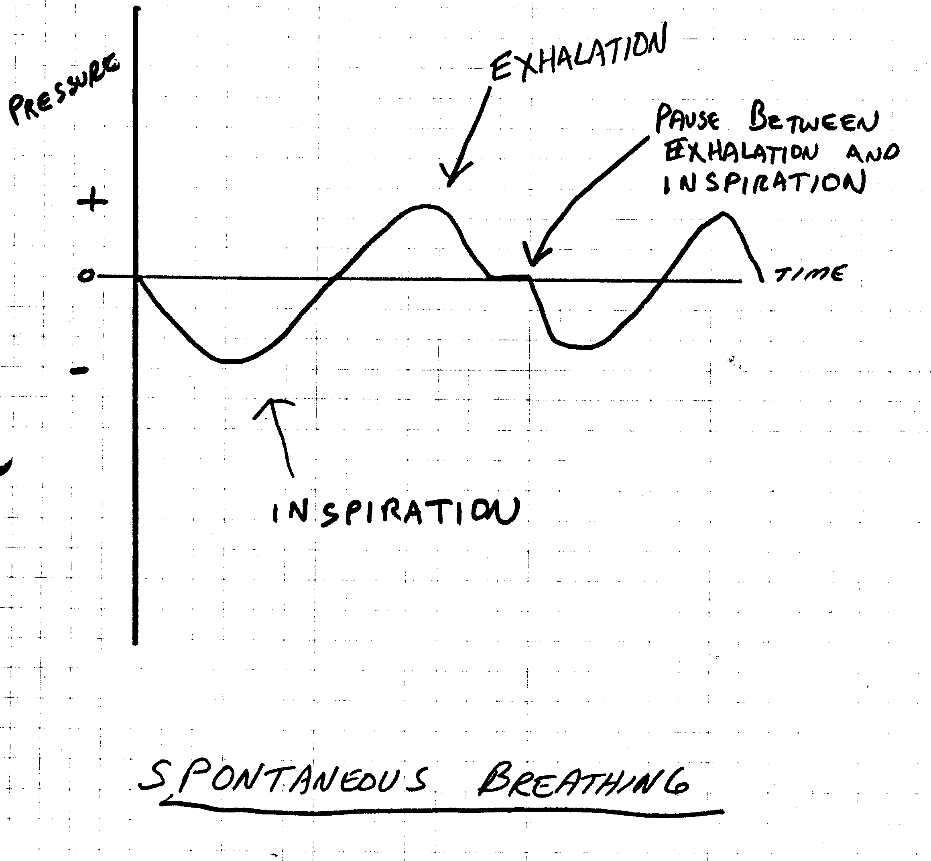
Spontaneous Breathing

Slide 9
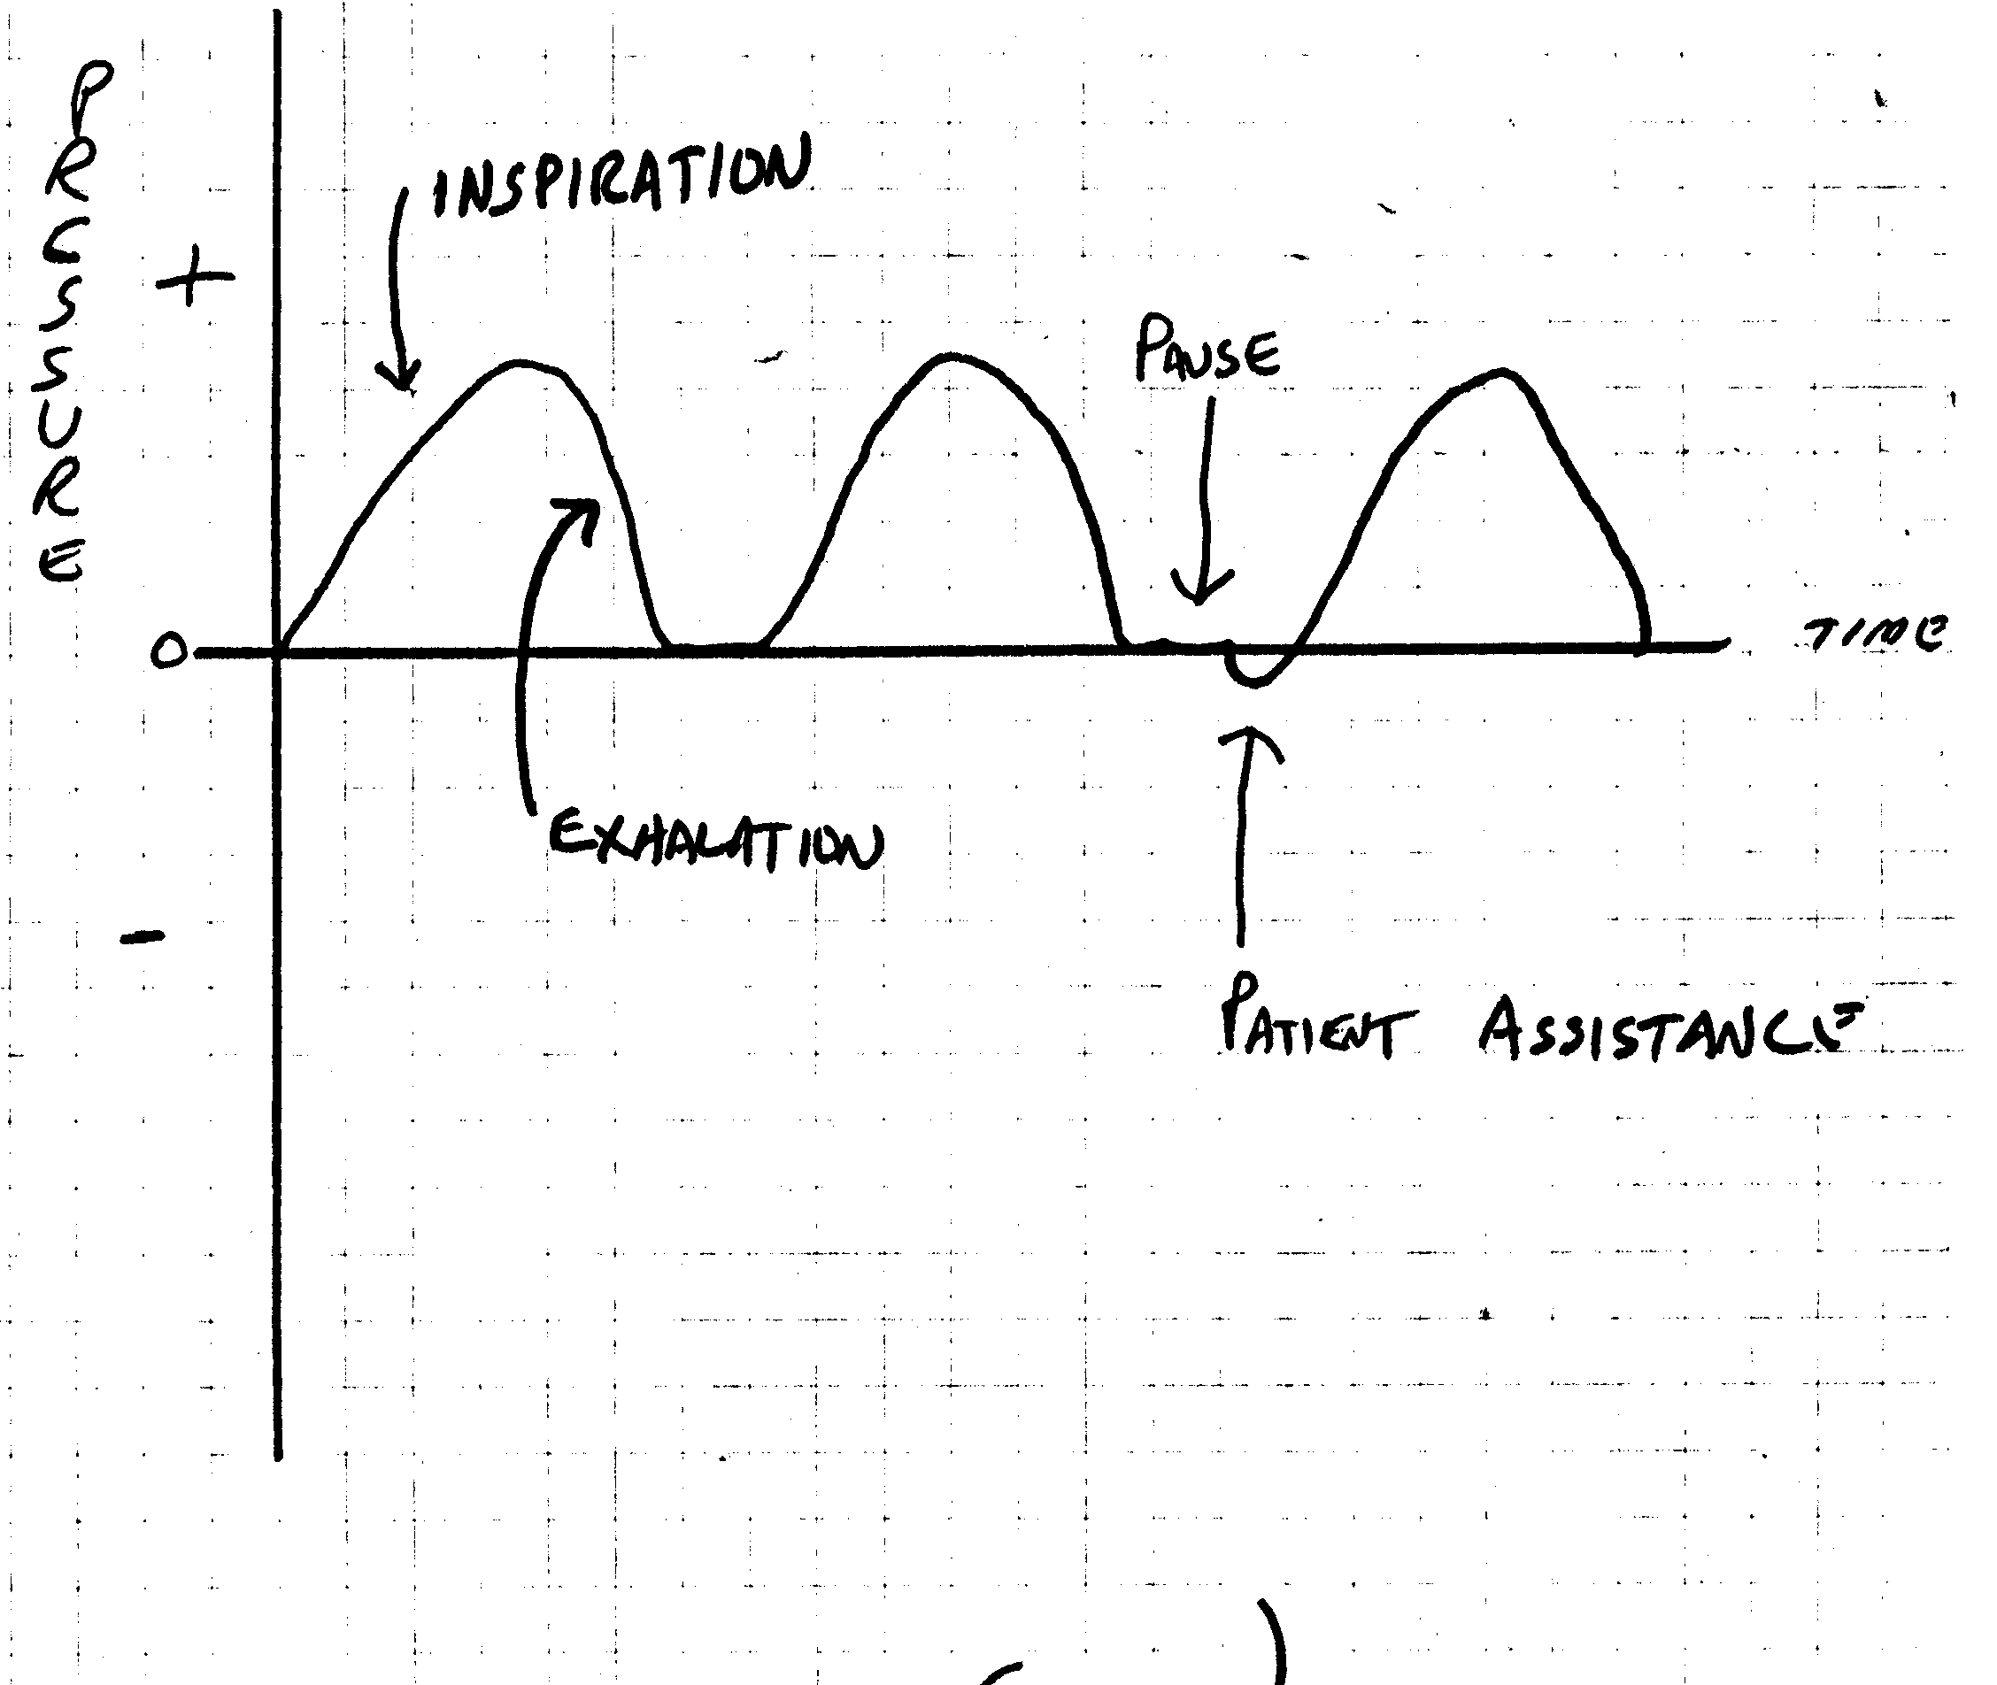
Positive Pressure Breath

Slide 10
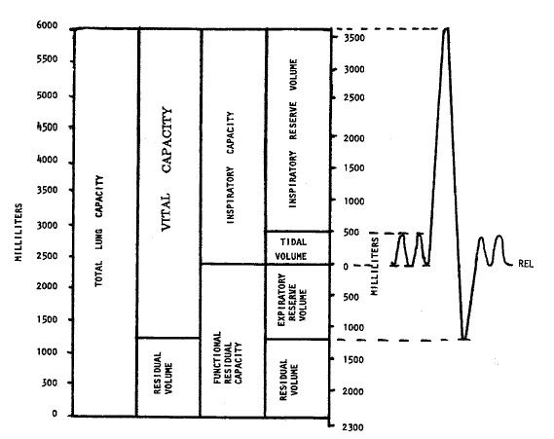

Slide 11
Terminology
Apena The patient has stopped breathing.
Sigh A breath delivered by the ventilator that differs in duration and pressure from a nominal breath.
Nebulizer A device for producing a fine spray of liquid or medication into the patient’s air.

Slide 12
The trigger
The trigger variable, which causes inspiration to begin, can be a preset pressure variation (pressure triggering), a preset volume (volume triggering), a designated flow change (flow triggering), or an elapsed time (time triggering).

Slide 13
The distinction between volume-targeted and pressure-targeted ventilation
Volume-targeted modes deliver a fixed tidal volume (Vt) with each breath. This means that airway pressure during a given breath can vary depending on the resistance to airflow during inspiration and on the patient’s lung and chest wall compliance.

Slide 14
The limit variable
The limit variable is the pressure, volume, or flow target that cannot be exceeded during inspiration. An inspiration may thus be limited when a preset peak airway pressure is reached (pressure limiting), when a preset volume is delivered (volume limiting), or when a preset peak flow is attained (flow limiting).

Slide 15
Cycling
Cycling refers to the factors that terminate inspiration. A breath may be pressure, volume, or time cycled when a preset pressure, volume, or flow as time interval has been reached, respectively.

Slide 16
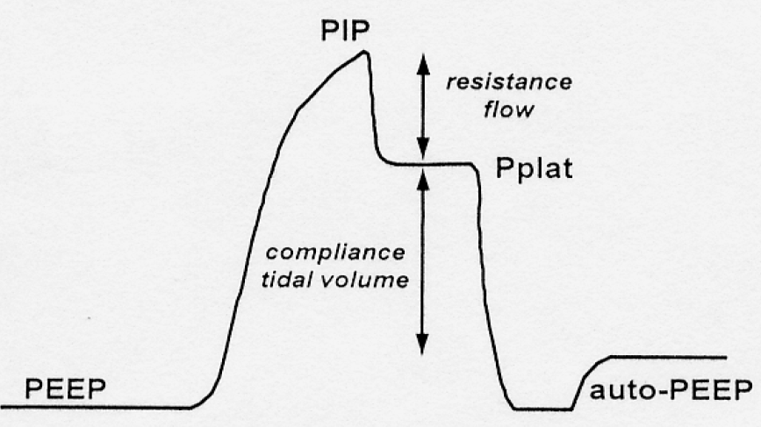
Pressure profile of a volume-targeted breath in which flow is interrupted at end-inspiration, allowing measurement of the quasi-static properties of the respiratory system. PEEP, positive end-expiratory pressure; PIP, peak inspiratory pressure; Pplat, end-inspiratory plateau pressure; auto-PEEP, pressure above the set level of PEEP that is generated by dynamic hyperinflation due to incomplete exhalation in the presence of obstructive lung disease.

Slide 17
WEANING AND EXTUBATION
break away from something one is accustomed to.
switch from full ventilatory support to fully spontaneous breathing.

Slide 18
Mode of Ventilation
Three different types of breath can be provided during mechanical ventilation, depending upon whether the ventilator or the patient does the work and whether the ventilator or the patient initiates (triggers) the breath.
These types are mandatory, assisted, and spontaneous breaths.

Slide 19
Mode of Ventilation
Mandatory breaths are machine cycled, and are triggered, limited, and cycled by the ventilator.
The patient is entirely passive, and the ventilator performs the work of breathing.
Assisted breaths are like mandatory breaths in that they are limited and cycled by the ventilator, but are triggered by the patient. Breathing work is thus partly provided by the ventilator and partly by the patient.
Spontaneous breaths are triggered, limited, and cycled by the patient, who performs all the work of breathing.

Slide 20
Volume-Targeted Modes
Assist/control (A/C, or AMV)
synchronized intermittent mandatory ventilation (SIMV).
controlled mechanical ventilation (CMV)
The theoretic risk of ‘stacking’ a mandatory breath on top of a large spontaneous breath, which might produce barotrauma, means that most ventilators deliver IMV in such a way that mandatory breaths can only be delivered after expiration is sensed, called SIMV.

Slide 21
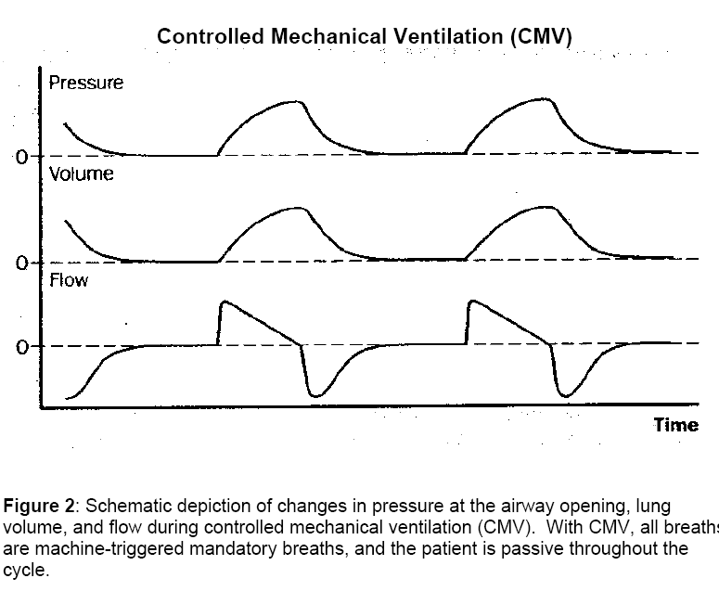

Slide 22
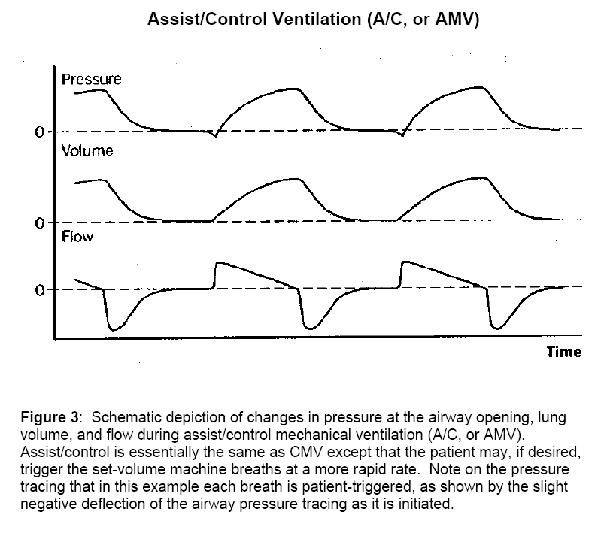

Slide 23
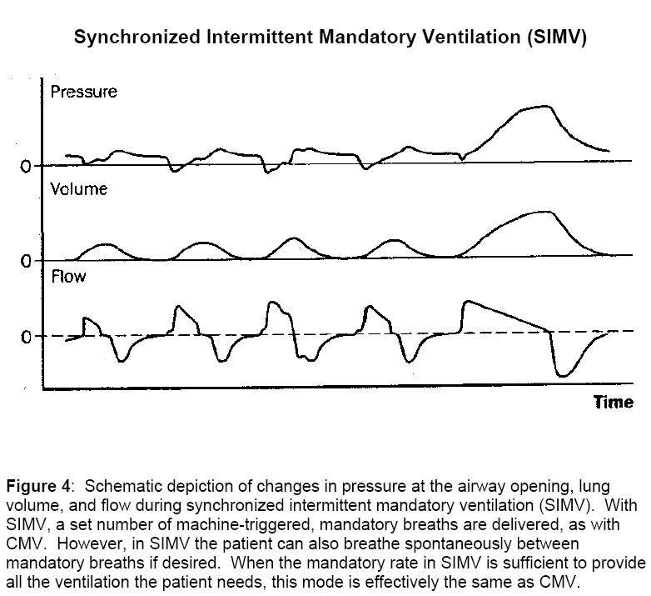

Slide 24
CMV A/C SIMV
Full ventilatory support is provided by CMV, which means that all work performed on the respiratory system during ventilation is provided by the ventilator (the patient is passive). In A/C ventilation, full ventilatory support is provided when the patient is not triggering, but partial ventilatory support when the patient breathes at a rate greater than the fixed backup rate. Studies have shown that patient work can be substantial in A/C, continuing throughout the inspiratory phase, particularly if the patient is air-hungry and the inspiratory flows provided by the ventilator are low. In SIMV, full ventilatory support is provided when the patient is not attempting to breathe above the mandatory rate, and partial ventilatory support when any spontaneous ventilation is present.

Slide 25
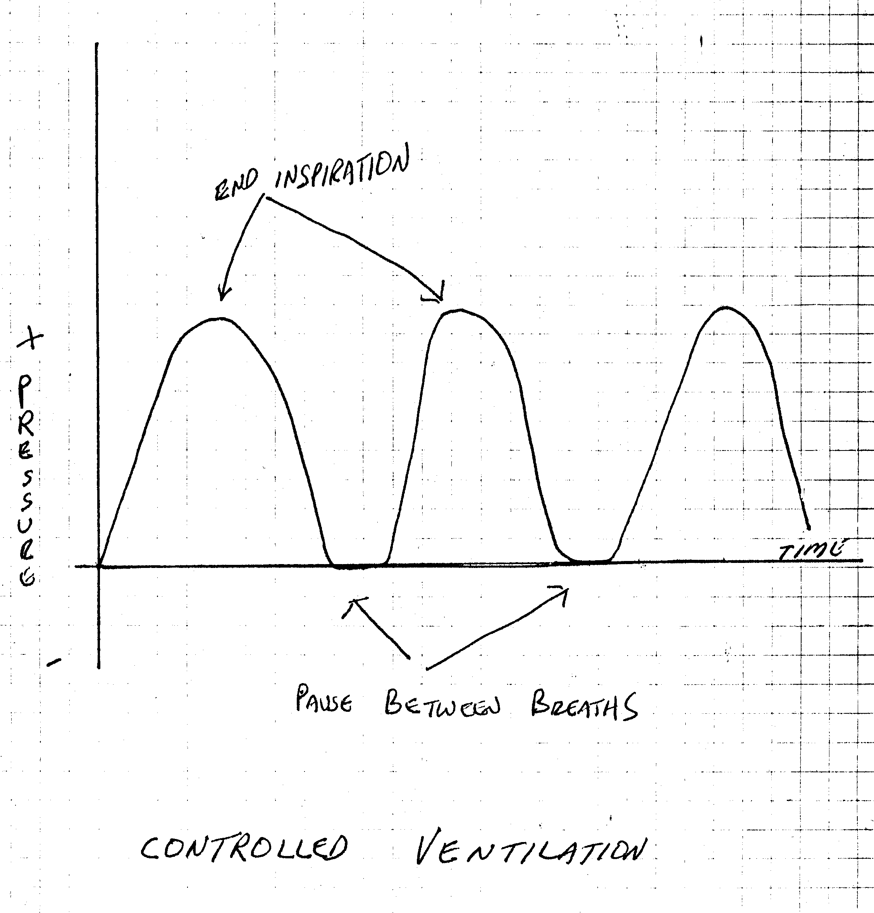
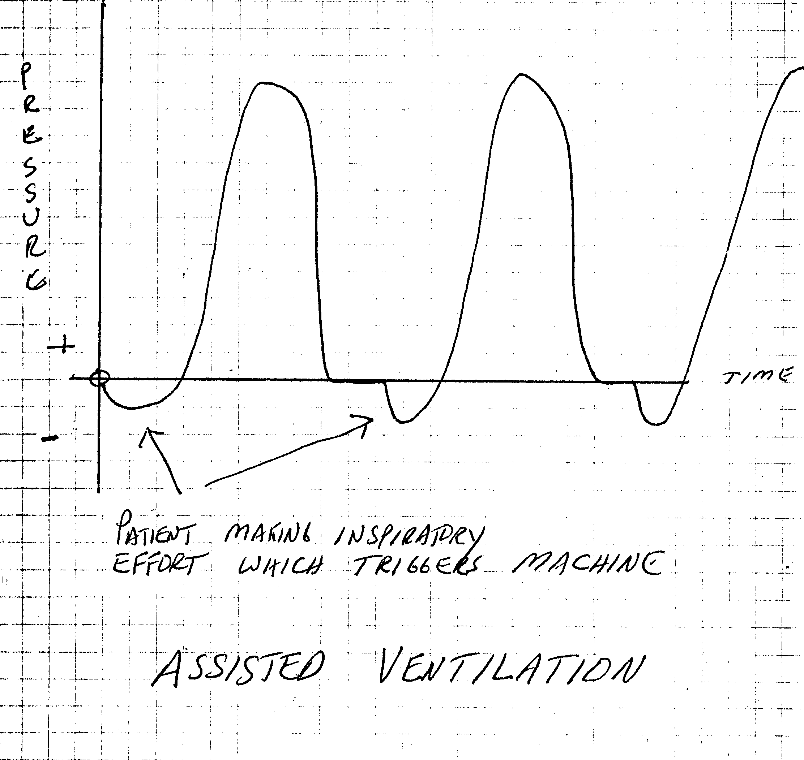
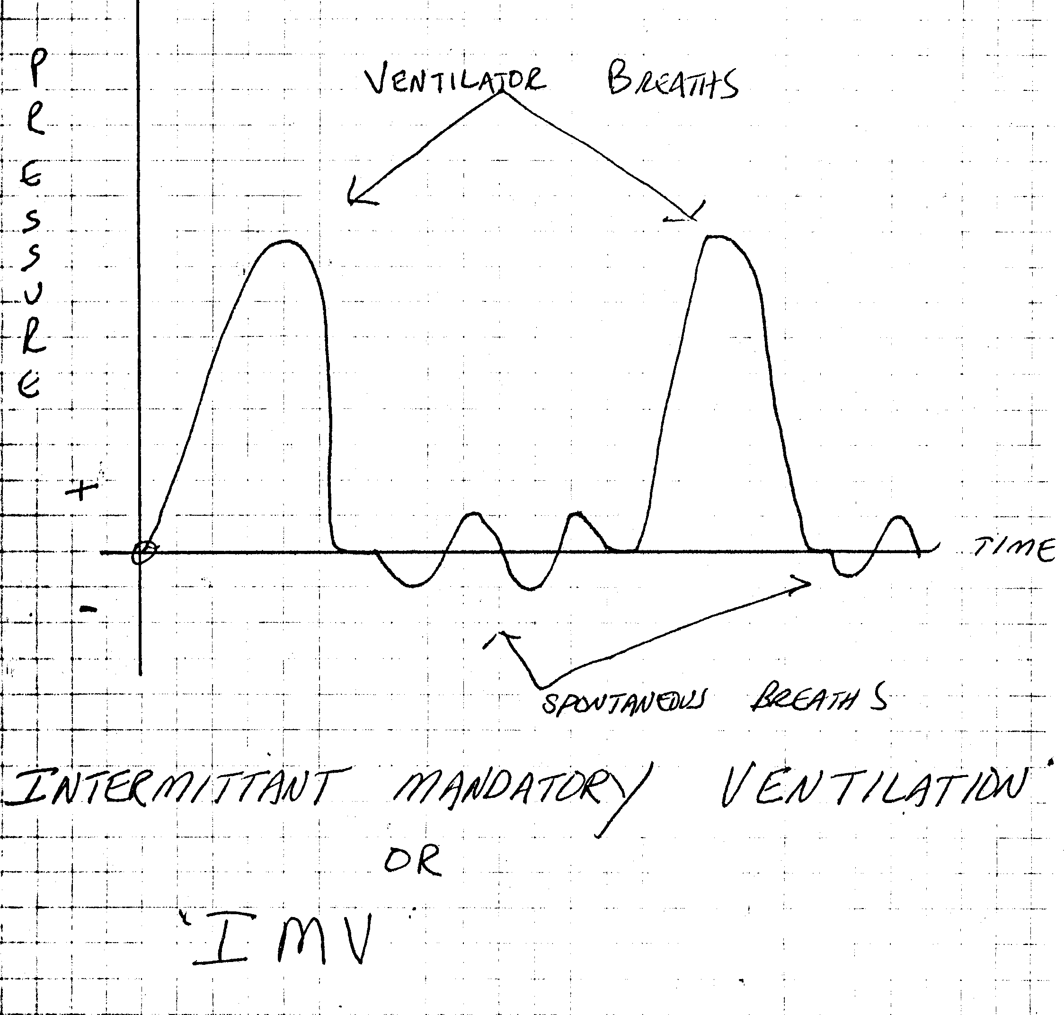
CMV A/C SIMV

Slide 26
Pressure-Targeted Modes
pressure support ventilation (PSV)
pressure control ventilation (PCV),
intermittent positive-pressure breathing (IPPB),
Continuous positive airway pressure (CPAP)
This variant of PCV has been used in patients who have severe hypoxemic respiratory failure in an attempt to improve oxygenation, but its popularity has waned because of the high incidence of hemodynamic compromise and barotrauma.

Slide 27
Volume-Targeted Ventilation (VTV) and Pressure-Targeted Ventilation (PTV)
A key distinction between volume- and pressure-targeted modes relates to what happens when the mechanics of the patient-ventilator system change. When a patient who receives volume-targeted ventilation develops a pneumothorax or partial airway obstruction by inspissated secretions, the same Vt is delivered as before, but at higher peak and static airway pressures. However, with pressure-targeted ventilation, maximal airway pressure is preset and cannot increase under these circumstances. Instead, with obstruction in the airway or a decrease in compliance, the pressure stays the same and the delivered Vt decreases. Thus, the clinician needs to be aware that complications may be manifested differently in the different modes. When managing a patient whose pulmonary process may improve rapidly, as in acute asthma or pulmonary edema, the clinician needs to be prepared to make frequent ventilator adjustments when pressure ventilation is used.

Slide 28
Volume-Targeted Ventilation (VTV) and Pressure-Targeted Ventilation (PTV)

Slide 29
Principles of Mechanical Ventilation
RET 2284L
Module 1.0
How Ventilators Work
http://faculty.mdc.edu/pslocum/RET%202284%20Mod%203.0%20Modes%20of%20Ventilation.ppt

Slide 30
How Ventilators Work
“To properly care for a critically ill person on ventilatory support, clinicians must know the various functions of the ventilator used. They must understand how the ventilator interacts with the patient and how changes in the patient’s lung condition can alter the ventilator’s performance”

Slide 31
How Ventilators Work
How Ventilators Work
Input Power
Power Transmission and Conversion
Control System
Phase Variable

Slide 32
How Ventilators Work
Input Power (power source)
The power source enables the machine to perform the work of ventilating the patient
Electrically powered
Pneumatically powered
Combination electrical/pneumatic powered

Slide 33
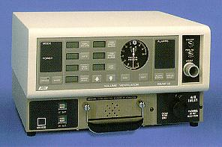
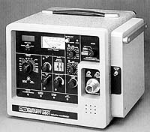
How Ventilators Work
Input Power
Electrically Powered Ventilators
Rely on electricity to drive motors, electromagnets, potentiometers, computers, etc., which help ensure a controlled pressure and gas flow to the patient
Alternating current (AC) – 120V
Direct current (DC) – 12V battery
Short term transport
Backup power
Bear 33
PB 2801 Companion

Slide 34
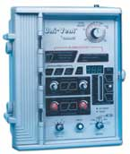
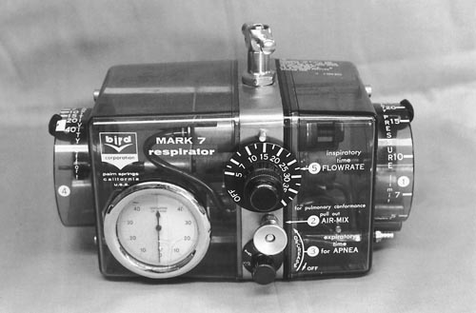
How Ventilators Work
Input Power
Pneumatically Powered Ventilators
Depend entirely on a compressed gas source for power
Require 50 psi gas sources
Built-in reducing valves to control operating pressure
Ideal for transport, MRI, or during power failure
Bird Mark 7
Impact 750 Transport Ventilator

Slide 35
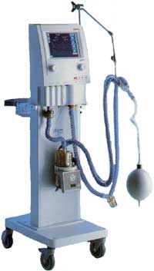
How Ventilators Work
Input Power
Combined Powered Ventilators
Pneumatically powered, electronically or microprocessor controlled
Pneumatic power provides the energy to deliver the breath to the patient
Electrical power energizes the microprocessor to control special valves that regulate the characteristics of the breath delivered (inspiration and expiration)
Most current ICU ventilators are this type
Galileo Gold
Puritan Bennett 840

Slide 36
How Ventilators Work
Positive and Negative Pressure Ventilators
Ventilator gas flow into the lungs is based on two different methods:
Positive pressure
Negative pressure

Slide 37
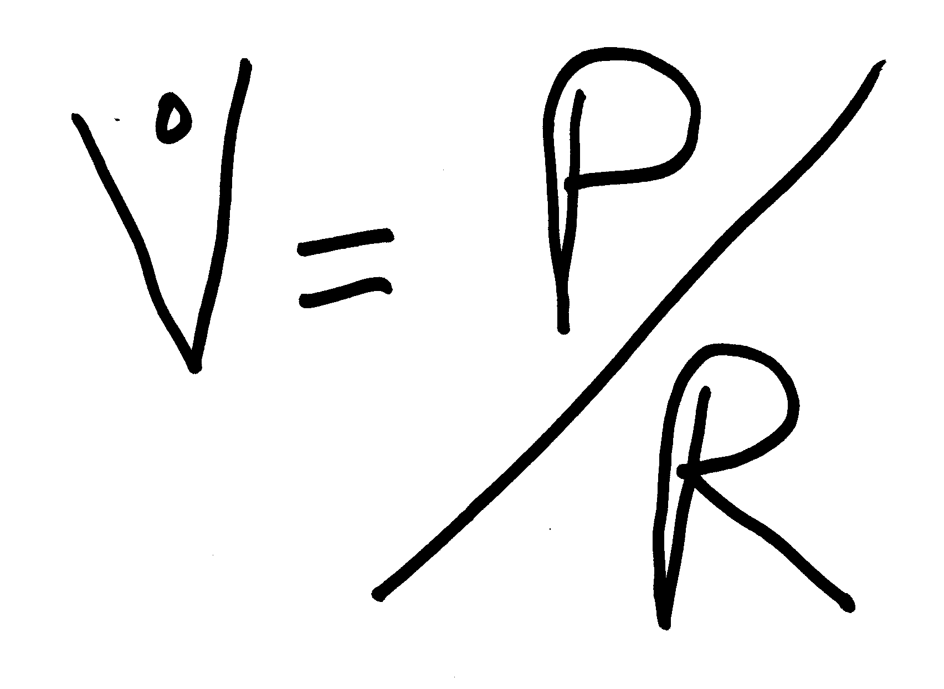
How Ventilators Work
Positive Pressure Ventilators
Applies pressure inside the chest to expand it.
Requires tight fitting mask or an artificial airway
Flow = Pressure divided by resistance

Slide 38
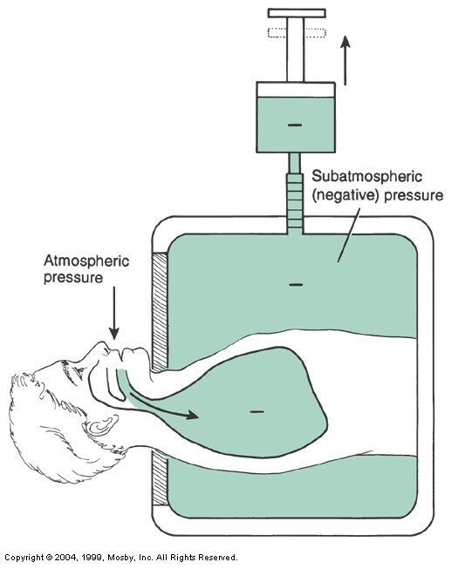
How Ventilators Work
Negative Pressure Ventilators
Applies subatmospheric pressure outside of the chest to inflate the lungs
Removing the negative pressure allows passive exhalation
Chest Cuirass
Iron Lung

Slide 39
How Ventilators Work
Control Systems and Circuits
The control system (control circuit), or decision-making system, regulates ventilator function
Open loop control circuits (unintelligent)
Operator sets control (e.g., tidal volume), and the ventilator delivers that volume to the patient circuit – the ventilator cannot be programmed to respond to changing conditions, e.g., gas leak
Usually, not microprocessor controlled

Slide 40
How Ventilators Work
Control Systems and Circuits
The control system (control circuit), or decision-making system, regulates ventilator function
Closed loop control circuits (intelligent, servo controlled)
Compares the set control variable to the measured control variable, e.g., compares the tidal setting to the measured tidal volume exhaled by the patient. If the two differ, the control system may alter the volume delivery

Slide 41
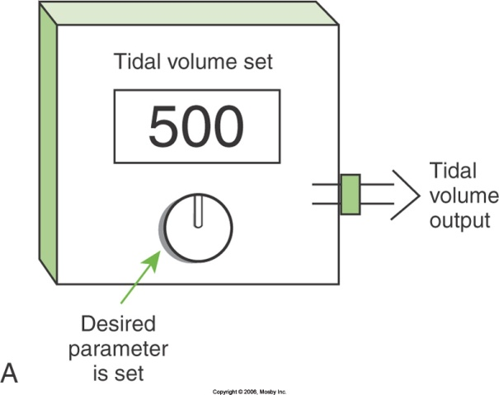
How Ventilators Work
A. Open loop circuit
(unintelligent)
B. Closed loop circuit
(intelligent)

Slide 42
How Ventilators Work
Question
A respiratory therapist sets a ventilator tidal volume at 650 mL. Volume measured at the exhalation valve is 500 mL. These measurements occur over the next several breaths with no changes. Is this open-loop or closed-loop logic?
Answer: Open-loop logic

Slide 43
How Ventilators Work
Question
A respiratory therapist sets the tidal volume at 650 mL. After one breath, the exhaled volume measures 500 mL and the peak pressure is 8 cm H2O. After a second breath, the exhaled volume is 600 mL and the pressure is 14 cm H2O. After a third breath, the exhaled volume is 649 mL and the peak pressure is 16 cm H20. What type of system is this?
Answer: Closed-loop system

Slide 44
How Ventilators Work
Control Systems and Circuits
Control Panel
The control panel or user interface, is located on the surface of the ventilator and is monitored and set by the ventilator operator
The internal control system reads the and uses the operator’s settings to control the function of the drive mechanism
For setting such components as VT, rate, inspiratory time, alarms, and FiO2

Slide 45
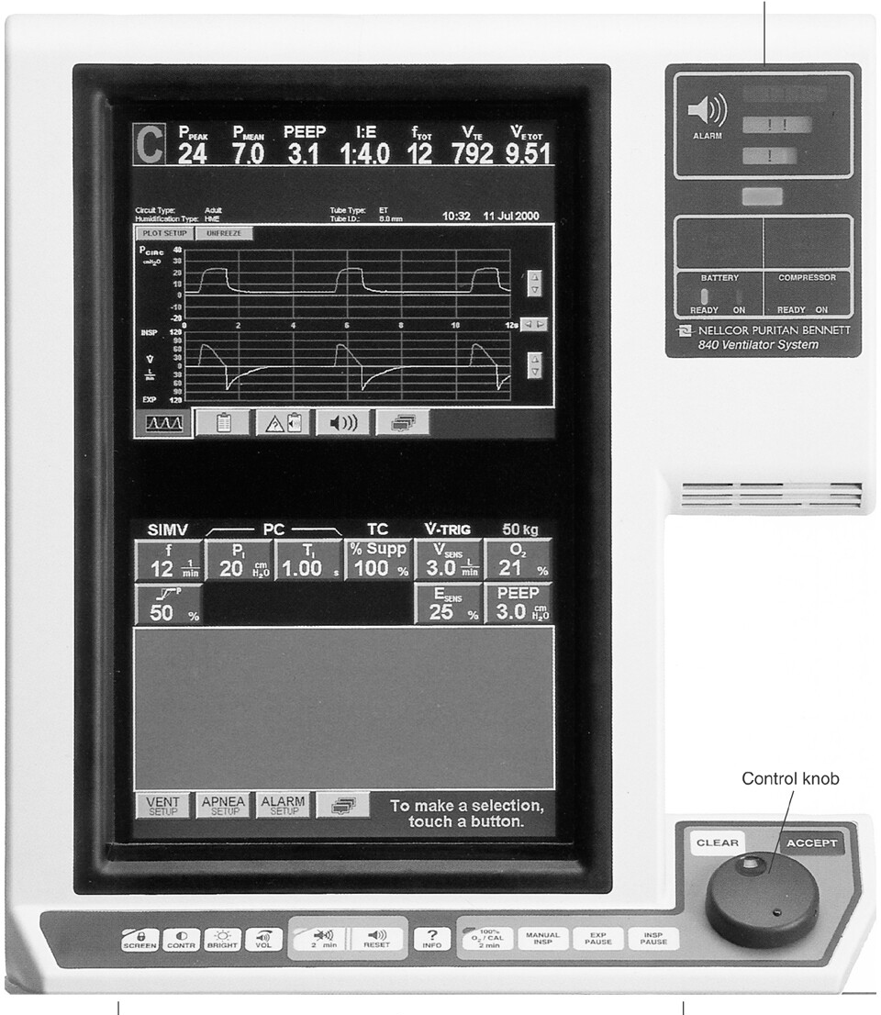
Puritan Bennett 840 Ventilator
Control Panel

Slide 46
Maquet’s Servo i
Control Panel

Slide 47
How Ventilators Work
Control Systems and Circuits
Pneumatic Circuit
Internal Pneumatic Circuit
A series of tubes within the ventilator that directs the flow of gas from the generating source to the ventilator’s outside surface
External Pneumatic Circuit
Also known as the patient circuit, connects the ventilator to the patient’s artificial airway

Slide 48
How Ventilators Work
Control Systems and Circuits
Pneumatic Circuit
External Pneumatic Circuit
Also known as the patient circuit, connects the ventilator to the patient’s artificial airway

Slide 49
How Ventilators Work
Drive Mechanism
The internal hardware (mechanical device) of the ventilator that converts the electrical or pneumatic power into a useful system that produces gas flow to the patient
The type of drive mechanism determines the characteristic flow and pressure patterns each ventilator produces
Piston Drive Mechanism
Bellow Drive Mechanism
Proportional Solenoid
Microprocessor-Controlled On/Off Valves

Slide 50
How Ventilators Work
Power Transmission and Conversion
The ventilator’s internal hardware that converts electrical or pneumatic energy into a useful system that provides a breath to a patient is called the power transmission and conversion mechanism

Slide 51
How Ventilators Work
Power Transmission and Conversion
Drive Mechanism
The mechanical device that produces gas flow to the patient
Output Control Mechanism
One or more valves that regulate gas flow to the patient

Slide 52
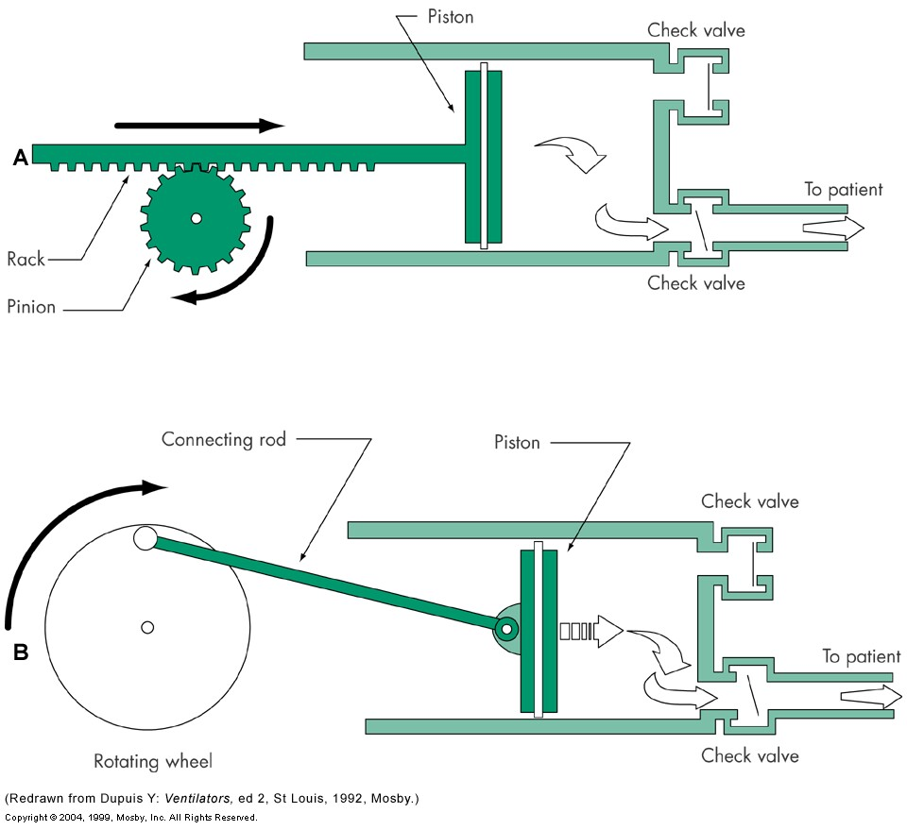
How Ventilators Work
Drive Mechanism
Piston Drive Mechanism (usually electrically powered)
Linear-driven
Rotary-driven

Slide 53
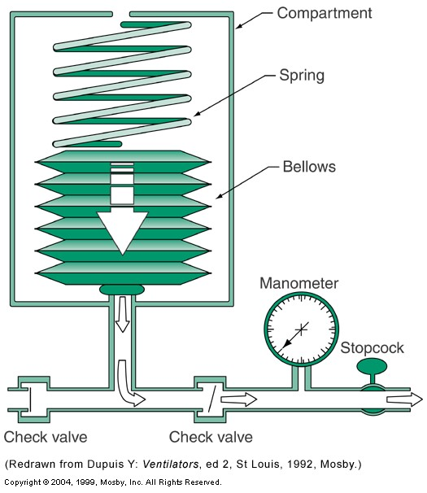
How Ventilators Work
Drive Mechanism
Bellows Drive Mechanism
Uses a bellows to compress the gas for delivery to the patient
Bellows may be compressed by:
Spring
Gas pressure

Slide 54
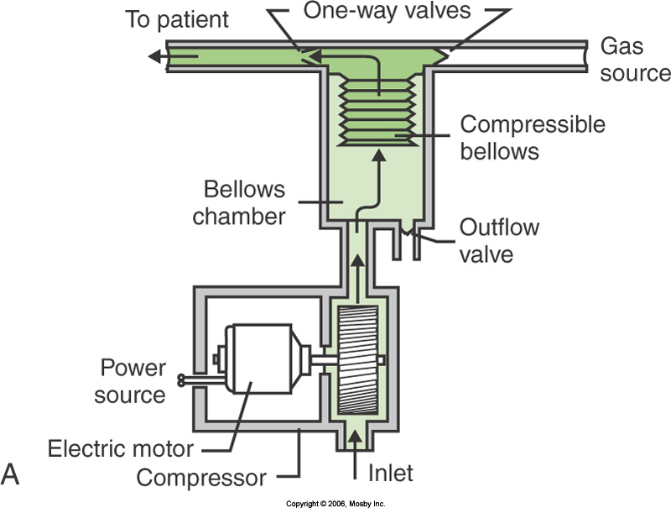
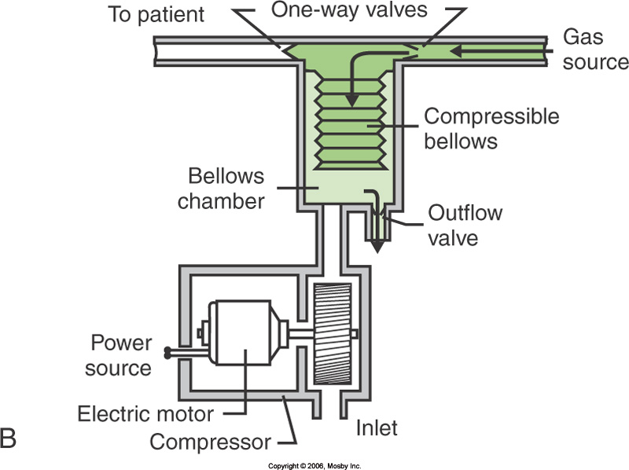
How Ventilators Work
Drive Mechanism
Bellows Drive Mechanism

Slide 55
How Ventilators Work
Drive Mechanism
Proportional Solenoid Valve Mechanism
Flow control valve

Slide 56
How Ventilators Work
Drive Mechanism
Microprocessor-Controlled On/Off Valves
Use proportional solenoid valves controlled by a microprocessor to control flow

Slide 57
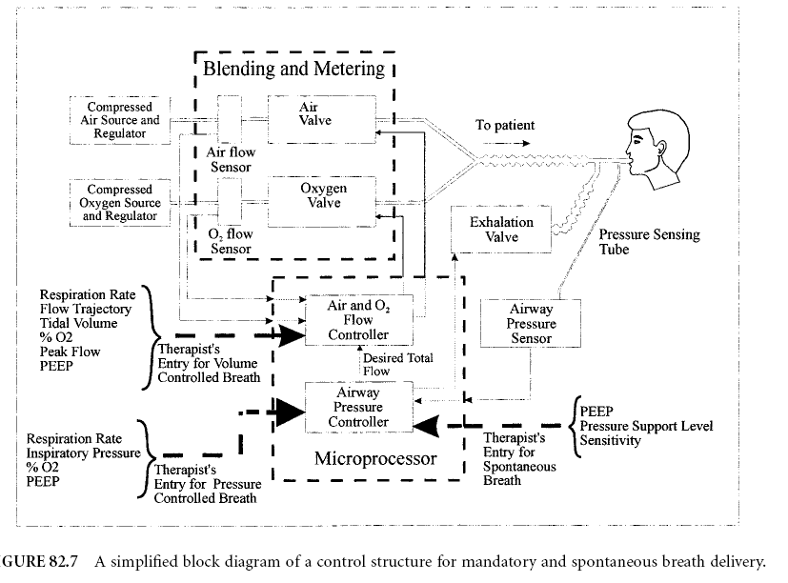

Slide 58
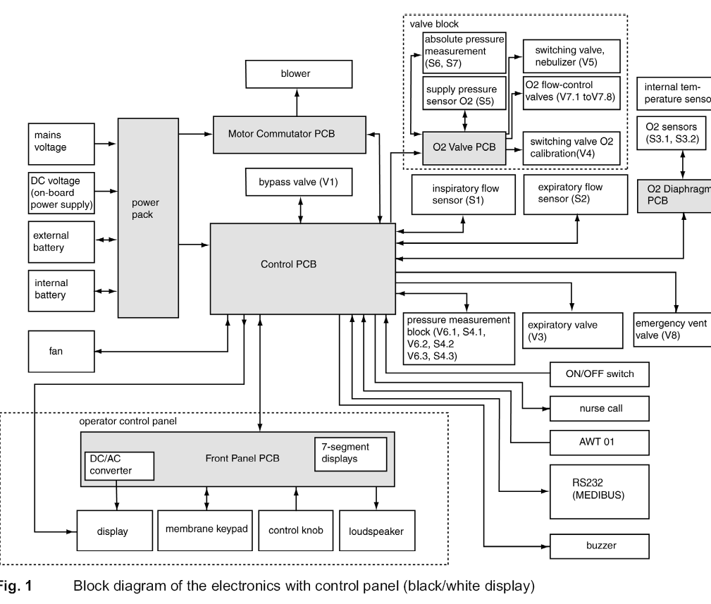

Slide 59
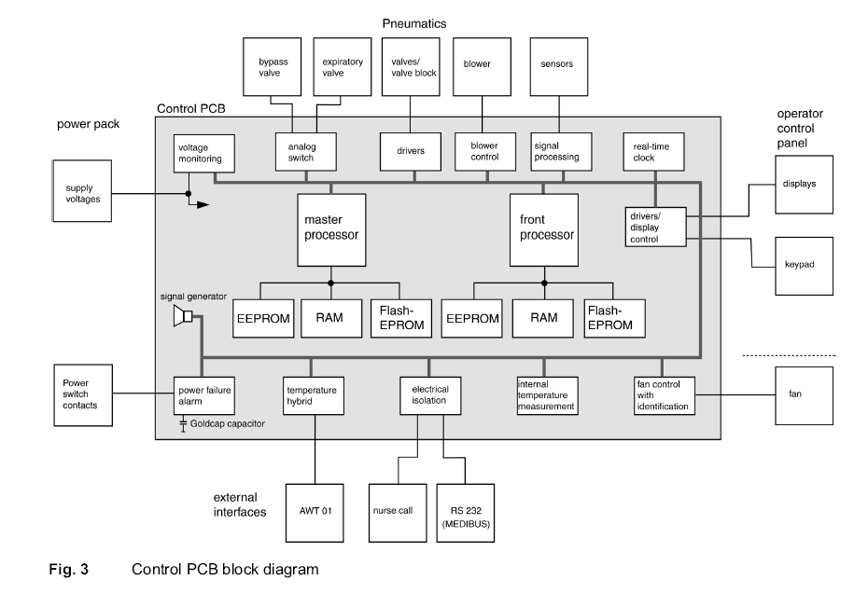

Slide 60
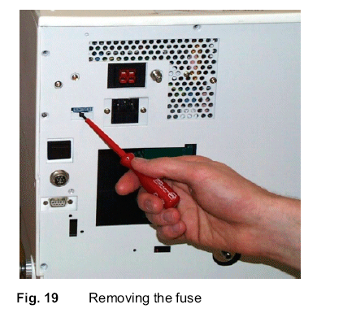
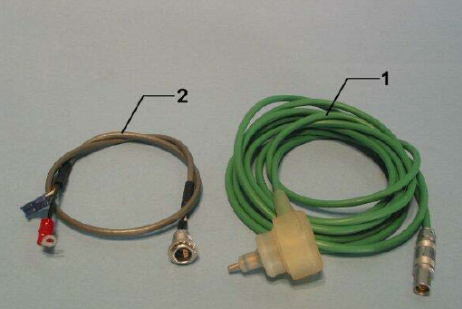
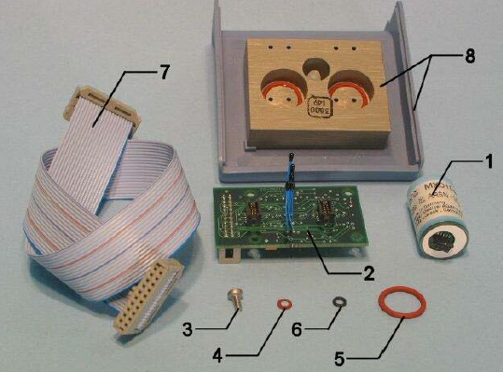
Drager_Savina_-_Service_manual

Slide 61
What to test?
Electrical safety

Slide 62
Flow Measurements
How to measure flow rate?

Slide 63
Flow Measurements
How to measure flow rate?

Slide 65
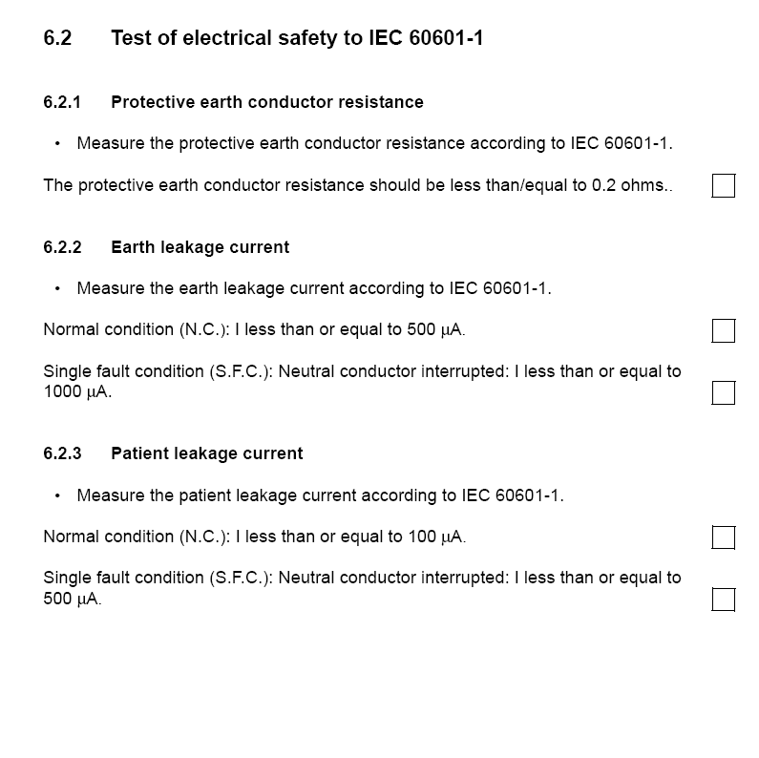

Slide 66
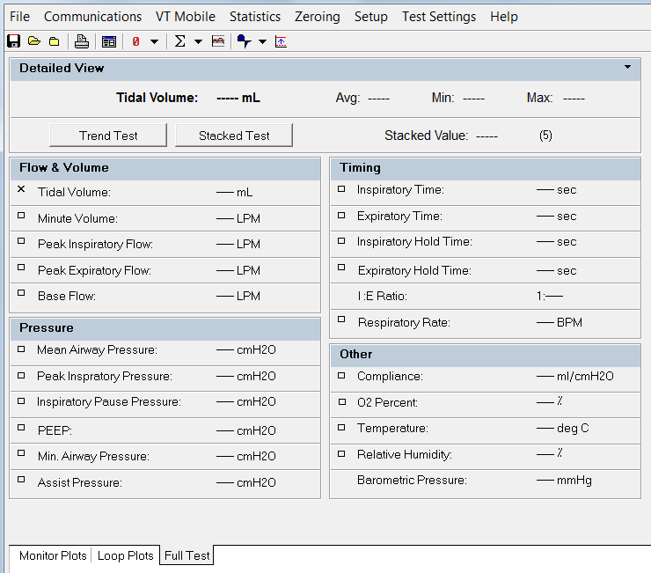

Slide 67
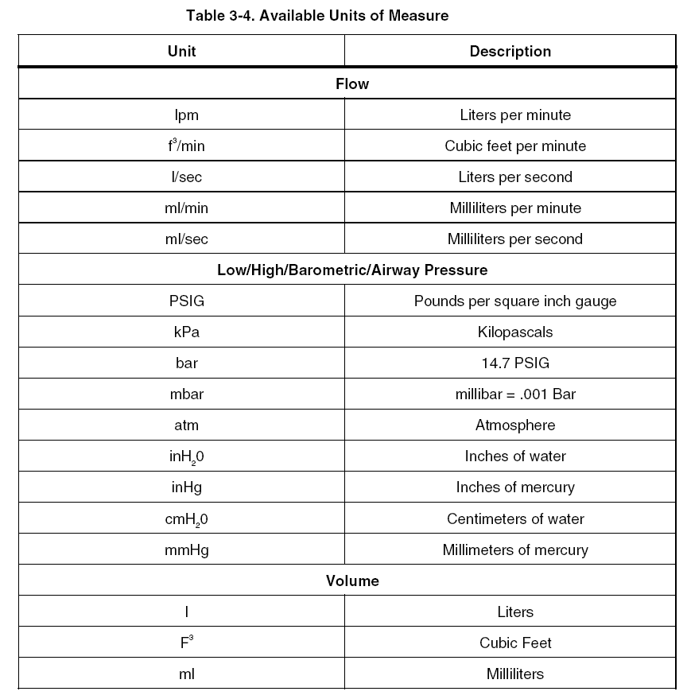

Slide 68
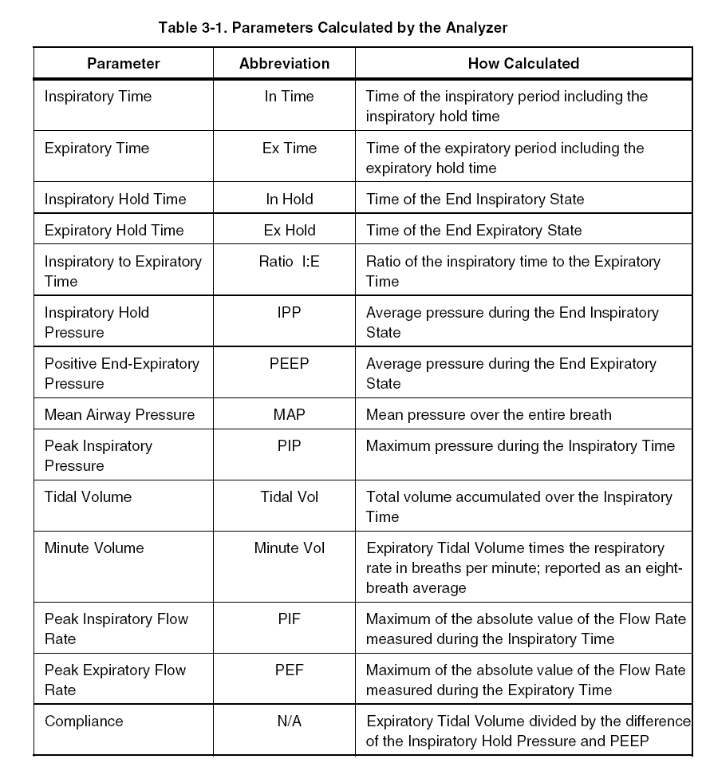

Slide 69
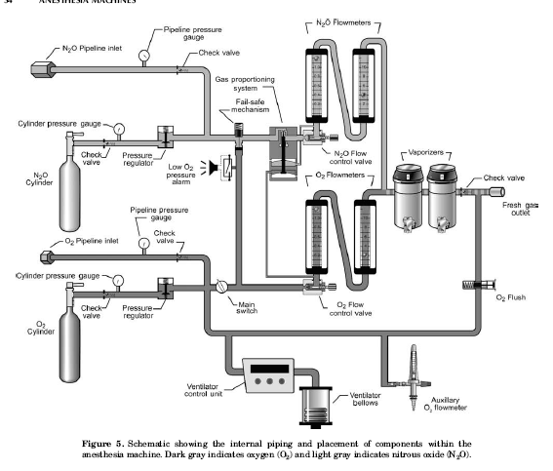
Anesthesia machine vs. ventilator

Slide 70
RESOURCES
A Primer on Mechanical Ventilation by David J Pierson MD
http://courses.washington.edu/med610/mechanicalventilation/mv_primer.html
RET 2284L – PRINCIPLES OF MECHANICAL VENTILATION. MEDICAL CENTER CAMPUS SCHOOL OF HEALTH SCIENCES RESPIRATORY CARE PROGRAM
Encyclopedia of Medical Devices and Instrumentation, 6 Volume Set - Second Edition by: John G. Webster
The Biomedical Engineering Handbook, 3rd Edition (3 Volume Set) by: Joseph D. Bronzino

