Slide 1
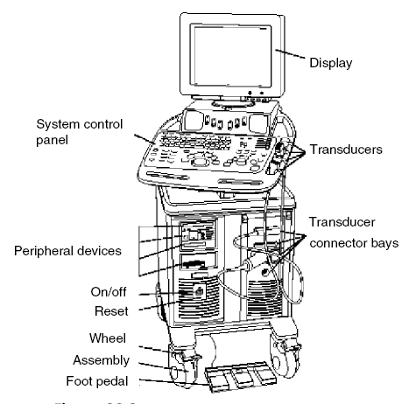
UltarSound Machine
Dr Fadhl Alakwaa
fadlwork@gmail.com

Slide 2
What are the first things to account when purchasing new US equipment
Clinical application
Operation Modes
Transducers
OTHERS
  DISOM & STORAGE
  PRINTER
  NETWORKING

Slide 3
EXCELLENT RESOURCES
Ultrasound Machine Comparison: An Evaluation of Ergonomic Design, Data Management, Ease of Use, and Image Quality
http://www.compareultrasound.com/
Objective measurements of image quality
Ultrasound Equipment Evaluation Project,

Slide 4
CLINICAL APPLICATIONS
Breast: Imaging of female (usually) breasts
Cardiac: Imaging of the heart
Gynecologic: Imaging of the female reproductive organs
Radiology: Imaging of the internal organs of the abdomen
Obstetrics (sometimes combined with Gynecologic as in OB/GYN): Imaging of fetuses in vivo
Pediatrics: Imaging of children
Vascular: Imaging of the (usually peripheral as in peripheral vascular) arteries and veins of the vascular system (called ‘‘cardiovascular’’ when combined with heart imaging)

Slide 5
(Note that ‘‘intra’’ (from Latin) means into or inside, ‘‘trans’’ means through or across, and ‘‘endo’’ means within.)
Endovaginal: Imaging the female pelvis using the vagina as an acoustic window

Slide 6
Intracardiac: Imaging from within the heart
Intraoperative: Imaging during a surgical procedure
Intravascular: Imaging of the interior of arteries and veins from transducers inserted in them
Laproscopic: Imaging carried out to guide and evaluate laparoscopic surgery made through small incisions
Musculoskeletal: Imaging of muscles, tendons, and ligaments

Slide 7
Small parts: High-resolution imaging applied to superficial tissues, musculature, and vessels near the skin surface
Transcranial: Imaging through the skull (usually through windows such as the temple or eye) of the brain and its associated vasculature
Transesophageal: Imaging of internal organs (especially the heart) from specially designed probes made to go inside the esophagus
Transorbital: Imaging of the eye or through the eye as an acoustic window
Transrectal: Imaging of the pelvis using the rectum as an acoustic window
Transthoracic: External imaging from the surface of the chest

Slide 8
What do you need to know to be professional in US?
Advantage of US OVER other modalities
US development
US physics
Ultrasound Terminology
US clinical applications
US components
US Transducer types
US modes
US specifications

Slide 9
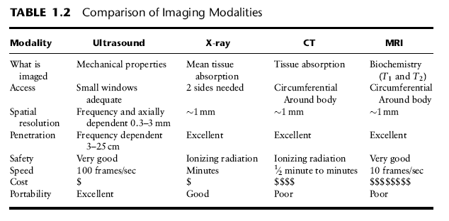
Advantage of US OVER other modalities

Slide 10
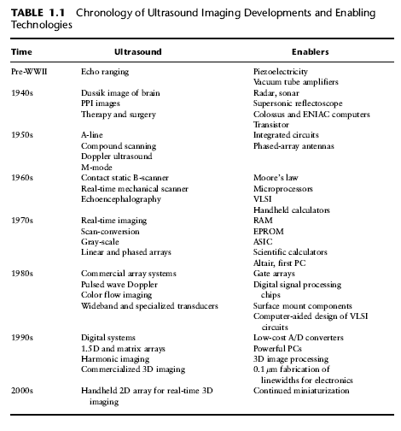
US development

Slide 11
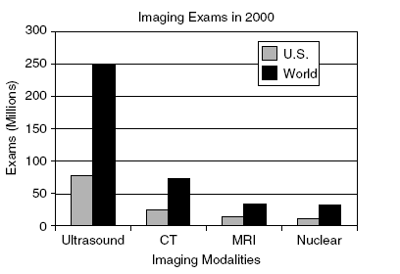

Slide 12
What is Ultrasound machine?
Ultrasound or ultrasonography is a medical imaging technique that uses high frequency sound waves and their echoes.
But what is the ultrasound waves?

Slide 13
Spectrum of sound
Frequency range Hz
Description
Example
0 - 20
Infrasound
Earth quake
20 - 20.000
Audible sound
Speech, music
> 20.000
Ultrasound
Bat, Quartz crystal
Medical ultrasound frequency is 1Mhz-10Mhz
الموجات الفوق صوتية نوعيين طولية وعرضية

Slide 14
Sound propagation
Longitudinal wave
Direction of propagation
Direction of oscillation

Slide 15
Sound propagation
Transverse wave
Direction of oscillation
Direction of propagation

Slide 16
Wave propagation
Longitudinal waves propagate in all kind of materials.
Transverse waves only propagate in solid bodies.
Due to the different type of oscillation, transverse waves
travel at lower speeds.
Sound velocity mainly depends on the density and E-modulus of the material.
Air
Water
Steel, long
Steel, trans
330 m/s
1480 m/s
5920 m/s
3250 m/s

Slide 17
Difference between EM and sound?
Material through which wave moves
Medium not required for all wave types
  no medium required for electromagnetic waves
    radio
    x-rays
    infrared
    ultraviolet
  medium is required for sound
    sound does not travel through vacuum
Talk louder! I can’t hear you.

Slide 18
How to produce sound wave?
By applying voltage on some material face like:
  Quartz
  PZT

Slide 19
Piezoelectric Effect
+
Battery
Piezoelectrical
Crystal (Quartz)

Slide 20
Piezoelectric Effect
+
The crystal gets thicker, due to a distortion of the crystal lattice

Slide 21
Piezoelectric Effect
+
The effect inverses with polarity change

Slide 22
Piezoelectric Effect
Sound wave with
frequency f
U(f)
An alternating voltage generates crystal oscillations at the frequency f

Slide 23
Piezoelectric Effect
Short pulse
( < 1 µs )
A short voltage pulse generates an oscillation at the crystal‘s resonant
frequency f₀ OPERATING FREQUNCY

Slide 24
How to receive sound waves?
A sound wave hitting a piezoelectric crystal, induces crystal vibration which then causes electrical voltages at the crystal surfaces.
Electrical
energy
Piezoelectrical crystal
Ultrasonic wave

Slide 25
Sound field
Crystal
Focus
Angle of divergence
Accoustical axis
γ₆
D₀
N
Near field
Far field

Slide 26
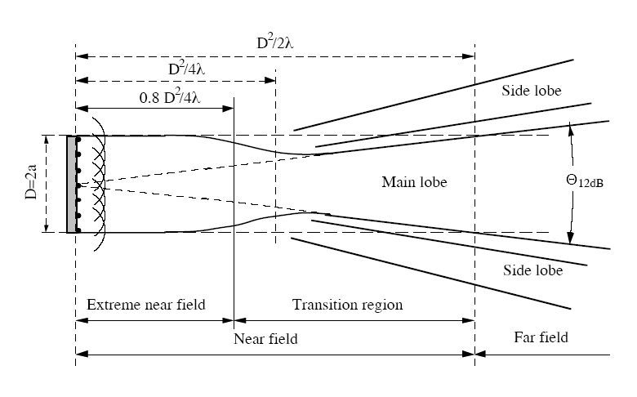

Slide 27
Transducer array
Transducer = ARRAY OF PIEZOELECTRICAL ELEMENTS. Typically 128 to 512
SPECFICATION:
  Material
  ARRAY LENGHT
  Frequency rang
    resolution
  Depth CM
  Type
    LINEAR ARRAY
    PHASED ARRAY

Slide 28
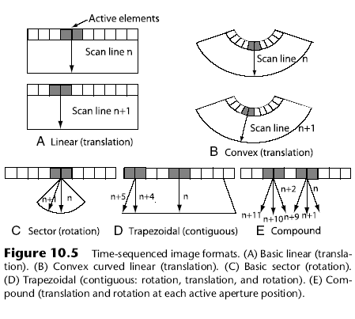

Slide 29
Ultrasound Display
One sound pulse produces
  one image scan line
    one series of gray shade dots in a line
Multiple pulses
  two dimensional image obtained by moving direction in which sound transmitted

Slide 30
Real-time Scanning
Each pulse generates one line
  Except for multiple focal zones
one frame consists of many individual scan lines
lines frames
PRF (Hz) = ------------ X --------------
frame sec.
One pulse = one line

Slide 31
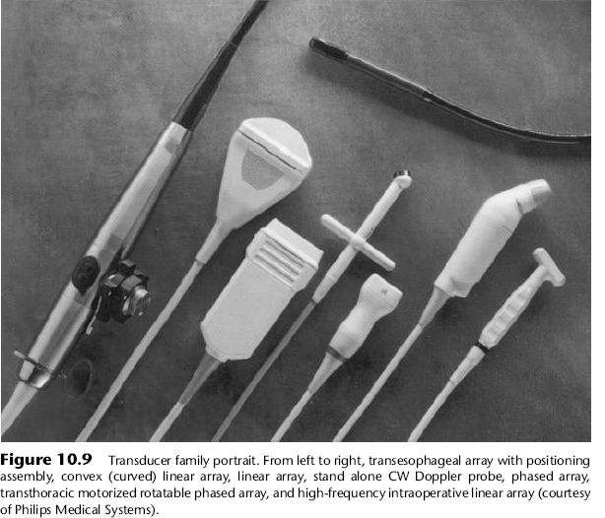
Linear, Curved linear array, Phased array/sector
Endocavitary, Intraoperative

Slide 32
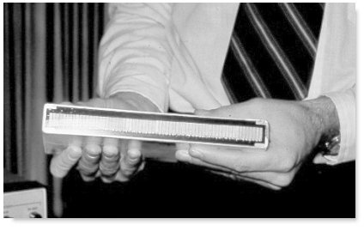
Transducer Arrays
Virtually all commercial transducers are arrays
  Multiple small elements in single housing
Allows sound beam to be electronically
  Focused
  Steered
  Shaped

Slide 33
Electronic Scanning
Transducer Arrays
  Multiple small transducers
  Activated in groups

Slide 34
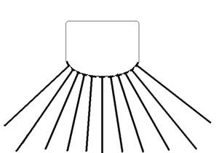
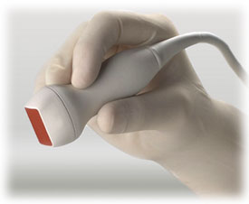
Electrical Scanning
Performed with transducer arrays
  multiple elements inside transducer assembly arranged in either
    a line (linear array)
    concentric circles (annular array)
Curvilinear Array
Linear Array

Slide 35
Linear Array Scanning
Two techniques for activating groups of linear transducers
  Switched Arrays
    activate all elements in group at same time
  Phased Arrays
    Activate group elements at slightly different times
    impose timing delays between activations of elements in group

Slide 36
Linear Switched Arrays
Elements energized as groups
  group acts like one large transducer
Groups moved up & down through elements
  same effect as manually translating
  very fast scanning possible (several times per second)
    results in real time image

Slide 37
Linear Switched Arrays

Slide 38
Linear Phased Array
Groups of elements energized
  same as with switched arrays
voltage pulse applied to all elements of a group
BUT
elements not all pulsed at same time
1
2

Slide 39
Linear Phased Array
timing variations allow beam to be
  shaped
  steered
  focused
Above arrows indicate timing variations.
By activating bottom element first & top last, beam directed upward
Beam steered upward

Slide 40
Linear Phased Array
Above arrows indicate timing variations.
By activating top element first & bottom last, beam directed downward
Beam steered downward
By changing timing variations between pulses, beam can be scanned from top to bottom

Slide 41
Linear Phased Array
Focus
Above arrows indicate timing variations.
By activating top & bottom elements earlier than center ones, beam is focused
Beam is focused

Slide 42
Linear Phased Array
Focus
Focal point can be moved toward or away from transducer by altering timing variations between outer elements & center

Slide 43
Linear Phased Array
Focus
Multiple focal zones accomplished by changing timing variations between pulses
Multiple pulses required
slows frame rate

Slide 44
Listening Mode
Listening direction can be steered & focused similarly to beam generation
  appropriate timing variations applied to echoes received by various elements of a group
Dynamic Focusing
  listening focus depth can be changed electronically between pulses by applying timing variations as above
2

Slide 45
1.5 Transducer
~3 elements in elevation direction
All 3 elements can be combined for thick slice
1 element can be selected for thin slice
Elevation
Direction

Slide 46
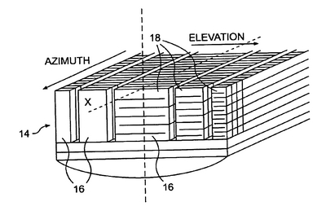
1.5 & 2D Transducers
Multiple elements in 2 directions
Can be steered & focused anywhere in 3D volume

Slide 47
Remember me to explain why we use the backing block and matching layer?

Slide 48
What we will use the returned or received ultrasound waves “echoes”?
NO ECHOES = NO IMAGING
WE WILL BACK TO THAT

Slide 49
Perpendicular Incidence
Sound beam travels perpendicular to boundary between two media
90º
Incident
Angle
1
Boundary
between
media
2

Slide 50
Oblique Incidence
Sound beam travel not perpendicular to boundary
Oblique
Incident
Angle
(not equal
to 90º)
1
2
Boundary
between
media

Slide 51
Perpendicular Incidence
What happens to sound at boundary?
  reflected
    sound returns toward source
  transmitted
    sound continues in same direction
1
2

Slide 52
Perpendicular Incidence
Fraction of intensity reflected depends on acoustic impedances of two media
1
2
Acoustic Impedance =
Density X Speed of Sound

Slide 53
Intensity Reflection Coefficient (IRC)
&
Intensity Transmission Coefficient (ITC)
IRC
  Fraction of sound intensity reflected at interface
  <1
ITC
  Fraction of sound intensity transmitted through interface
  <1
Medium 1
IRC + ITC = 1
Medium 2

Slide 54
IRC Equation
For perpendicular incidence
2
  reflected intensity z₂ - z₁
  IRC = ------------------------ = ----------
  incident intensity z₂ + z₁
Z₁ is acoustic impedance of medium #1
Z₂ is acoustic impedance of medium #2
Medium 1
Medium 2

Slide 55
Reflections
2
  reflected intensity z₂ - z₁
  Fraction Reflected = ------------------------ = ----------
  incident intensity z₂ + z₁
Impedances equal
  no reflection
Impedances similar
  little reflected
Impedances very different (bone\air interference)
  virtually all reflected

Slide 56
Why Use Gel and matching layer?
2
  reflected intensity z₂ - z₁
  IRC = ------------------------ = ----------
  incident intensity z₂ + z₁
 | Acoustic Impedance (rayls)
Air | 400
Soft Tissue | 1,630,000
Fraction Reflected: 0.9995
Acoustic Impedance of air & soft tissue very different
Without gel virtually no sound penetrates skin

Slide 58
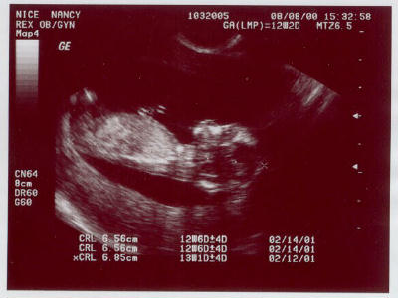
THE BASICS US IDEA
The returned echoes represent gray levels in ultrasound images

Slide 59
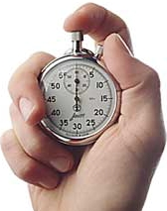
What does your scanner know about echoed sound?
What was the time delay between sound broadcast and the echo?

Slide 60
What Does Your Scanner Assume about Echoes
(or how the scanner can lie to you)
Sound travels at 1540 m/s everywhere in body
  average speed of sound in soft tissue
Sound travels in straight lines in direction transmitted
Sound attenuated equally by everything in body
  (0.5 dB/cm/MHz, soft tissue average)

Slide 61
Distance of Echo from Transducer
Time delay accurately measured by scanner
distance = time delay X speed of sound
distance

Slide 62
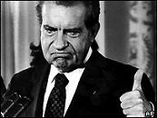
What is the Speed of Sound?
B AND M-mode
Color, spectral, power Doppler
Tissue harmonic imaging (detection of harmonics signals; abdominal and liver)
Contrast agent imaging (detection of subtle parenchymal change and metastases in the liver. abdominal and vascular)
3-D imaging
distance = time delay X speed of sound
scanner assumes speed of sound is that of soft tissue
  1.54 mm/μsec
  1540 m/sec
  13 usec required for echo object 1 cm from transducer (2 cm round trip)
13 μsec
1 cm
Handy rule of thumb

Slide 63

So the scanner assumes the wrong speed?
Sometimes
Luckily, the speed of sound is almost the same for most body parts
  soft tissue ==> 1.54 mm / μsec
  fat ==> 1.44 mm / μsec
  brain ==> 1.51 mm / μsec
  liver, kidney ==> 1.56 mm / μsec
  muscle ==> 1.57 mm / μsec
?

Slide 64
Attenuation Correction
scanner assumes entire body has attenuation of soft tissue
  actual attenuation varies widely in body
Tissue Attenuation Coefficient
(dB / cm / MHz)
Fat 0.6
Brain 0.6
Liver 0.5
Kidney 0.9
Muscle 1.0
Heart 1.1

Slide 65
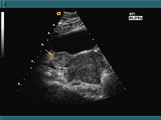
Gray Shade of Echo
Ultrasound is gray shade modality
Gray shade should indicate echogeneity of object
?
?

Slide 66
How does scanner know what gray shade to assign an echo?
Based upon intensity (volume, loudness) of echo
?
?

Slide 67
How to reconstruct the image from echoes?
US MODES:
  B AND M-mode
  Color, spectral, power Doppler
  Tissue harmonic imaging (detection of harmonics signals; abdominal and liver)
  Contrast agent imaging (detection of subtle parenchymal change and metastases in the liver. abdominal and vascular)
  3-D imaging

Slide 68
M Mode
Multiple pulses in same location
  New lines added to right
horizontal axis
  elapsed time (not time within a pulse)
vertical axis
  time delay between pulse & echo
    indicates distance of reflector from transducer
Echo Delay Time
Elapsed Time
Each vertical line is one pulse

Slide 69
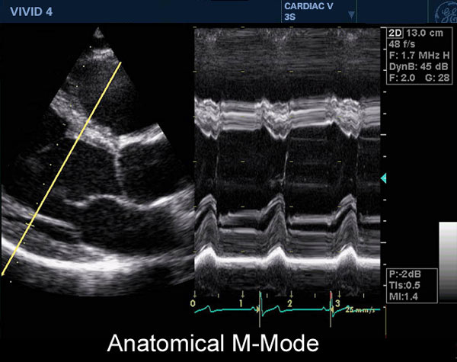
M-Mode (left ventricle)

Slide 70
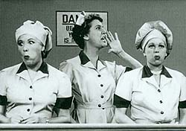
Scanner Processing of Echoes
Amplification
Compensation
Compression
Demodulation
Rejection

Slide 71
Amplification
Increases small voltage signals from transducer
  incoming voltage signal
    10’s of millivolts
larger voltage required for processing & storage
Amplifier

Slide 72
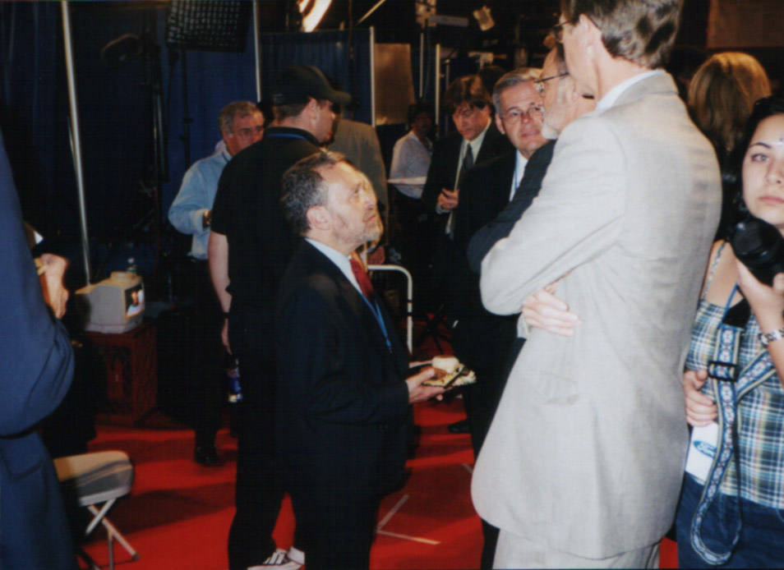
Compensation
Amplification
Compensation
Compression
Demodulation
Rejection

Slide 73
Need for Compensation
equal intensity reflections from different depths return with different intensities
  different travel distances
    attenuation is function of path length
Display without
compensation
echo
intensity
time since pulse

Slide 74
Equal Echoes
Voltage
before
Compensation
Early Echoes
Later Echoes
Time within a pulse
Voltage
Amplification
Voltage
Amplitude
after
Amplification
Equal echoes,
equal voltages

Slide 75
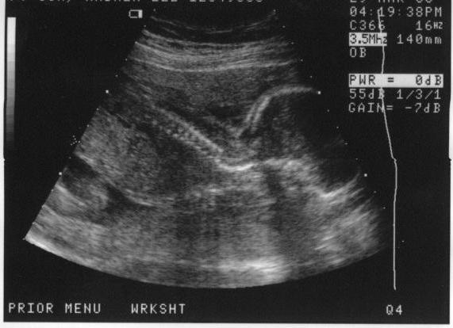
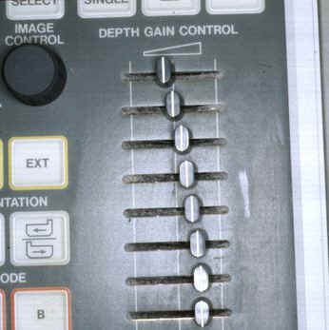
Compensation (TGC)
Body attenuation varies from 0.5 dB/cm/MHz
TGC allows manual fine tuning of compensation vs. delay
TGC curve often displayed graphically

Slide 76
Compensation (TGC)
TGC adjustment affects all echoes at a specific distance range from transducer

Slide 77

Compression
Amplification
Compensation
Compression
Demodulation
Rejection

Slide 78
Compression
1,000
Can’t easily distinguish between 1 & 10 here
Input
Logarithm
100,000
5
10,000
4
1,000
3
1
10
100
1000
100
2
10
1
3 = log 1000
1
0
2 =log 100
Difference between 1 & 10 the same as between 100 & 1000
1 = log 10
0 = log 10
Logarithms stretch low end of scale; compress high end
1
10
100
1000

Slide 79
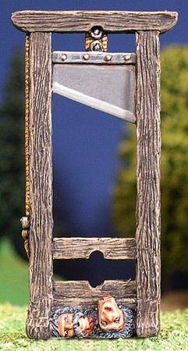
Demodulation
Amplification
Compensation
Compression
Demodulation
Rejection

Slide 80
Demodulation
Intensity information carried on “envelope” of operating frequency’s sine wave
  varying amplitude of sine wave
demodulation separates intensity information from sine wave

Slide 81
Demodulation Sub-steps
rectify
  turn negative signals positive
smooth
  follow peaks

Slide 82

Rejection
Amplification
Compensation
Compression
Demodulation
Rejection

Slide 83
Rejection
also known as
  suppression
  threshold
object
  eliminate small amplitude voltage pulses
reason
  reduce noise
    electronic noise
    acoustic noise
  noise contributes no useful information to image
Amplitudes below dotted line reset to zero

Slide 84
Image Resolution
Detail Resolution
  spatial resolution
  separation required to produce separate reflections
Detail Resolution types
Axial
Lateral

Slide 85
Resolution & Reflector Size
minimum imaged size of a reflector in each dimension is equal to resolution
Objects never imaged smaller than system’s resolution

Slide 86
Axial Resolution
minimum reflector separation in direction of sound travel which produces separate reflections
depends on spatial pulse length
  Distance in space covered by a pulse
H.......E.......Y
HEY
Spatial Pulse Length

Slide 87
Axial Resolution
Axial Resolution = Spatial Pulse Length / 2
Gap;
Separate
Echoes
Separation
just greater
than half the
spatial
pulse length

Slide 88
Axial Resolution
Axial Resolution = Spatial Pulse Length / 2
Overlap;
No Gap;
No Separate
Echoes
Separation
just less
than half the
spatial
pulse length

Slide 89
Spatial Pulse Length
Spat. Pulse Length = # cycles per pulse X wavelength
Wavelength = Speed / Frequency
Duty Factor = Pulse Duration X Pulse Repetition Freq.
# CYCLES

Slide 90
Wavelength
Calculate SPL for 5 MHz sound in soft tissue, 5 cycles per pulse
(Wavelength=0.31 mm/cycle)
Spat. Pulse Length = # cycles per pulse X wavelength
SPL = 0.31 mm / cycle X 5 cycles / pulse = 1.55 mm / pulse

Slide 91

Improve Axial Resolution by Reducing Spatial Pulse Length
Spat. Pulse Length = # cycles per pulse X wavelength
Speed = Wavelength X Frequency
increase frequency
  Decreases wavelength
  decreases penetration; limits imaging depth
Reduce cycles per pulse
  requires damping
    reduces intensity
    increases bandwidth

Slide 93
Lateral Resolution
Definition
  minimum separation between reflectors in direction perpendicular to beam travel which produces separate reflections when the beam is scanned across them
Lateral Resolution = Beam Diameter

Slide 94
Lateral Resolution
if separation is greater than beam diameter, objects can be resolved as two reflectors

Slide 95
Lateral Resolution
Complication:
  beam diameter varies with distance from transducer
  Near zone length varies with
    Frequency
    transducer diameter
Near
zone
Near zone length
Far
zone

Slide 96
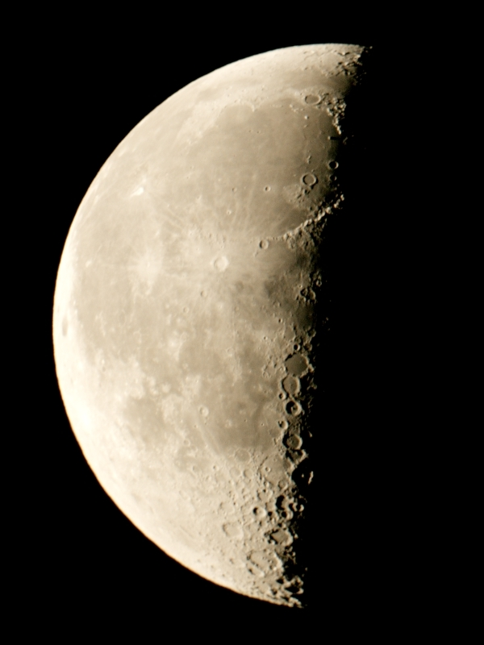
Contrast Resolution

Slide 97
Contrast Resolution
difference in echo intensity between 2 echoes for them to be assigned different digital values
88
89

Slide 98
Pre-Processing
Assigning of specific values to analog echo intensities
analog to digital (A/D) converter
converts output signal from receiver (after rejection) to a value
89

Slide 99
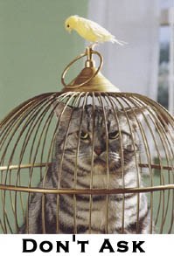
Gray Scale
the more candidate values for a pixel
  the more shades of gray image can be stored in digital image
  The less difference between echo intensity required to guarantee different pixel values
    See next slide

Slide 100
7
6
5
4
3
2
1
1
2
6
6
4
4
5
3
2
3
7
7
6
4
2
5
5
2
14
13
12
11
10
9
8
7
6
5
4
3
2
1
2
4
11
11
7
8
10
6
3
6
14
14
11
6
4
8
12
4

Slide 101
Display Limitations
not possible to display all shades of gray simultaneously
window & level controls determine how pixel values are mapped to gray shades
numbers (pixel values) do not change; window & level only change gray shade mapping
17
17
=
=
Change window / level
65
65
=
=

Slide 102
Presentation of Brightness Levels
pixel values assigned brightness levels
  pre-processing
manipulating brightness levels does not affect image data
  post-processing
    window
    level
125
25
311
111
182
222
176
199
192
85
69
133
149
112
77
103
118
139
154
125
120
145
301
256
223
287
256
225
178
322
325
299
353
333
300

Slide 103
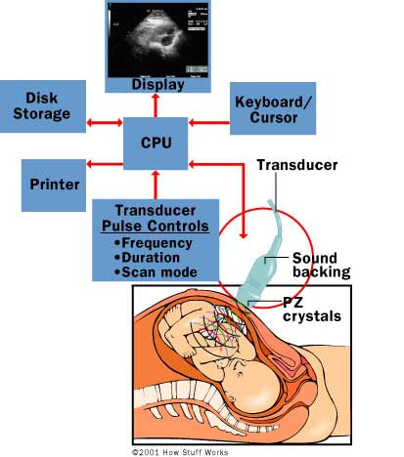

Slide 104
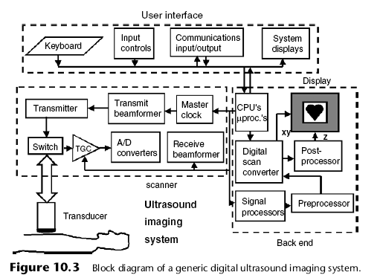
Block Diagram

Slide 105
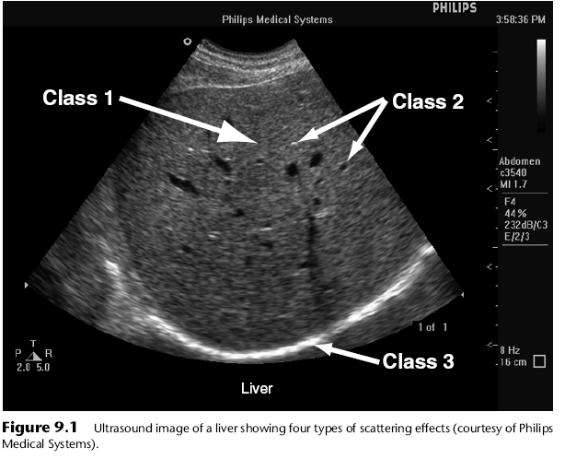
B Mode

Slide 106
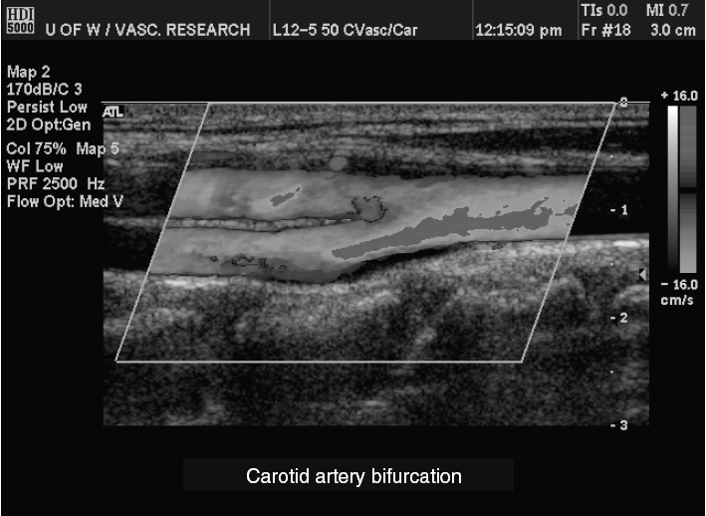
Color flow imaging (mode)
Color Doppler (mode):
Notes:
A spatial map is overlaid on a B-mode gray-scale image
that depicts an estimate of blood flow mean velocity, indicating the direction of
flow encoded in colors (often blue away from the transducer and red toward it),
the amplitude of mean velocity by brightness, and turbulence by a third color
(often green). It is also known as a ‘‘color flow Doppler.’’ Visualization is usually
two-dimensional (2D) but can also be three-dimensional (3D) or four-dimensional
(4D) (see Figure 10.6a).

Slide 107
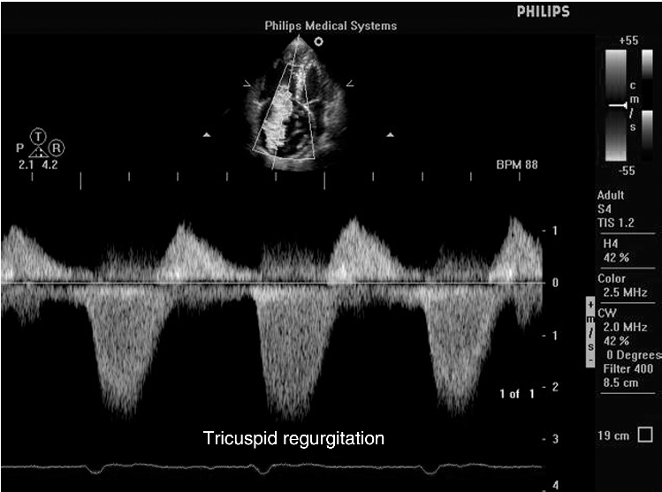
Continuous wave (CW) Doppler:
Notes:
Continuous wave (CW) Doppler: This Doppler mode is sensitive to the Doppler
shift of blood flow all along a line (see Figure 11.13).

Slide 108
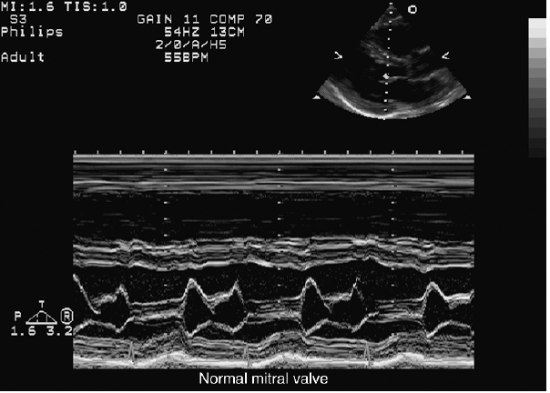
M-mode:
Notes:
M-mode: This mode of operation is brightness modulated, where depth is the y
deflection (fast time), and the x deflection is the same imaging line shown as a
function of slow time. This mode displays the time history of a single line at the
same spatial position over time (see Figure 10.4).

Slide 109
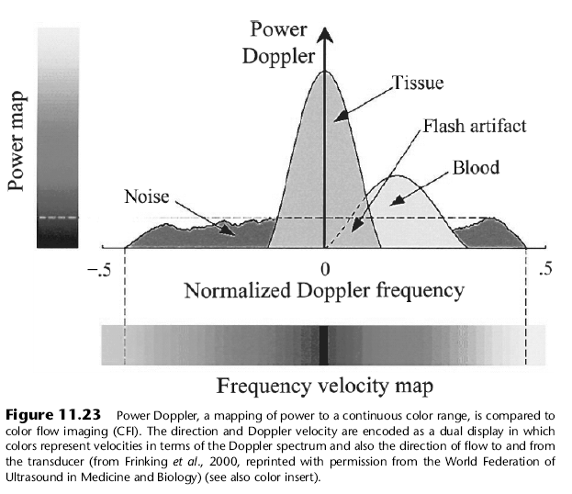
Power Doppler (mode):
Notes:
Power Doppler (mode): This color-coded image of blood flow is based on intensity
rather than on direction of flow, with a paler color representing higher intensity.
It is also known as ‘‘angio’’ (see Figure 11.23).

Slide 110
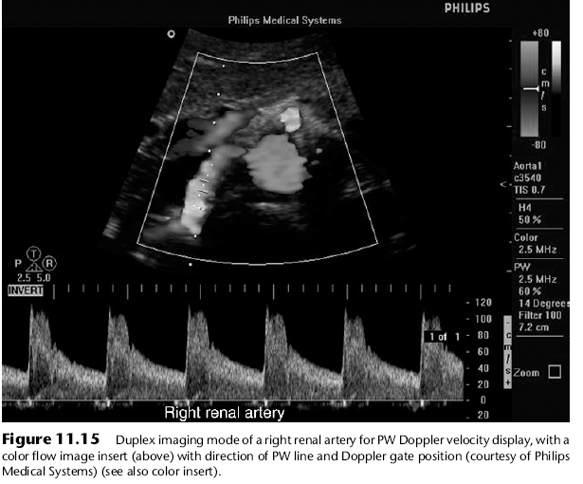
Pulsed wave Doppler
Notes:
Pulsed wave Doppler: This Doppler mode uses pulses to measure flow in a region
of interest (see Figures 11.15 and 11.21).

Slide 111
 |  | Transducer/ frequency MHZ | Depth cm |  | Mode
 |  |  | Min | Req
Abdominal | liver, spleen, kidney, gallbladder, pancreas and retroperitoneum | LCA/PA 2-7 min 2-10 req | 15 | 18 | B
 |  | LCA/PA 2-5 1.5-4 | 10 | 15 | Spectral Doppler
 |  | LCA/PA 2-5 min 1.5-4 req | 10 | 15 | Flow imaging
Small parts |  | LA 7-10 min 5-15 req | 6 | 8-10 | Dynamic imaging
 |  | LA 4-5 min 4-8 req | 6 | 8-10 | Spectral Doppler
 |  | LA 4-5 min 4-8 req | 6 | 8-10 | Flow imaging
Vascular |  | LA CLA 2-8 MIN 2-10 REQ | 6 | 8 | Dynamic imaging
 |  | LA CLA 2-8 MIN 2-10 REQ | 6 | 8 | Spectral Doppler
 |  | LA CLA 3-5 MIN 3-6 REQ | 6 | 10 | Flow imaging

Slide 112
 |  | Transducer/ frequency MHZ | Depth cm |  |  | Mode
 |  |  | Min |  | Req
Abdominal | liver, spleen, kidney, gallbladder, pancreas and retroperitoneum | LCA/PA 2-7 min 2-10 req | 15 | 18 |  | B
 |  | LCA/PA 2-5 1.5-4 | 10 | 15 |  | Spectral Doppler
 |  | LCA/PA 2-5 min 1.5-4 req | 10 | 15 |  | Flow imaging

Slide 113
Small parts |  | LA 7-10 min 5-15 req | 6 | 8-10 | Dynamic imaging
 |  | LA 4-5 min 4-8 req | 6 | 8-10 | Spectral Doppler
 |  | LA 4-5 min 4-8 req | 6 | 8-10 | Flow imaging

Slide 114
Vascular |  | LA CLA 2-8 MIN 2-10 REQ | 6 |  | 8 | Dynamic imaging
 |  | LA CLA 2-8 MIN 2-10 REQ | 6 |  | 8 | Spectral Doppler
 |  | LA CLA 3-5 MIN 3-6 REQ | 6 | 10 |  | Flow imaging

Slide 115
DOPPLER US

Slide 116
Hemodynamics
Blood Flow Characterization
Plug
Laminar
Disturbed
Turbulent

Slide 117
Plug Flow
Type of normal flow
Constant fluid speed across tube
Occurs near entrance of flow into tube

Slide 118
Laminar Flow
also called parabolic flow
fluid layers slide over one another
occurs further from entrance to tube
central portion of fluid moves at maximum speed
flow near vessel wall hardly moves at all
  friction with wall

Slide 119
Flow
Disturbed Flow
  Normal parallel stream lines disturbed
  primarily forward particles still flow
Turbulent Flow
  random & chaotic
  individual particles flow in all directions
  net flow is forward
  Often occurs beyond obstruction
  such as plaque on vessel wall

Slide 120
Flow, Pressure & Resistance
Pressure
  pressure difference between ends of tube drives fluid flow
Resistance
  more resistance = lower flow rate
  resistance affected by
    fluid’s viscosity
    vessel length
    vessel diameter
  flow for a given pressure determined by resistance

Slide 121
Doppler Shift
difference between received & transmitted frequency
caused by relative motion between sound source & receiver
Frequency shift indicative of reflector speed
IN
OUT

Slide 122
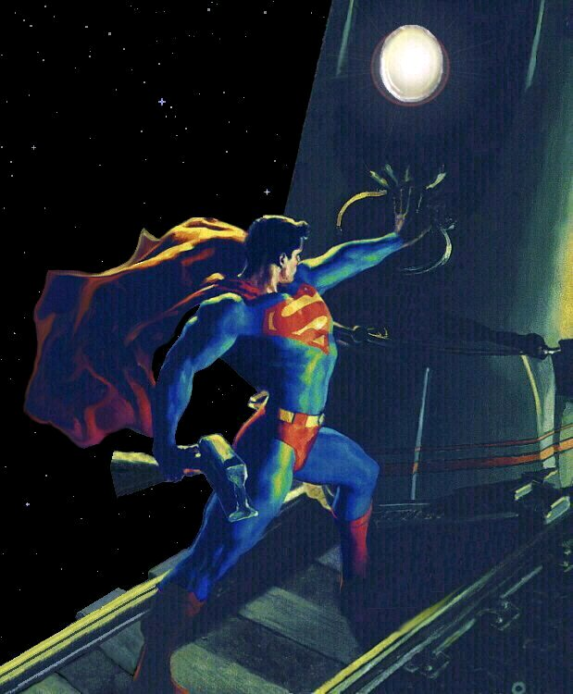


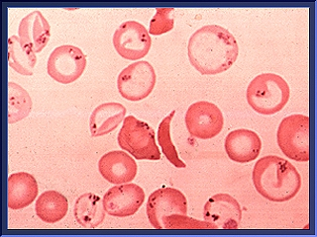
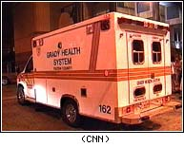
Doppler Examples
change in pitch of as object approaches & leaves observer
  train
  Ambulance siren
moving blood cells
  motion can be presented as sound or as an image

Slide 123
Doppler Angle
angle between sound travel & flow
0 degrees
  flow in direction of sound travel
90 degrees
  flow perpendicular to sound travel
θ

Slide 124
Flow Components
  Flow vector can be separated into two vectors
Flow parallel to sound
Flow perpendicular to sound

Slide 125


Doppler Sensing
  Only flow parallel to sound sensed by scanner!!!
Flow parallel to sound
Flow perpendicular to sound

Slide 126
Doppler Sensing
  Sensed flow always < actual flow
Actual flow
Sensed flow

Slide 127
Doppler Sensing
  cos(θ) = SF / AF
Actual flow
(AF)
θ
θ
Sensed flow
(SF)

Slide 128
Doppler Equation
2 X f_{o} X v X cosθ
f _{D} = f_{e} - f_{o} = -------------------------
c
θ
where
  f_{D} =Doppler Shift in MHz
  f_{e} = echo of reflected frequency (MHz)
  f_{o} = operating frequency (MHz)
  v = reflector speed (m/s)
  θ = angle between flow & sound propagation
  c = speed of sound in soft tissue (m/s)

Slide 129
Relationships
2 X f_{o} X v X cosθ
f _{D} = f_{e} - f_{o} = -------------------------
c
positive shift when reflector moving toward transducer
  echoed frequency > operating frequency
negative shift when reflector moving away from transducer
  echoed frequency < operating frequency
θ
θ

Slide 130
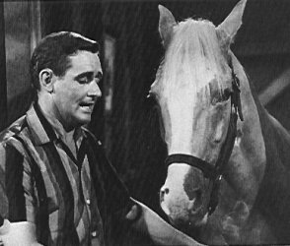
Relationships
2 X f_{o} X v X cosθ
f _{D} = f_{e} - f_{o} = -------------------------
c
cosθ
Doppler angle affects measured Doppler shift
θ
θ

Slide 131
Doppler Relationships
77 X f_{D} (kHz)
v (cm/s) = --------------------------
f_{o} (MHz) X cosθ
θ
higher reflector speed results in greater Doppler shift
higher operating frequency results in greater Doppler shift
larger Doppler angle results in lower Doppler shift

Slide 132
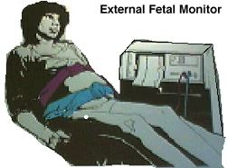
Continuous Wave Doppler
Audio presentation only
No image
Useful as fetal dose monitor

Slide 133
Continuous Wave Doppler
2 transducers used
  one continuously transmits
    voltage frequency = transducer’s operating frequency
      typically 2-10 MHz
  one continuously receives
Reception Area
  flow detected within overlap of transmit & receive sound beams

Slide 134
Continuous Wave Doppler:
Receiver Function
receives reflected sound waves
Subtract signals
  detects frequency shift
  typical shift ~ 1/1000 th of source frequency
    usually in audible sound range
Amplify subtracted signal
Play directly on speaker
-
=

Slide 135
Pulse Wave vs. Continuous Wave Doppler
Continuous Wave | Pulse Wave
No Image | Image
Sound on continuously | Both imaging & Doppler sound pulses generated

Slide 136
Dangers of Ultrasound
There have been many concerns about the safety of ultrasound.
  Because ultrasound is energy, the question becomes "What is this energy doing to my tissues or my baby?"

Slide 137
There have been some reports of low birthweight babies being born to mothers who had frequent ultrasound examinations during pregnancy.

Slide 138
The two major possibilities with ultrasound are as follows:
  development of heat - tissues or water absorb the ultrasound energy which increases their temperature locally
  formation of bubbles (cavitation) - when dissolved gases come out of solution due to local heat caused by ultrasound

Slide 139
However, there have been no substantiated ill-effects of ultrasound documented in studies in either humans or animals.
  This being said, ultrasound should still be used only when necessary (i.e. better to be cautious).

Slide 140
Ultrasound Terminology
Impedance resistance
steered

Slide 141
PZT is Most Common Piezoelectric Material
Lead Zirconate Titanate
Advantages
  Efficient
    More electrical energy transferred to sound & vice-versa
  High natural resonance frequency
  Repeatable characteristics
    Stable design
Disadvantages
  High acoustic impedance
    Can cause poor acoustic coupling
    Requires matching layer to compensate

