Slide 1
Bio-safety Cabinet
Dr Fadhl M Alakwaa

Slide 2
Agenda
What is bio safety cabinet (BSC)?
BSC risks
BSC Components.
What is bio safety levels?
Types of bio safety cabinet?
What is NSF?
What is NSF Exam?
Certification of bio safety cabinet.
BSC decontamination.
BSC companies

Slide 3
Group activity
Talk with your colleague:
How to protect while you work in the work area?

Slide 4
Laboratory safety protection Equipment
Fume hood
Isolator
Clean bench
BCS
What are their differences? Good question !

Slide 5
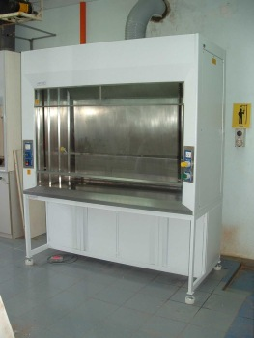
Fume hood
If you are care about personal protection.
No environment protection
No product protection.

Slide 6
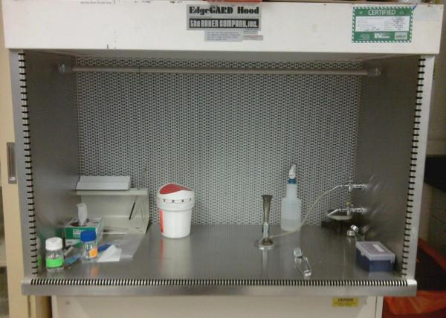
Clean bench
If you are care about product protection.

Slide 7
ISOLATOR

Slide 8
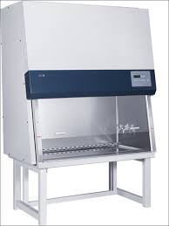
BSC
If you are care about product protection.

Slide 9
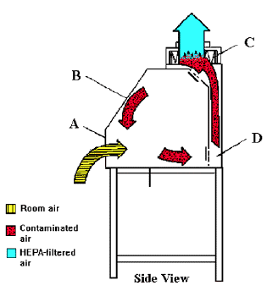

Slide 10
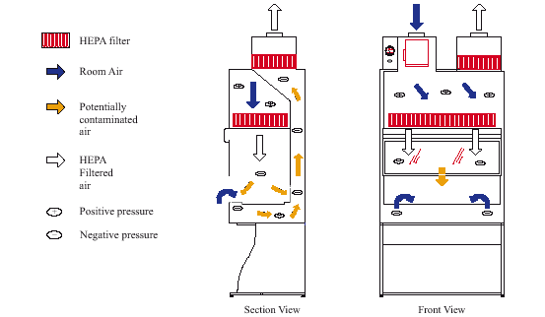

Slide 11
Definition of BSC
Is a cabinet where laboratory specialists work with virus, bacteria, parasite, vangia, culture, patient samples and infectious small organism.
Device which protect personal, product and the environment.
It is ventilator device which optimize air circulation from lab to the work area and the outside environment.

Slide 12
Class and types
Class I type A1 OR A
Class II type A2 OR A1/B3
Class II type B1
Class II type B2
Class III

Slide 13
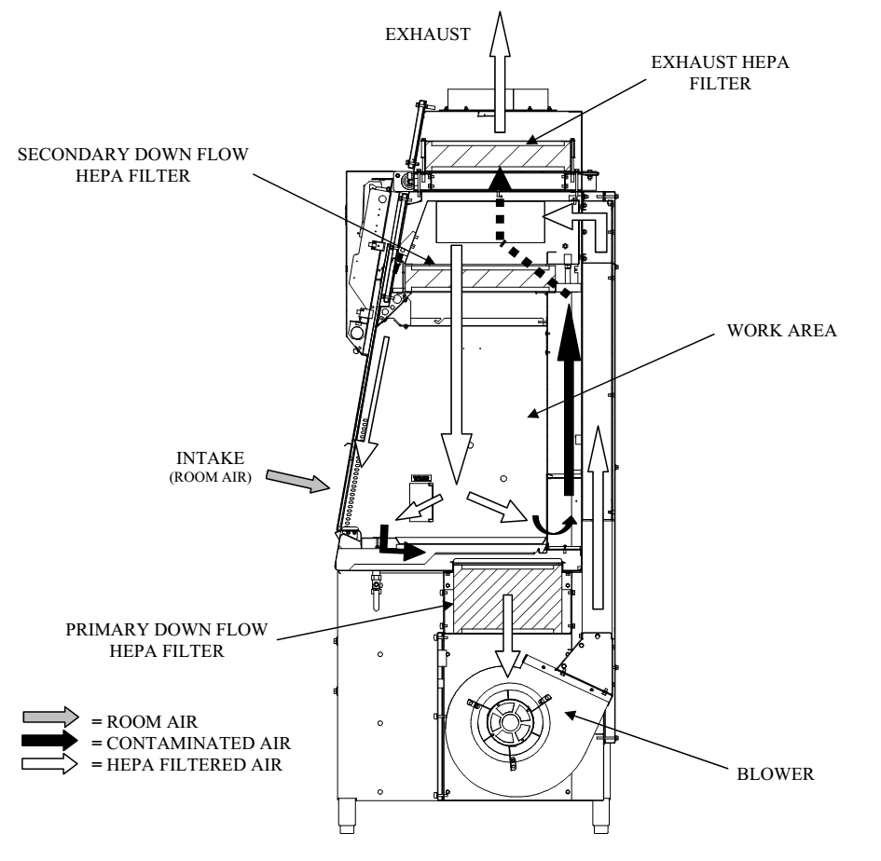
BSC components
Sash
Blower
HEPA filter
Fluorescence lamp
UV lamp

Slide 14
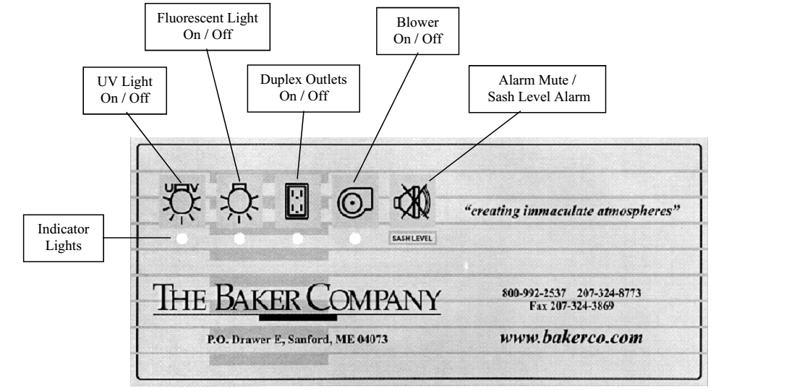

Slide 15
Blower
Negative and positive pressure

Slide 16
Home work assignment

Slide 17
HEPA filter

Slide 18
Balance BSC
Using blower speed control and Damper closing or opening.
Group activity
Control the inflow and down flow velocities using blower speed and damper positions?

Slide 19
Balance BSC
Intake flow | Down flow | Blower | Damper
Hi | Hi | Decrease | Open
Low | Low | Increase | close
Hi | Low | Decrease | Close
Low | Hi | Increase | Open
Hi | OK | Decrease | Close
OK | HI | Decrease | Open
Low | Ok | Increase | Close
ok | Low | Increase | Close

Slide 20
Choosing BSC for my lab
It depends on many things:
My lab safety level. Level 1-Level 4
Risk assessment.
There is no mapping between BSC types and safety levels.
Mostly Level 4 require class III
You could use class II A2, B1, B2 in Level 3 with more PPT requirement.
My exhaust System. B1 and B2 need more exhaust system requirements.
Power saving $$$$$$ more protection
Lab budget

Slide 21
How to differentiate between BSC types?
Sash(Fixed or variable )
No of blowers
Position of blowers
No of hepa filters
Connection to exhaust system
Intake air flow positions

Slide 22
 | Class A | A2 | B1 | B2
SASH | Fixed | Variable | Variable | Variable
BLOWER # | 1 | 1 | 1 | 2
Blower Position | Downside | Upside | Downside | Upside Exhaust
FILTERS # | 2 Supply and Exhaust | 2 | 3 | 3
Exhaust connection | No | Canopy | Hard | Hard
Intake air position | front | front | Front | Front Behind or upside

Slide 23
Pictures and video

Slide 24
Class 1

Slide 25
Class II A1

Slide 26
Group activity 1
Draw Class II A1

Slide 27
Class II A2

Slide 28
Group activity
Draw Class II A2

Slide 29
Class II B1

Slide 30
Group activity
Draw Class II B1

Slide 31
Class II B2

Slide 32
Group activity
Draw Class II B2

Slide 33
Effective use of BSC
Video

Slide 34
What is NSF?
National American organization to guide BSC manufacture, certifiers and users.
What are the best specifications of BSC?
How to assess the performance of BSC?
Examine BSC certifiers
NSF 49(Annex F is important)
Other standards
EN and Japan and Australian

Slide 35
BSC should assess based on the standards they manufacture on it.
You can not test European BSC with NSF standards.

Slide 36
NSF Exam
Theoretical (120 multiple questions for 3 and half hours ) You have to answer 90 correctly.
Read practical and procedures of good laboratory practice (20 pages)MBLB and the NSF standard (Annex F).
If you fail wait 30 days then take the exam again.
12 tests Practical EXAM.
If you fail in primary test retest this just this test in the next day. If you fail again you have to test it after 30 days. If you fail you have to retest the whole exam after 90 days.
You have to pass the theoretical and practical exam.
You have to certified 20 BSC (FIVE OF THEM Bs )
There are 350 NSF certifiers around the wordl, 300 USA and 25 from the world(12 Canadians).

Slide 37
Performance assessment of BSC
Intake flow velocity test
P tube
Restricted opening
3 inch SASH
Exhaust filter
DIM
Down flow velocity test
HEPA filter supply and Exhaust leak test

Slide 38
Performance assessment of BSC
Smoke test
Down flow test
View screen test
Opening test
SASH test
Secondary test
Vibration test
Lightning test
Electrical safety test

Slide 39
Calibration Tools
DIM
Hot wire
Aerosoloe generator
Photometer
Silicon
Stands
Smoke tube
Ppm formaldehyde detector

Slide 40
BSC Decontamination
What is the difference between disinfection & decontamination and sterilization?
The purpose of disinfection is to destroy particular organisms that could pose a potential hazard to humans or compromise the integrity of the experiment. It is important to use a suitable disinfectant in the concentration appropriate to the organism being killed.
Standard disinfectants include: Hypochloride (chlorine bleach), IodophorDetergent, Ethanol, Phenol and Alcohol.

Slide 41
BSC Decontamination
When?
Based on your risk assessment.
If you need to change contaminated HEPA filter or Blower
If you need to close or open the Damper(A type).
Based on your risk assessment

Slide 42
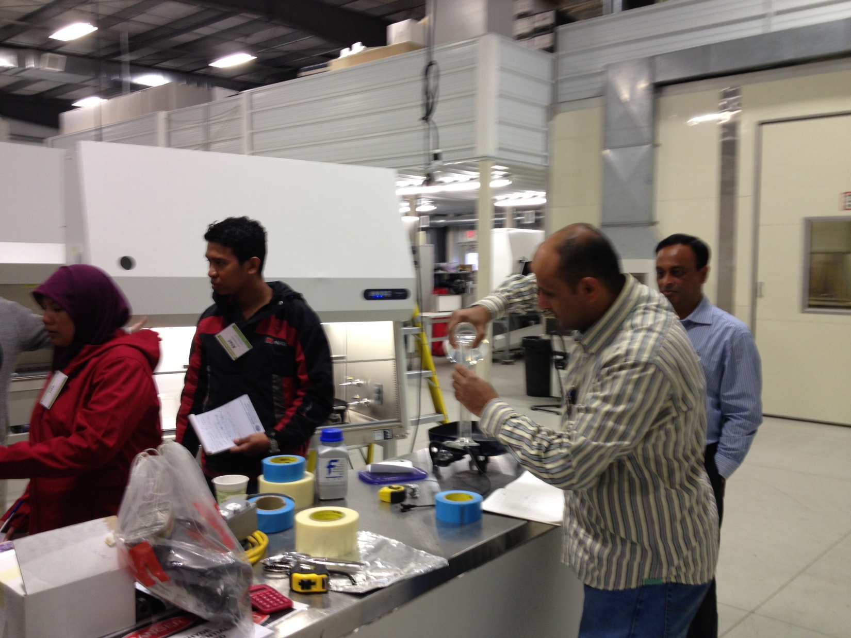

Slide 43
BSC Decontamination
Whenever maintenance, service or repairs are needed in a contaminated area of your cabinet, the cabinet must first be decontaminated with an appropriate agent. The National Institute of Health, National Cancer Institute and the Centers for Disease Control have all recommended the use of formaldehyde gas for most microbiological agents. Its application requires individuals who are experienced in the decontamination of cabinets, since the gas itself is toxic.
A good reference for this procedure is NSF/ANSI Standard 49-2004 ANNEX G “Recommended Microbiological decontamination Procedure”, NSF International, 789 North Dixboro Road, P.O. Box 130140, Ann Arbor, Michigan 48113-0140.

Slide 44
BSC Decontamination
How?
Formaldehyde or hydrogen peroxide
Formalin (liquid ml)
paraformaldehyde (mass gm or lb)
Naturalization using bicarbonate or carbonate sodium.
How to calculate formalin and paraformaldehyde and bicrbonate amount?
What are the experiments conditions like tem and humidity?
How long it take for the interactions?

Slide 45
Important warning
Sealed the BSC Perfect so no leaks.
Monitor the humidity.

Slide 46
