Slide 1
What is Spectroscopy? المحاضرة الرابعة
Dr Fadhl Alakwaa
2013-2014 Third Year
Biomedical engineering Department
www.Fadhl-alakwa.weebly.com

Slide 2
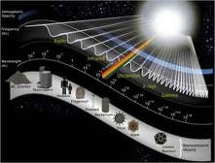
Introduction to Spectroscopy
Spectroscopy is the science which study the interaction of radiation with matter.
Notes:
the study of molecular structure and dynamics through the absorption, emission, and scattering of light.

Slide 3
To understand spectroscopy you have to understand:
Radiation
Matter
What happen when they interact?

Slide 4
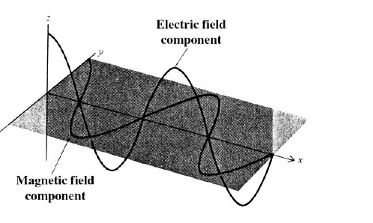
What is Electromagnetic Radiation?
Visible light that comes from your lamb and radio waves from your radio station.
Example: Radio waves, Microwaves, IR, Visible, UV, X-ray, Gamma ray.

Slide 5
What is Electromagnetic Radiation?
E = hν
ν = c / λ

Slide 6
X-Ray
UV
Visible
IR
Microwave
200nm
400nm
800nm
100,000nm
WAVELENGTH(nm)

Slide 7
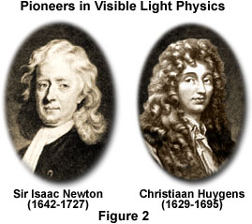
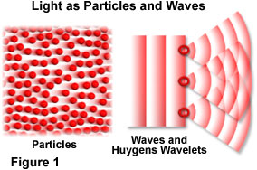
Electromagnetic radiation is
viewed as both a wave and a particle
wave-particle duality

Slide 8
Understanding the nature of light
1. Light is composed of particles
2. Light is wave
a. General concepts of Wave
(wavelength, frequency, velocity, amplitude)
b. Properties of Wave
I. Diffraction & Coherent Radiation
II. Transmission & Dispersion
III. Refraction: Snell’s Law
3. Black Body Radiation and photoelectric effect
wave-particle duality
4. Interaction between electromagnetic radiation
and matter for spectroscopy: scattering, absorption,
and emission

Slide 9
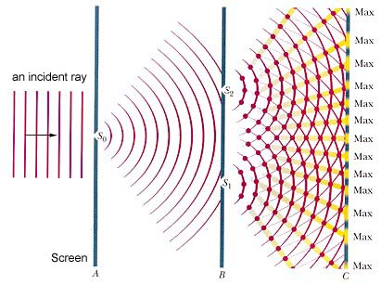
The Thomas Young’s Experiment (1801)
Interference phenomenon: Light is wave!

Slide 10
Light is Wave

Slide 11
What is a wave?!
amplitude
Harmonic wave:
wavelength
frequency
or
wavelength
c
velocity
Velocity (300,000,000 meters/sec)
frequency
=
Frequency
(Hertz)
ν
=
Propagation
λ
wavelength
Wavelength (meters)

Slide 12
Wave Parameters
The amplitude A of the sinusoidal wave is shown as the length of the electric vector at a maximum in the wave.
The time in seconds required for the passage of successive maxima or minima through a fixed point in space is called the period, p, of the radiation.
The frequency, ν, is the number of oscillations of the field that occur per second and is equal to l/p.
Another parameter of interest is the wavelength, λ, which is the linear distance between any two equivalent points on successive waves (e.g., successive maxima or minima).
angstrom: 10 ⁻¹⁰ m nanometer: 10 ⁻⁹ m
micrometer: 10 ⁻⁶ m millimeter: 10 ⁻³ m

Slide 13
Equation of wave motion
Y =a sin(wt-kx+Θ)
Displacement due to wave at any distance x and time t
a maximum displacement
W=2pi*f (angular velocity)
k =2 pi /wavelength (propagation constant)
Θ phase angle

Slide 14
Light is particles

Slide 15
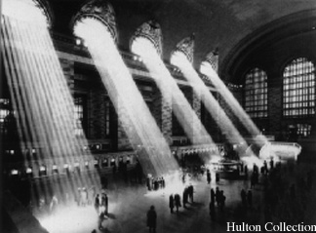
Light travels in a straight line

Slide 16
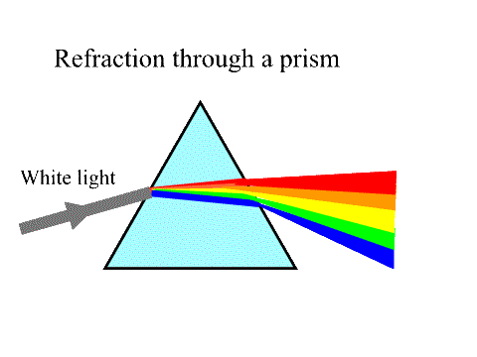
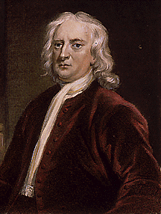
Light is consists of small particles
Newton

Slide 17
Electromagnetic Energy
Light is composed of particles ”Photons”
E =hf =hc/λ h= 6.626x10^-34 j.s (Plank constant)
Photon energy unit is (e.v)
Energy gained by one electron when accelearted by potential difference of one volt
e.v=1.6x10^-19 coulomb x 1 volt= =1.6x10^-19 Joule

Slide 18
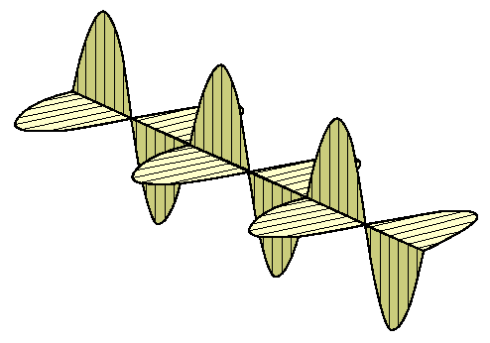
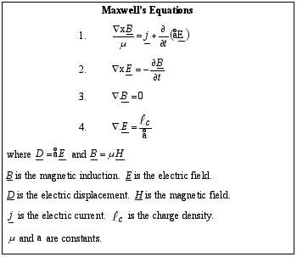
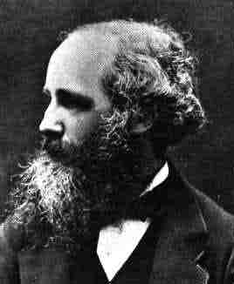
Light is Electromagnetic Wave
(1864)
Maxwell

Slide 19
Matter
Component >> atom like Iron {FE}
Compound >> Molecular like Sugar {CHO} {more than one atom}

Slide 20
Atom
Neutron
Proton
Electron
Mass number
A=# protons + Neutrons
X
Uranium
238
Z = # electrons
U
Atomic Number
Periodic table
92

Slide 21
Isotopes the same Z and different A
1
Hydrogen
One proton
H
1
2
One proton
One neutron
Deuterium
H
1
3
One proton
Two neutrons
H
Tritium
1

Slide 22
Orbital Electrons
Electrons
“-” charge
very small mass compared with protons / neutrons
Electrons reside only at certain energy levels or Shells
Designations start at K shell
K shell closest to nucleus
L shell next closest
Shells proceed up from K, L, M, N, etc.
Except for K shell, all shells contain sub-shells
L
K
-
~
+
~
+
+
~
X
-
-
-

Slide 23
Shell Capacities
Shell | Electron Capacity (2x²)
1 (k) | 2
2 (l) | 8
3 (m) | 18
4 (n) | 32
5 (o) | 50
6 (p) | 72
7 (q) | 98

Slide 24
Binding Energy
Negative electrons attracted to positive nucleus
more binding energy for shells closer to nucleus
K shell has highest binding force
higher atomic # materials (higher Z) result in more binding energy
more positive charge in nucleus
energy required to remove orbital electron from atom
L
K
-
~
+
~
+
+
~
-
-

Slide 25
The Shell Game
*
Electrons can move from shell to shell
to move to higher energy shell requires energy input equal to difference between the binding energy of the two shells
L
K
Requires energy input!
-
~
+
-
~
+
+
~
-
-

Slide 26
The Shell Game
An atom with a gap in a lower shell is unhappy (unstable)
Electrons will attempt to drop to lower shells to fill the gap BUT
to move to a lower energy shell requires the release of energy equal to the difference between shells.
This energy what we will measure and find the element/molecular kind or the element/molecular concentration.
L
K
-
~
+
~
+
+
~
-
-
-
Energy released

Slide 27
When Light Strikes Matter…
Transmission
Absorption
Reflection Refraction
Interference
Scattering

Slide 28
Excitation methods:
(i) EM radiation
(ii) Spark/discharge/arc
(iii) Particle bombardement (electrons, ions... )
(iv) Chemiluminescence (exothermic chemical reaction generates excited products

Slide 29
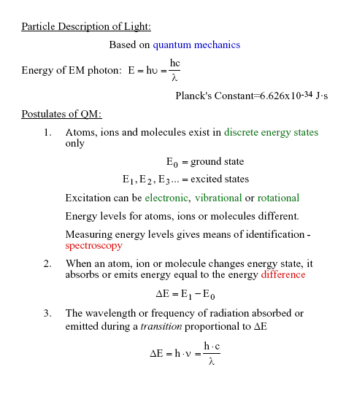
Notes:
6.626x10^-34 j.s

Slide 30
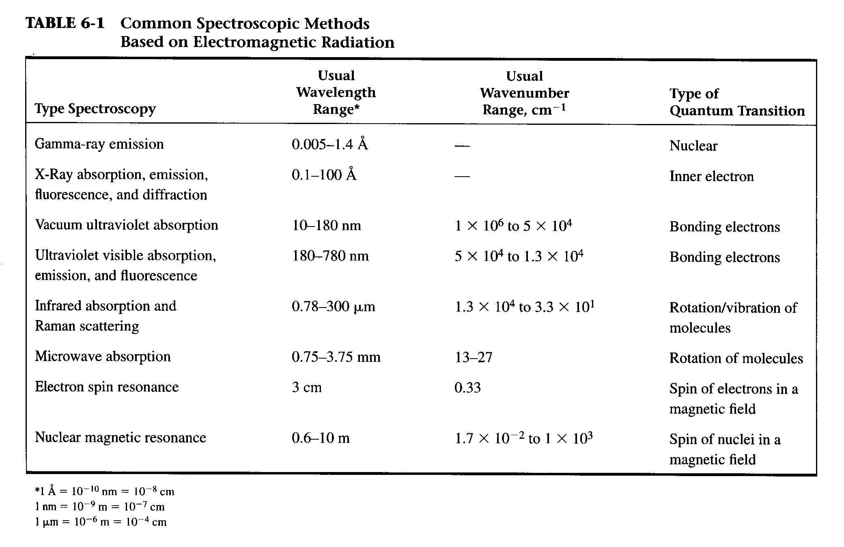

Slide 31
تمرين رقم 4
في الشكل اسفل اي الالكترونين سوف يحصل لة تحفيز
M 6
L 8 e.v
L 4 e.v
K 2 e.v
K 2 e.v
E=6 e.v
-
-
~
+
~
+
+
+
~
~
+
~
+
~
-
-

Slide 32
Absorption Spectra
Absorption Spectra Plot of Absorbance vs. wavelength called absorption spectrum.

Slide 33
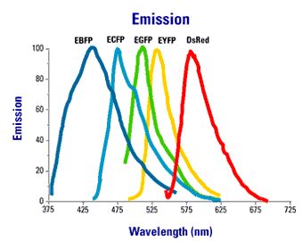
Emission Spectra
Emission Spectra Plot of emission intensity vs. wavelength called emission spectrum.

Slide 34
Question page 33 Example 2
Given that the ionization potential of hydrogen atom is 13.6 volt and the energy level of any………..
Home work 1 ,2, 3 pages 39 and 40

