Slide 1
Medical Laboratory Instrumentation 2010-2011 Third Year
Dr Fadhl Alakwa
www.Fadhl-alakwa.weebly.com
UST-Yemen
Biomedical Department

Slide 2
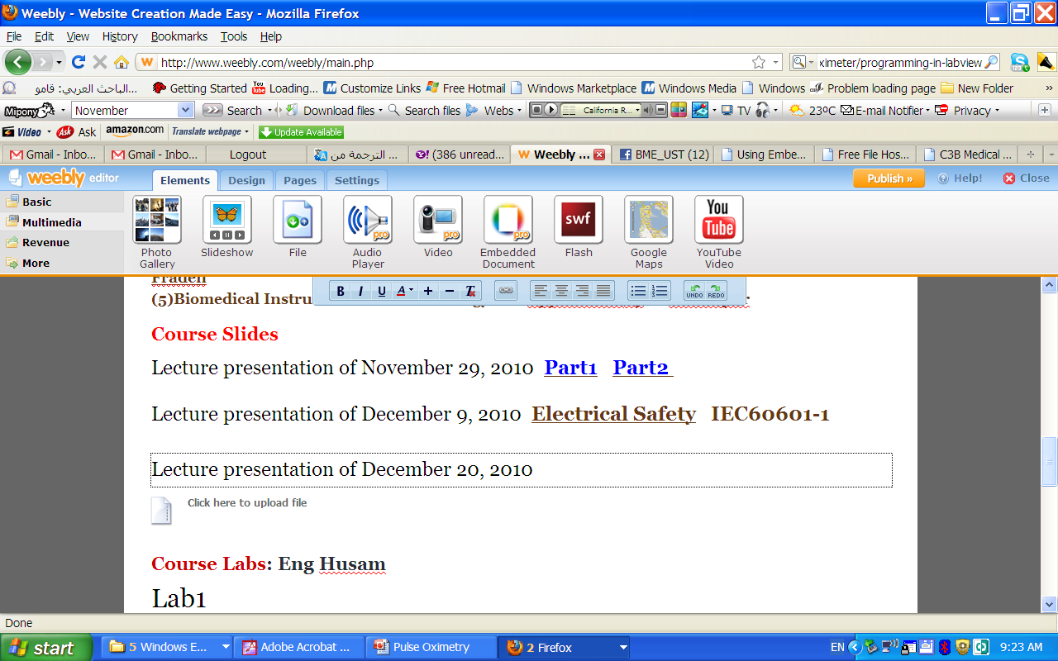

Slide 3
Spectrophotometer
Is optical device that measure light absorption at various wavelengths for a given liquid sample.

Slide 4
Absorption Spectra
Absorption Spectra Plot of Absorbance vs. wavelength called absorption spectrum.

Slide 5
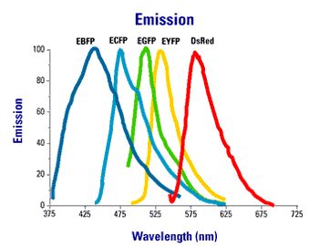
Emission Spectra
Emission Spectra Plot of emission intensity vs. wavelength called emission spectrum.

Slide 6
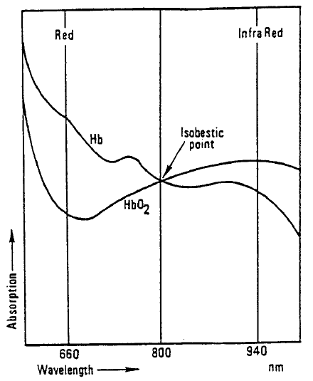
Spectrophotometer Example:
Oxygen Saturation Using Pulse Oximetry

Slide 7
Spectrophotometer Example:
Oxygen Saturation Using Pulse Oximetry
Why Red was absorb more by Hb?
Why Red was absorbed less by Hbo2?
% Saturation = (HbO2/HbO2 + Hb) X 100
Notes:
The infrared light is absorbed by the oxyhemoglobin ,and the red light is absorbed by the reduced hemoglobin.

Slide 8
Photodetector senses only light of alternating intensity

Slide 9
Sao2 & Spo2
Pulse oximetry is a noninvasive monitoring technique used to estimate the measurement of arterial oxygen saturation (Sao2) of hemoglobin.
Oxygen saturation is an indicator of the percentage of hemoglobin saturated with oxygen at the time of the measurement .
Oxygen saturation values obtained from pulse oximetry (Spo2)
Notes:
SaO2 Abbreviation for saturated oxygen, SaO2 is the ratio of the concentration of oxyhemoglobin (cHbO2) to the concentration of the two principle types of blood hemoglobin: saturated hemoglobin (HbO2) plus reduced hemoglobin (Hb).
SpO2 The type of saturated oxygen measured with a pulse oximeter.

Slide 10
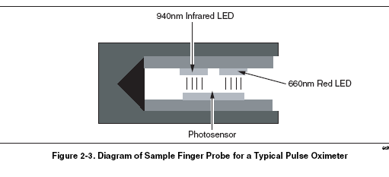

Slide 11
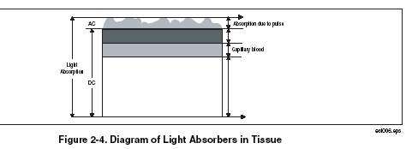
AC and DC

Slide 12
Pulse Oximetry
http://www.robots.ox.ac.uk/~neil/teaching/lectures/med_elec/downloads.html#lecture

Slide 13
Pulse Oximetry: The story so far
Oxygen is carried in the blood by haemoglobin which has two forms: Hb and HbO two forms: Hb and HbO2.
These two forms have different absorptions at different wavelengths in the red to infra−red frequency band.
By measuring the absorption of two different wavelengths and taking appropriate ratios it is possible, in theory, to evaluate the percentage of haemoglobin carrying oxygen.

Slide 14
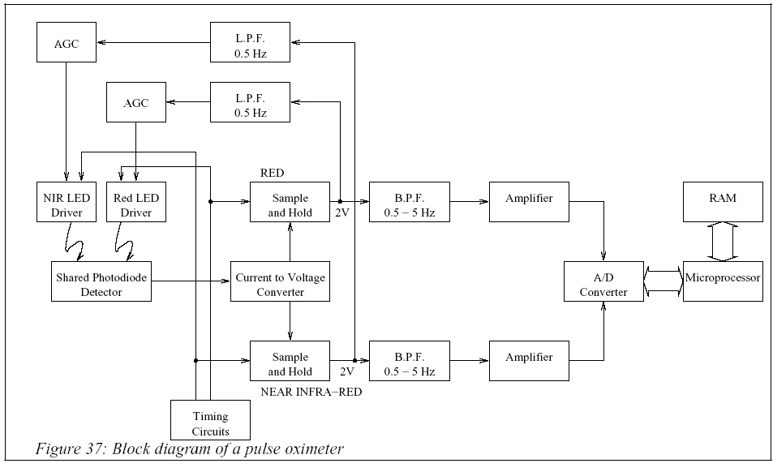
Pulse Oximter Block Diagram

Slide 15
Pulse Oximetry instrumentation
Looking at them one at a time
(a) Shine light through the finger or ear lobe.
(b) Control the pulsing of that light.
(c) Receive the transmitted light.
(d) Retain the received signal.
(e) Control the amplitude of the transmitted light.
(f) Filter, store and interpret the information.

Slide 16
Pulse Oximetry instrumentation
Looking at them one at a time
(a) Shine light through the finger or ear lobe.
(b) Control the pulsing of that light.
(c) Receive the transmitted light.
(d) Retain the received signal.
(e) Control the amplitude of the transmitted light.
(f) Filter, store and interpret the information.

Slide 17
Illuminating
Light Emitting Diodes (LEDs) are therefore, in principle, appropriate.
However, standard LEDs are not sufficiently powerful.
Special purpose LEDs have been designed
Internal lensing to give a high intensity output.
Pulsed LEDs so that peak peak power is increased.

Slide 18
Illuminating
The LEDs need to be driven.
Constant current through the LED (when on) ensures constant light output.
How might this be achieved?

Slide 19
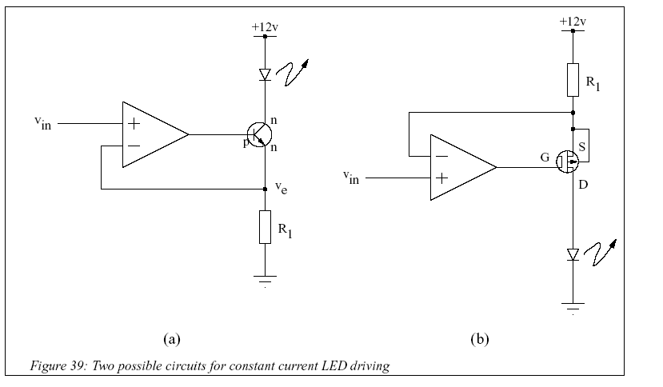
Illuminating

Slide 20
Pulse Oximetry instrumentation
Looking at them one at a time
(a) Shine light through the finger or ear lobe.
(b) Control the pulsing of that light.
(c) Receive the transmitted light.
(d) Retain the received signal.
(e) Control the amplitude of the transmitted light.
(f) Filter, store and interpret the information.

Slide 21
Timing
The LEDs should be pulsed for two reasons:
Increased peak power for same average power.
Careful timing of the ’on’ time for each LED allows a single photo−detector to be used for both LEDs.

Slide 22
Timing

Slide 23
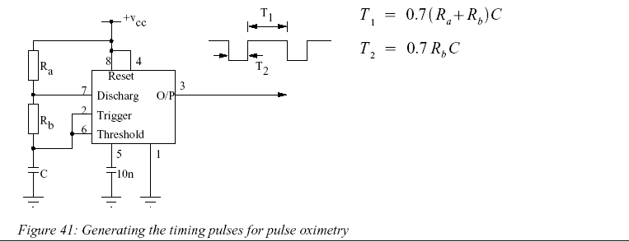
Timing

Slide 24
Pulse Oximetry instrumentation
Looking at them one at a time
(a) Shine light through the finger or ear lobe.
(b) Control the pulsing of that light.
(c) Receive the transmitted light.
(d) Retain the received signal.
(e) Control the amplitude of the transmitted light.
(f) Filter, store and interpret the information.

Slide 25
Detecting
Photodiodes are the simplest solid−state optical detectors.
When light falls on the junction p−n junction region an electron−hole pair is created.
The hole and the electron are swept in opposite directions.
The resulting light current is seen as a large increase in the reverse current.
This current needs to be turned into a voltage.

Slide 26
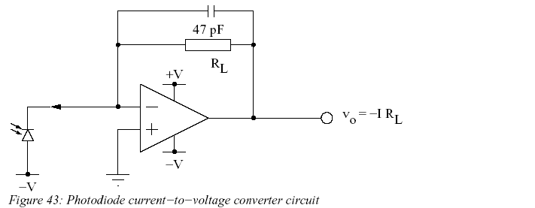
Detecting

Slide 27
Pulse Oximetry instrumentation
Looking at them one at a time
(a) Shine light through the finger or ear lobe.
(b) Control the pulsing of that light.
(c) Receive the transmitted light.
(d) Retain the received signal.
(e) Control the amplitude of the transmitted light.
(f) Filter, store and interpret the information.

Slide 28
Retaining
A single photodetector is being used to provide two pieces of information.
Therefore, it is important to know when it is giving information about absorption of the red and the NIR wavelengths respectively.
Some form of sample−and−hold circuitry is therefore necessary.

Slide 29
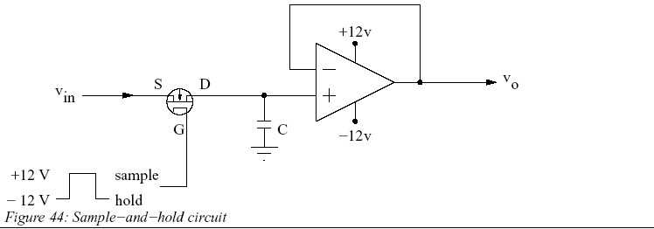
Retaining

Slide 30
Pulse Oximetry instrumentation
Looking at them one at a time
(a) Shine light through the finger or ear lobe.
(b) Control the pulsing of that light.
(c) Receive the transmitted light.
(d) Retain the received signal.
(e) Control the amplitude of the transmitted light.
(f) Filter, store and interpret the information.

Slide 31
Automatic Gain Control
Automatic Gain Control (AGC) is when an attribute of a received signal is used to control the amplitude of the received signal.
Commonly used in A.M. Radios.

Slide 32
Automatic Gain Control
Three reasons why an AGC circuit is used in pulse oximetry
It allows the frequency response of the photodiode to be ’corrected’.
It keeps the a.c. signal (which varies between 0.1% and 2% of the total signal) within a pre−defined range.
It allows the d.c. level of both the NIR and the red signals to be kept at the same level (say 2V).

Slide 33
Pulse Oximetry instrumentation
Looking at them one at a time
(a) Shine light through the finger or ear lobe.
(b) Control the pulsing of that light.
(c) Receive the transmitted light.
(d) Retain the received signal.
(e) Control the amplitude of the transmitted light.
(f) Filter, store and interpret the information.

Slide 34
Programming
Finally, a CPU of some description will be used to process the data.
It will:
Do any necessary noise final reduction (possibly using averaging).
Calculate R.
Infer the SaO2 using a look−up table.

Slide 35
The Ration R and Oxygen Saturation
Attenuation not only by the arterial, venous and capillary blood but also by the skin (pigmentation causes absorption varies from person to person).
Calibration uses look-up tables derived from studies on large numbers of healthy volunteers.

Slide 36
Pulse oximeter Test Index 2 Pulse Oximeter Simulator optical “finger”
Simulators or performance analyzer?
F Version
FE Version

Slide 37
Verified Oximeter Makes
The following makes of oximeters have been verified as working properly, both electronically and with their probes, and are pre-programmed into Index 2XL:
• BCI® (3101)
• Criticare® (504)
• Datascope® (Passport)
• Datex® (CardioCap, Ultima, Satellite Trans, AS/3, 251)
• HP® (Merlin)
• Nellcor® (N-100, 200)
• Nihon-Kohden® (Lifescope)
• Novametrix®
• Ohmeda® (3700) and Nova
• Respironics®
• Philips Medical Systems (PMS M1190)
• Nonin

Slide 40
Index 2 features
Simulate saturated peripheral oxygen (SPO2) simulations with saturation levels between 35% and 100%.
Variable heart rate settings from 30 beats per minute to 250

Slide 41
Challenge the pulse oximeter
The Index 2XL preset feature combines SpO2 levels, heart rates, signal strength, motion, and pulse amplitude into seven preset conditions, which simulate a broad range of normal and abnormal patient conditions.
The intent of this feature is to challenge the pulse oximeter under test with a variety of patient conditions to show operation over a complete range.

Slide 42
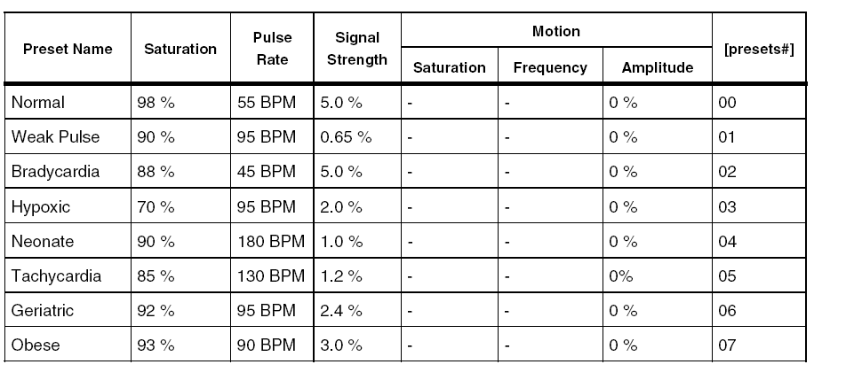
Preset simulations reproduce several patient conditions

Slide 43
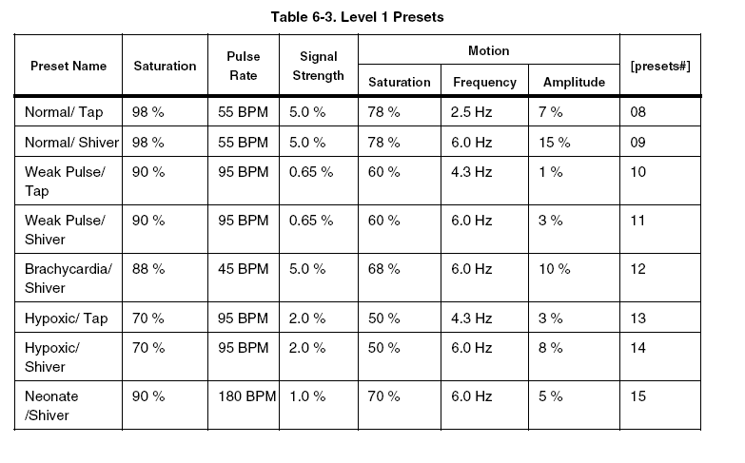

Slide 44
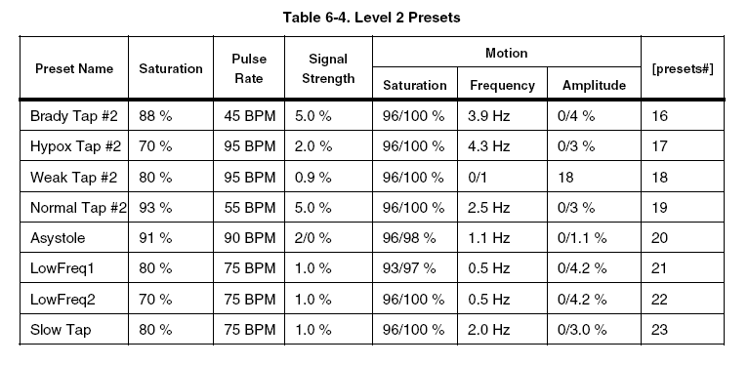

Slide 45
Setting the Light Artifact
You can set a light artifact with Index 2XL to test oximeters under different simulated ambient (surrounding) light conditions.

Slide 46
Transmission Level Control
Up until the advent of Transmission Level Control (TLC), Index 2XL SpO2 simulations were based on a fixed finger-thickness uniquely defined for each pulse oximeter make.
Since the implementation of TLC, pulse oximeters and probe performance can be more thoroughly tested over a range of simulated finger thicknesses.
In simple terms, TLC is a variable attenuation of the RDC and IRDC terms, selectable over the entire range of 0-4095 counts for each make of the pulse oximeter.

Slide 47
Testing the Pulse Oximeter Limits
Alarm tests for response time, recovery time, and pulse amplitude. O2, BPM, Amplitude
If the O2 setting is outside the oximeter's alarm limit, the alarm will sound on the pulse oximeter being tested after a period of time. Press STOP immediately. This stops the timer, and Index 2XL display the “elapsed time to alarm” for the specified simulation level.

Slide 48
Simulating Pulse Amplitude
The peak-to-peak amplitude of the blood pressure wave simulated by Index 2XL can be increased or decreased. Decreasing amplitude corresponds to a weakening pulse. You can decrease amplitude to find where the oximeter fails to find the pulse.

Slide 49
Simulating Asystole or No Pulse
In a clinical setting, a no-pulse condition is life threatening. Most pulse oximeters sound alarms in response to this condition. Index 2XL can measure the response time of these alarms.

Slide 50
Electrical Probe Test
BCI® (3101)
• Criticare® (504)
• Datascope® (Passport)
• Nellcor® (N-100)
• Nihon-Kohden® (Lifescope)
• Novametrix®
• Ohmeda® (3700)
• Respironics®
probe and electronics assembly testing either optically or electrically.
Tests include:
LED and photodiode electrical test
Photodiode detector optical test
pin-to-pin resistance

Slide 51
LED Testing
Index 2XL applies 1.0 mA current AC signal source to the red and infrared LEDs. Index 2XL performs the electrical test separately on each diode to confirm they are functioning properly. The voltage drop across each lement is measured and displayed. Values can range from 0.0 to 2.0:
0.0 Volts = LED shorted
1.4 +/- Volts = LED OK

Slide 52
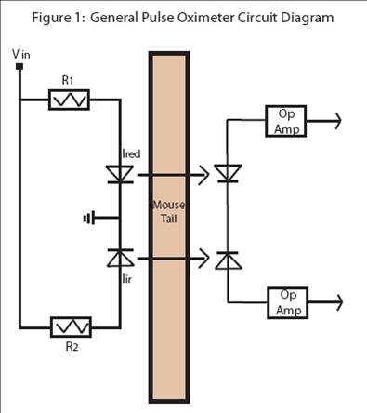
LED Testing
The LEDS test should return a PHTO reading of approximately 0.6 volts if electrically good. Use

Slide 53
Photodiode Test
This test looks at the probe as a functioning entity. Numbers close to zero support a faulty probe diagnosis.
The red LED lights up and Index 2XL measures the resulting photodiode output.
The red LED then goes out and again Index 2XL measures the output. The difference indicates the response to a 1 mA LED illuminating current.
The same test measures the infrared LED.
During the photodiode test, the finger probe being tested should not be
attached to the Index 2XL finger.

Slide 54
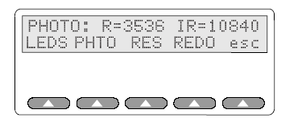
Photodiode Test
Both tests are repeated multiple times to average out ambient light, with the results displayed as a pair of numbers; one for red, and one for infrared, on a fixed scale giving an indication of photodiode response to each color. A higher number yields more response. Numbers can range from 0-20,000 or more. It is a nominal value only.

Slide 55
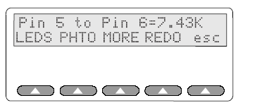
Resistance Testing
A resistance where none should exist indicates a faulty probe.
Results must be interpreted in context of the probe schematic; some probes contain resistors, some do not.

Slide 56
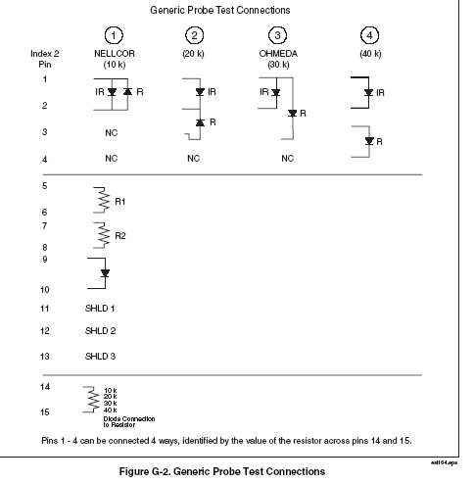

Slide 57
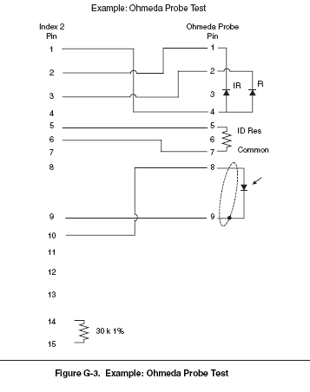

Slide 58
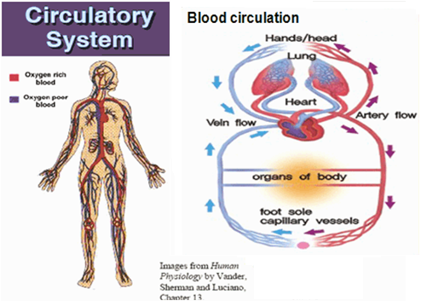
Motivation
Oxygen –basis for human survival
Level of oxygen that a particular organ receives is very importance as it determines proper functioning of the body parts (organs)
For example: DM patients suffer from some form of lower extremity problem(neuropathy, vascular complication) are due to oxygen level changes(reduced blood flow) and decreased perfusion.

Slide 59
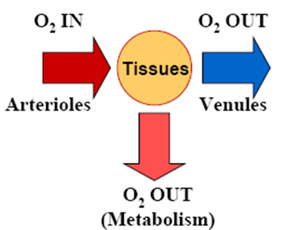
Importance of tissue oxygen level in any organ
Deficiency of oxygen in tissue
Tissue oxygenation and hemoglobin concentration are sensitive indicators of tissue status (Ferrari, et al., 1992 )
A sudden dip in the tissue oxygenation can be a direct indication of many harmful conditions like tissue degeneration, microbial infection etc.
Non-invasive, real time, local measurement of tissue O₂ and HbT is not commercially available
Tissue oxygenation - relative conc. of oxyhemoglobin & myoglobin, depends on the balance between oxygen delivery, as reflected by the product of blood flow and oxygen content and consumption.

Slide 60
Currently available Diagnostics methods
Palpable pulse, Ankle brachial Index(ABI) by Doppler
Blood flow or perfusion by Laser Doppler Imaging(LDI)
Oxygen consumption and partial pressure by Transcutaneous oximetry.
Altered blood flow status and arterial oxygen saturation by Photo Plethysmography(PPG) and pulse oximetry

Slide 61
Limitations
Use of two wavelengths of light to derive fractional concentration of HBO2 is based on assumption that other forms of haemoglobin (metHb) and (COHb) have negligible contributions to total haemoglobin.
In most situations, < 5% of haemoglobin is present as COHb and metHb.
Increase in COHb or metHb leads to falsely high estimates of HbO2.

Slide 62
Accuracy of Pulse Oximetry Recording

Slide 63
Determine the Accuracy of Pulse Oximetry
Compare and monitor the actual heart rate with the pulse rate value from the oximeter to determine accuracy of values . (The two numeric heart rate values should correlate closely. A difference in heart rate values may indicate excessive movement or a loss of pulsatile flow detection .

Slide 64
The accuracy of Spo2
The accuracy of Spo2 measurements requires consideration of many physiologic variables. Patient variables include the following
1- Hemoglobin level,
2- Arterial blood flow to vascular bed,
3- Temperature of digit or the area where the oximetry sensor is located,
4- Patient oxygenation ability,
5- Fraction of inspired oxygen (percentage of inspired oxygen),
6- Evidence of ventilation perfusion mismatch,
7- Amount of ambient light seen by the sensor,
8- Venous return at the sensor location.

