Slide 1
Impact of Bioinformatics in our life and BME engineer responsibility
Dr Fadhl Alakwaa
fadhl-alakwa.weebly.com

Slide 2
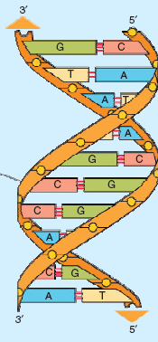
The Central Dogma
3
1
2
3
Library
Book shelves
Book
Target

Slide 3
Protein Synthesis: DNA, RNA, and the Flow of Information
4
Replication
Transcription
Translation
3
Notes:
A copy of DNA contains genes could be transcript by RNA polymerase

Slide 4
Protein synthesis mechanism
4
Gene 1
protein 1
protein 2
Gene 2

Slide 5
Protein synthesis mechanism
4
Gene 1
protein 1
protein 2
Gene 2

Slide 6
Protein synthesis mechanism
4
Gene 1
protein 1
protein 2
Gene 2

Slide 7
Protein synthesis mechanism
4
Gene 1
protein 1
protein 2
Gene 2
We know a little about this gene regulation mechanism

Slide 8
Protein synthesis mechanism
4
Gene 1
Gene 2
Balance Feedback Loop system

Slide 9
Gene Regulatory Network “GRN”
4
Gene x3
Gene x2
Gene x4
Gene x
Gene x5
Gene x8
Gene x7
Gene x6
Notes:
As the number of genes became large as an example there are more than 40,000 genes in the human so if we want to know which genes control gene x, I should to construct what is called the Gene Regulatory Network.
9

Slide 10
Drug discovery
4
Gene x3
Gene x2
Gene x4
DRUG
Gene x
Gene x5
Gene x8
Gene x7
Gene x6
Notes:
What is the benefit from construction of GRN?
1- the most common application of this network is in Drug Discovery and study the side effect of Drug
2- it helps in understanding the ontology of the disease.
10

Slide 11
Gene regulation network
5
If we have 40,000 genes how the mechanism looks like.

Slide 12
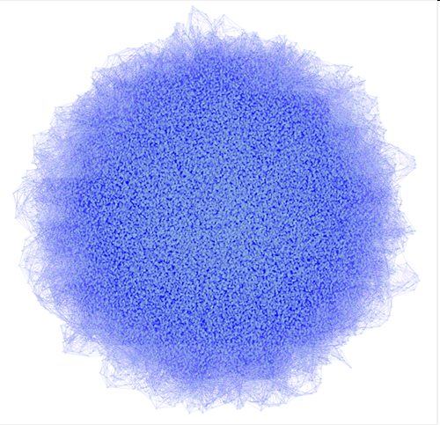
Gene regulation network
5
50k nodes and 250k esges

Slide 13
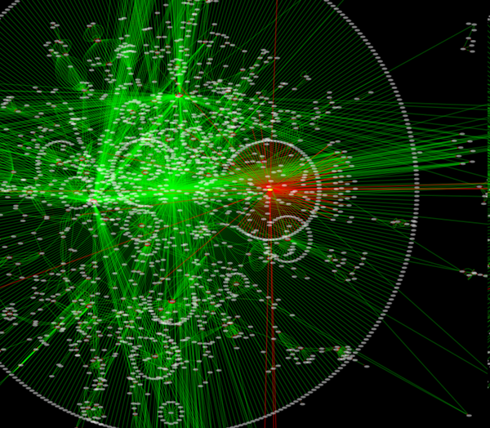
http://cytoscape.org/screenshots/26_ss1.png

Slide 14
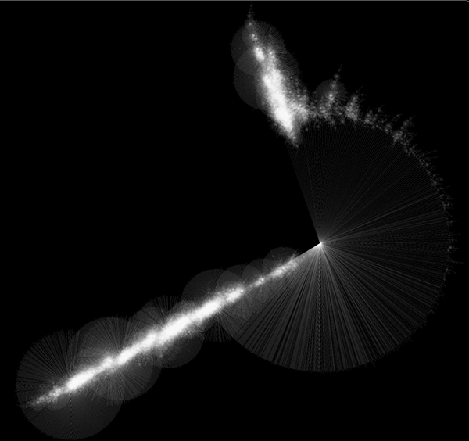
500K nodes and 500k edges; 5GB of memory is used

Slide 15
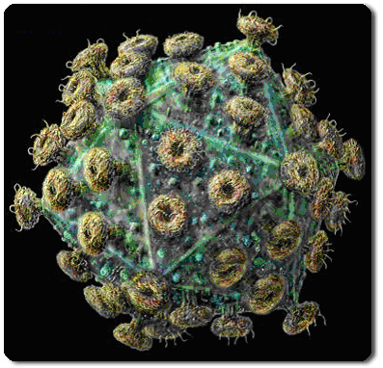
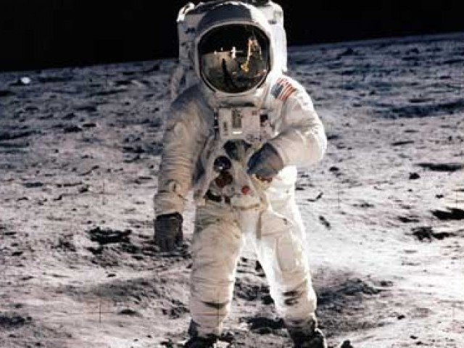
OUTCOMES
3
Why our body is very complicated?
15

Slide 16
Data structures
Software engineering
(C, C++,PERL)
1
Cell structure
Genome, genes
DNA, RNA
Summary
Computer Science
Biology
Bioinformatics
Chemistry
Statistics
Protein structure
Molecular bounds
Markof Model
Neural Network
16

Slide 17
2
Summary: Bioinformatics Subareas
The subareas within bioinformatics include Genomics and Proteomics.
Genome comparison
evolutionary tree
Microarray Analysis
Gene predication
Gene classification
Gene regulation
Protein 3D predication
Protein protein interaction
Protein alignment
17
Notes:
Transcriptome The entire mRNA content of a cell.
Proteome The collection of functioning proteins synthesized by a living cell.
Transcription The synthesis of an RNA copy of a gene.
Translation The synthesis of a polypeptide, the amino acid sequence of which is determined by the nucleotide sequence of an mRNA in accordance with the rules of the genetic code.

Slide 18
3
Summary
فلينظر الانسن مما خلق
الذي أحسن كل شي‏ء خلقه
وفي انفسكم افلا تبصرون
سنريهم آياتنا في الافاق وفي انفسهم حتى يتبين لهم انة الحق
هذا خلق اللة فاروني ماذا خلق الذين من دونة

Slide 20
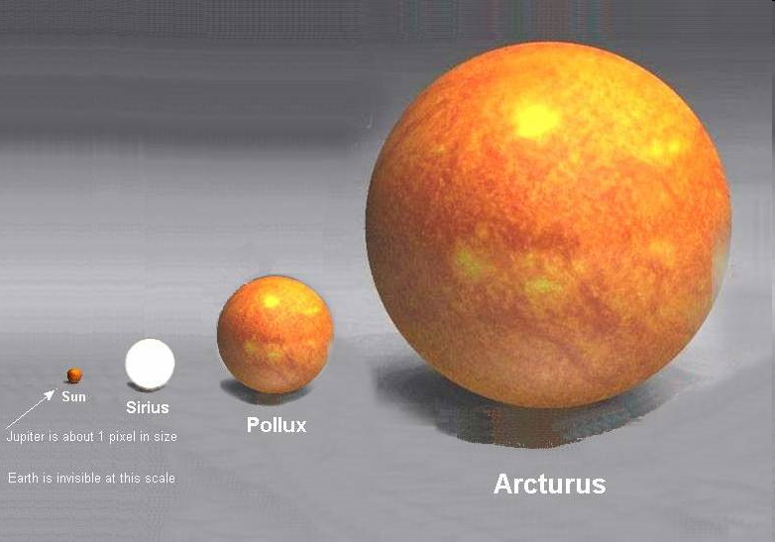
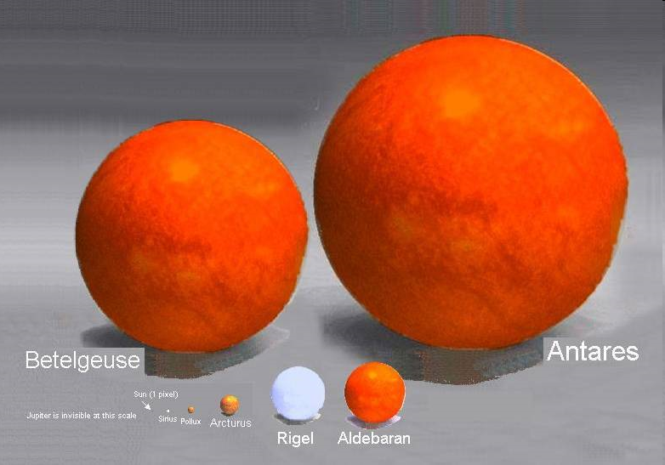
لخلق السموات ولارض اكبر من خلقكم انفسكم

Slide 21
References
http://biology.ucok.edu/bidlack/biology/notes.htm
http://www.ncbi.nlm.nih.gov/books/bv.fcgi?rid=genomes
http://www.estrellamountain.edu/faculty/farabee/biobk/biobooktoc.html
http://www.werathah.com/
http://lectures.molgen.mpg.de/online_lectures.html
21

Slide 22
References
http://www.biology.lsu.edu/webfac/jmoroney/BIOL3090/
22

Slide 23
THANKYOU
FOR YOUR ATTENATION
Fadhl-alakwaa.weebly.com

